Slide 1
AIR AND ATMOSPHERE
CLASS-VII
SUBJECT-CHEMISTRY
CHAPTER-07
OXYGEN,CARBON DIOXIDE,WATER VAPOUR,INERT GASES AND DUST PARTICLES
PERIOD-3

Slide 2
LEARNING OBJECTIVE
Students will be able to.
Familiarize with the other components of air like oxygen , carbon dioxide , water vapour , inert gases and dust particles.
Familiarize them with the Water Cycle.

Slide 3
WARM UP QUESTIONS
Why oxygen and carbon dioxide are the essential component of air?
How water vapour circulate in the atmosphere?
Mention the importance of oxygen and carbon dioxide.

Slide 4
OXYGEN
Oxygen constitutes about 21 % of air by volume. It is the active part of air.
Uses of Oxygen: -
It supports life on the earth.
It is essential for combustion.
Oxygen dissolved in water supports aquatic life.

Slide 5
CARBON DIOXIDE
Carbon dioxide is present in the atmosphere in a very small quantity i.e 0.03 to 0.04 %.
Uses of Carbon dioxide: -
It is essential for the process of Photosynthesis.
It acts as a greenhouse gas and thus balances the temperature of the earth.
Carbon dioxide is used in the fire extinguisher.

Slide 6
WATER VAPOUR
Water vapour in the air is also known as moisture. The amount of moisture present in the air is known as Humidity.
Uses of water vapour: -
It determines the earth’s climatic condition.
It controls the rate of evaporation
It is essential for the growth of plants.

Slide 7
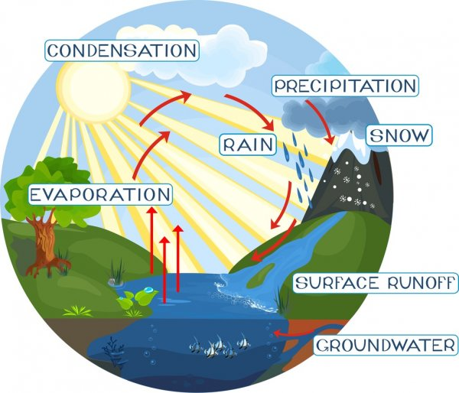
WATER CYCLE
The continuous circulation of water from the earth’s surface to the atmosphere in the form of vapour and back to the earth’s surface in the form of snow, mist, dew and fog etc in a cyclic manner is known as Water Cycle.
The different form of precipitation are Fog, Mist, Dew, Frost, Hail, Sleet and Snow.
The diagrammatic representation of the water cycle is given below : -

Slide 8
INERT GASES AND DUST PARTICLES
INERT GASES
About 0.96% of air , by volume is made up of inert gases. They are six in number. Helium, Neon, Argon, Radon, Krypton and Xenon. Argon is the most abundant inert gas.
DUST PARTICLES
These are solid , minute soil particles present in the air.
Water vapour condenses around the dust particles and form clouds.
An excess of these particles causes serious respiratory problems.

Slide 9
HOME ASSIGNMENT
Exercise- Q1 & Q2
Explain Water Cycle with a diagram.
Define Precipitation. Mention some of its forms.
Write the uses of carbon dioxide.
Name the inert gases

Slide 10
THANKING YOU
ODM EDUCATIONAL GROUP

