Slide 1
FORCE
SUBJECT-PHYSICS
CHAPTER NO- 3
Kinds of friction, disadvantages of friction
PERIOD-5

Slide 2
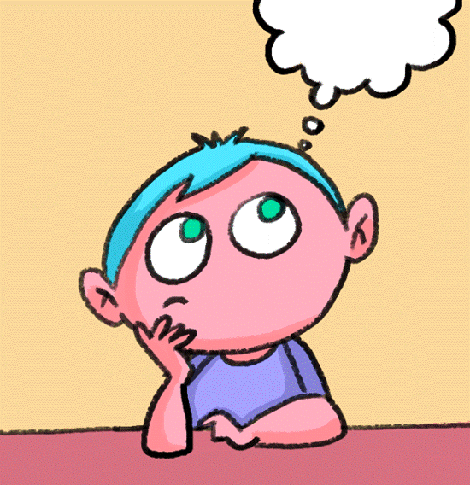
LEARNING OBJECTIVE
Students will be able to
familiarize with the kinds of friction
Describe the different kinds of friction with appropriate examples
Know the disadvantages of friction

Slide 3
WARM UP QUESTIONS
Recapitulation of previous topic by asking the following questions.
Q. Explain with example how friction opposes motion
Q. ‘Friction always acts in a direction opposite to the direction of motion’. Elaborate the statement by giving an example.

Slide 4
Kinds of friction

Slide 5
Explain the kinds of friction by showing a video
https://youtu.be/R10tuvCdl8c

Slide 6
Real life examples
Activity(discussion)
Students after understanding, share some real life experiences.

Slide 7
Demonstrate activity 3
https://youtu.be/tfXHifE2jgU

Slide 8
Disadvantages of friction

Slide 9
HOME ASSIGNMENT
Exercise- B 15,16
Q. List 3 disadvantages of friction
Q. List three types of friction.
Q. You can move heavy boxes by sliding them over the ground. Or you can put them on a dolly, like the one in the Figure below, and then roll them over the ground. Explain which way makes it easier to move the boxes.

Slide 10
THANKING YOU
ODM EDUCATIONAL GROUP

