Slide 1
PHYSICAL AND CHEMICAL CHANGES
SUBJECT-CHEMISTRY
CHAPTER NO- 2
Physical and chemical changes-chemical change- characteristics and examples
PERIOD-5

Slide 2
LEARNING OBJECTIVE
Students will be able to
Understand the meaning of chemical change
Familiarize with the characteristics of chemical change
Sensitize different examples of chemical change

Slide 3
WARM UP QUESTIONS
Recapitulation of the previous topic by asking following questions
Differentiate between physical and chemical change
What do you mean by condensation point, melting point and boiling point ?

Slide 4
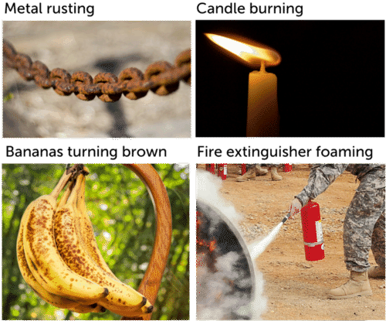
Chemical Changes
The chemical property of a substance is those characteristic of a substance that describes its chemical nature.

Slide 5
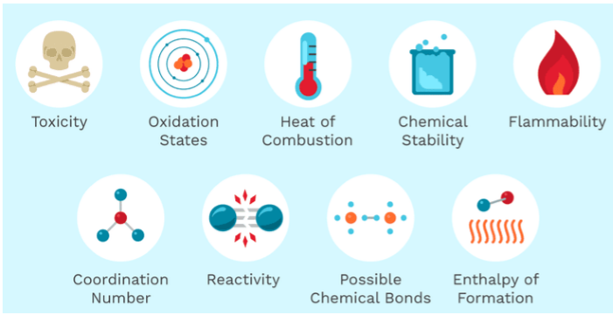
Some chemical properties are given below

Slide 6
Show a video for better understanding of the concept
https://youtu.be/yIJ2qnUOOwQ

Slide 8
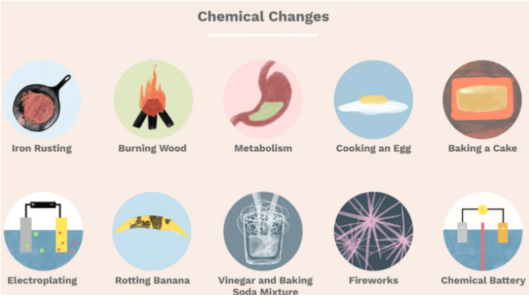
Examples of chemical changes

Slide 9
HOME ASSIGNMENT
Exercise-8,9
Write the characteristics of chemical changes
Give some examples of chemical changes

Slide 10
THANKING YOU
ODM EDUCATIONAL GROUP

