Slide 1
METALS AND NON-METALS
CLASS-VII
SUBJECT-CHEMISTRY
CHAPTER-06
Uses of Non-Metals
PERIOD-5

Slide 2
LEARNING OBJECTIVE
Students will be able to.
Familiarize with the importance and uses of some non- metals.
Sensitize of the different uses of non- metals like oxygen, nitrogen, carbon and sulphur etc.

Slide 3
WARM UP QUESTIONS
Activate prior knowledge by asking students whether they have witnessed the use of non- metals in their day today life.
After listening to their responses, guide them to know of the various uses of some non-metals.

Slide 4
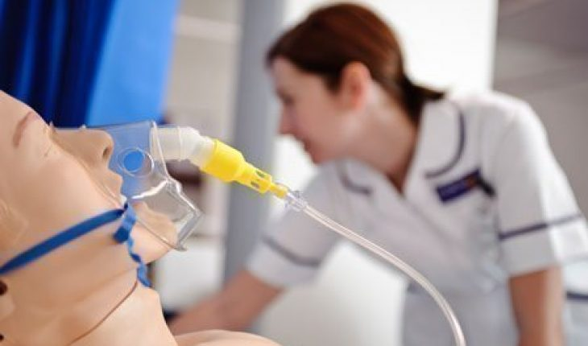
OXYGEN (O₂)
Used during breathing and Respiration by human beings and animals
Used in industries
It is important for combustion
Used in the hospitals

Slide 5
NITROGEN (N₂)
Used in packaging of chips packets
Used in electrical bulbs
Used in preparing fertilizers like urea

Slide 6
CARBON (C)
COAL
Used as a fuel in the industries and home.
Used in the pharmaceutical and textile sectors, as a source of synthetic chemicals.
GRAPHITE
Used as pencil leads.
As electrode
As a solid Lubricants
In nuclear reactors
Used for making heat resistant crucibles.

Slide 7
CARBON (C)
DIAMOND
Used in ornaments
In glass cutting
CHARCOAL
Used as a decolourising agent in the sugar industries.
Used to purify water as it removes the colour and smell if present in the water.

Slide 8
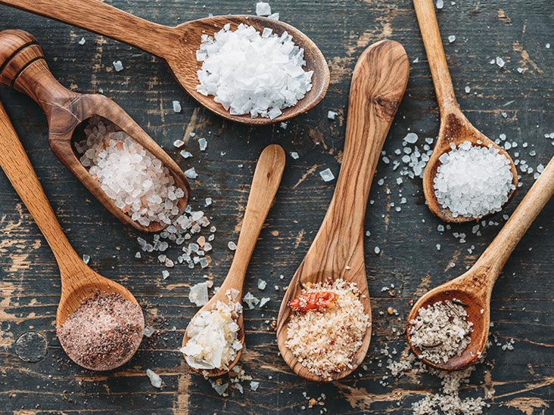
IODINE (I₂)
Used in salts
Used in photographic films in the form of potassium Iodide
Used in making Tincture of iodine and iodex. Tincture of Iodine is a mixture of Iodine and alcohol

Slide 9
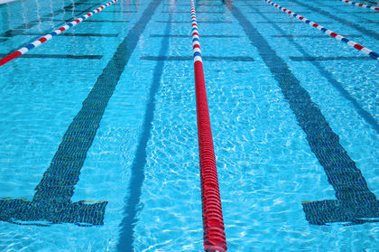
CHLORINE (Cl₂)
Used as bleaching agent
Used as a disinfecting agent for drinking water and swimming pool
Used in the manufacture of DDT (Dichlorodiphenyl trichloro ethane) and BHC (Benzene hexachloride)
Used in making Hydrochloric acid

Slide 10
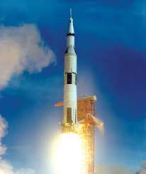
HYDROGEN (H₂)
Used as a reducing agent
Used in making ammonia
Used in converting vegetables oil to “ghee”
Used as an aviation fuel or rocket fuel.

Slide 11
SULPHUR (S)
Used as fungicides and insecticides
Used in making antibiotics
Used in match box industries in making the striking heads (Phosphorous Sulphide)
Used to vulcanize the rubber.

Slide 12
HOME ASSIGNMENT
Exercise Q 3 (a) , (b), (c), (d) & (e)
Mention the uses of the following : -
Nitrogen
Oxygen
Carbon
Sulphur

Slide 13
THANKING YOU
ODM EDUCATIONAL GROUP

