Slide 1
LIFE PROCESSES.
SUBJECT:BIOLOGY
CHAPTER:6
MECHANISM OF RESPIRATION.
PERIOD-5

Slide 2
LEARNING OBJECTIVE
Student will be able to know the structure of lungs
Student will be familiarized with the function of lungs .
Student will be familiarized with the mechanism of breathing in human.
Learners will be sensitized about the constituents of air.

Slide 3
WARM UP QUESTIONS
In which type of respiration, aerobic or anaerobic, more energy is released?
Name the substance whose build up in the muscles during vigorous physical exercise may cause cramps.
Why is the rate of breathing in aquatic organisms much faster than in terrestrial organisms

Slide 4
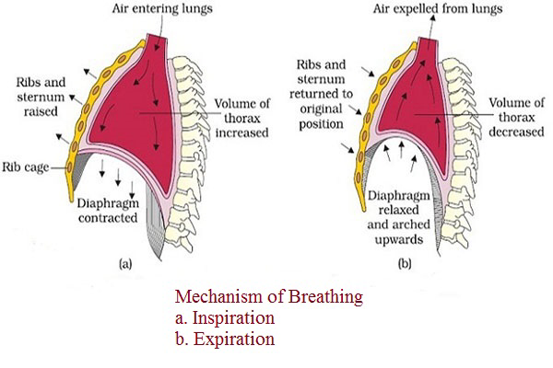
MECHANISM OF RESPIRATION
Breathing Mechanism: The breathing mechanism of lungs is controlled by the diaphragm . Diaphragm is a membrane which separates the thoracic chamber from the abdominal cavity. When diaphragm moves down, the lungs expand and air is inhaled. When diaphragm moves up, the lungs contract and air is exhaled.

Slide 5
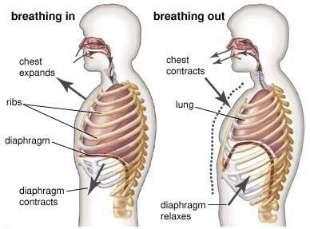
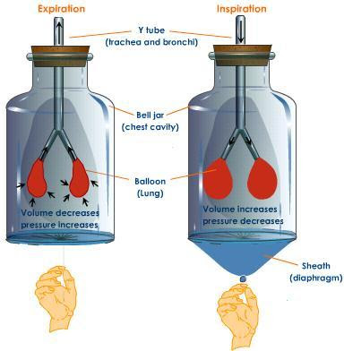
When we breathe in air, the muscles of the diaphragm contracts and moves downward and the chest cavity expands and air enters into the lungs.
When we breathe out air, the muscles of the diaphragm relaxes and moves upward and the chest cavity contracts and air goes out of the lungs.

Slide 6
ACTIVITY

Slide 7
https://www.youtube.com/watch?v=MPovpAXcmIU

Slide 8
GASEOUS MECHANISM

Slide 9
HOME ASSIGNMENT
In box Question - 3,4 ,Pg No- 105 and Exercise Question No- 9

Slide 10
THANKING YOU
ODM EDUCATIONAL GROUP

