Slide 1
LIFE PROCESSES.
SUBJECT:BIOLOGY
CHAPTER:6.
TRANSPORTATION IN PLANTS
PERIOD-9

Slide 2
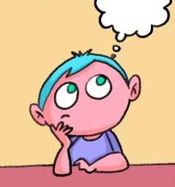
LEARNING OBJECTIVE
Student will be able to understand the meaning of transportation and translocation .
Student will be familiarized with the mechanism of transportation of materials through xylem and phloem.
They will be able to analyze various types of xylem and phloem elements.

Slide 3
WARM UP QUESTIONS
What is “translocation”? Why it is essential for plants.
How does food pass in the phloem?
what forms the continuous water conducting channels in the plants?
4.why does water diffuse into the root hair passively?

Slide 4
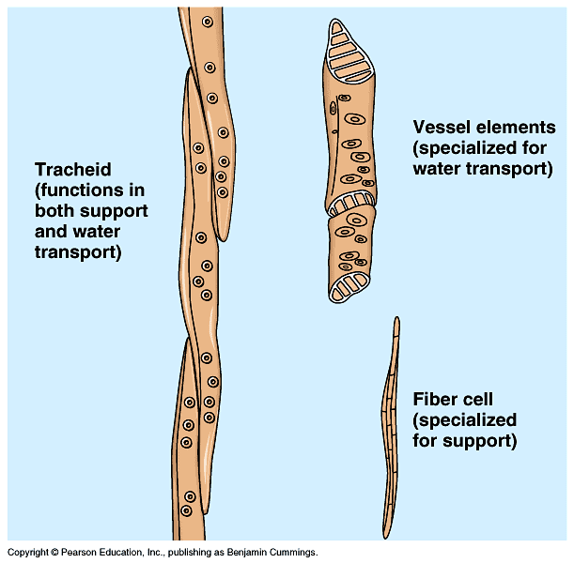
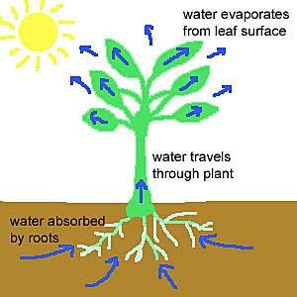
TRANSPORTATION IN PLANTS
In plants, transportation of materials like food, water and minerals takes place through conducting tissues called xylem and phloem.
i) Xylem :- transports water and minerals from the roots to all parts of the plant. It consists of xylem vessels and tracheids. Water and minerals enter the roots by diffusion. Then due to transpiration, the suction force helps in the upward movement of water an minerals.

Slide 5
XYLEM ELEMENTS

Slide 6
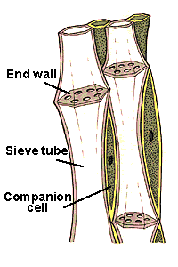
PHLOEM ELEMENTS
Transports food from the leaves to the other parts of the plant. This process is called translocation. The phloem consists of sieve tubes and companion cells. Food from the leaves is transferred to the xylem by the energy of ATP molecules. Due to osmotic pressure water enters the phloem and helps in the transport of food.

Slide 7
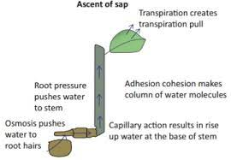
ASCENT OF SAP
Ascent of SapThe upward movement of water and minerals from roots to different plant parts is called ascent of sap. Many factors are at play in ascent of sap and it takes place in many steps. They are explained as follows:

Slide 8
https://www.youtube.com/watch?v=cnk3BJDBqIo

Slide 9
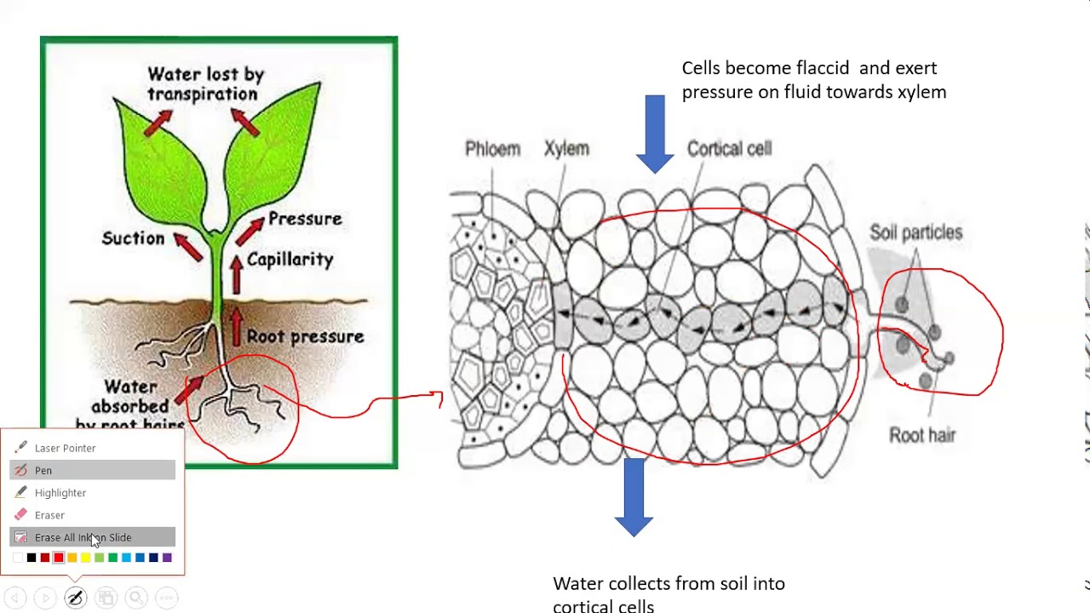
ROOT PRESSURE
Root Pressure: The walls of cells of root hairs are very thin. Water; from soil; enters the root hairs because of osmosis. Root pressure is responsible for movement of water up to the base of the stem.

Slide 10
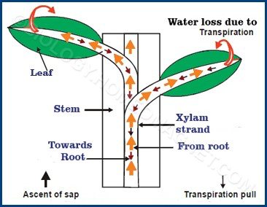
TRANSPIRATION PULL
Loss of water vapour through stomata and lenticels; in plants; is called transpiration. Transpiration through stomata creates vacuum which creates a suction; called transpiration pull. The transpiration pull sucks the water column from the xylem tubes and thus water is able to rise to great heights in even the tallest plants.

Slide 11
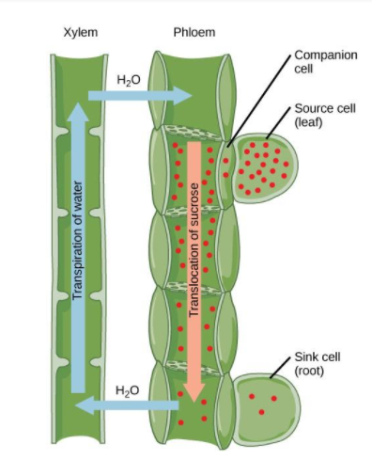
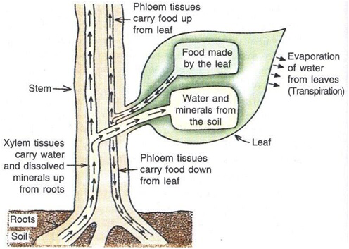
Transport of food
Transport of Food: Transport of food in plants happens because of utilization of energy. Thus, unlike the transport through xylem; it is a form of active transport. Moreover, the flow of substances through phloem takes place in both directions, i.e. it is a two-way traffic in phloem.

Slide 12
HOME ASSIGNMENT
In box Question - 3,4 Pg No- 110 and Exercise Question No-12

Slide 13
THANKING YOU
ODM EDUCATIONAL GROUP.

