Slide 1
MARKET AROUND US
SUBJECT : SOCIAL SCIENCE
CHAPTER NUMBER: 7
CHAPTER NAME : MARKET AROUND US

Slide 2
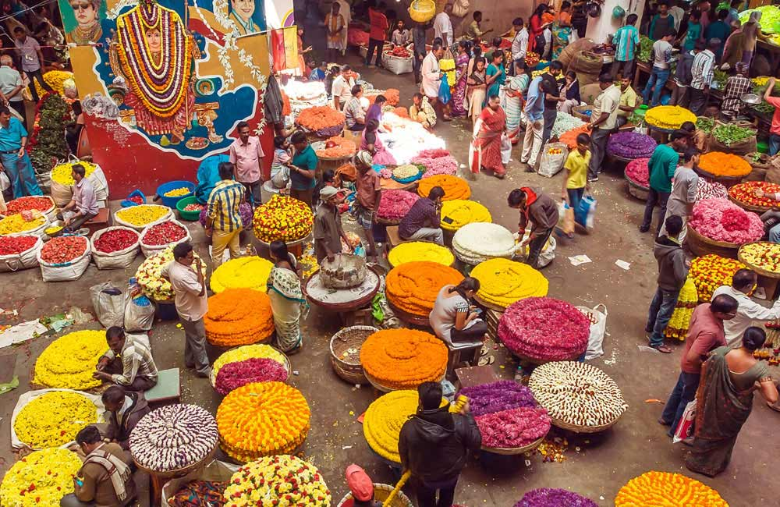
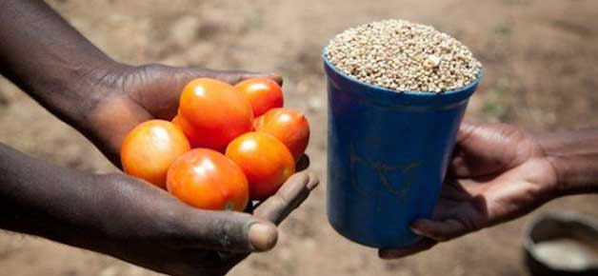
INTRODUCTION
A market is a place where buyers and sellers meet and exchange goods, services and information. Markets serve as a link between the producers and the consumers, thereby ensuring the distribution of goods and services in a society.
There are two kinds of activities that take place in a market—buying and selling.
BARTER SYSTEM: In ancient days, before the invention of money, people met in a marketplace to barter or exchange goods and service
What is money?
Money is an item that is universally acceptable as a medium of exchange and a means of payment. The exchange of goods and services for money is known as a transaction.

Slide 3
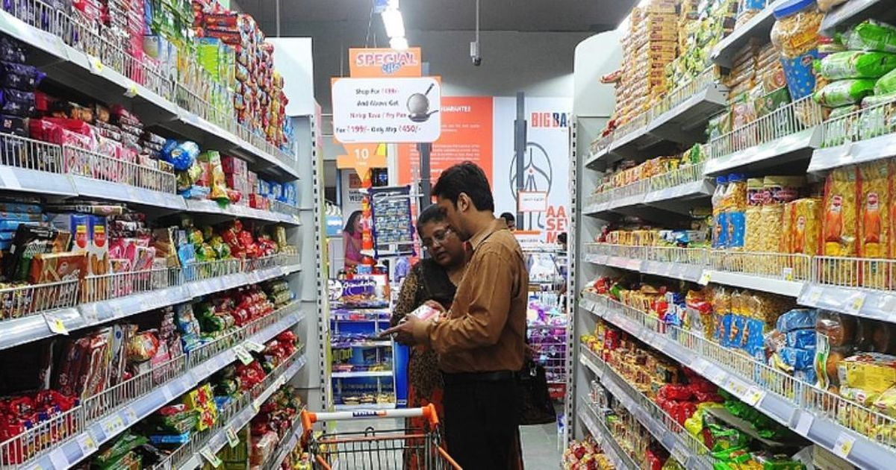
MARKETING
Marketing refers to the process of introducing a product to the market. It includes market research and advertising.
It makes a study of what a customer would prefer byway of quality, price, type of packaging, etc.
The study also gathers information about competing products and their features
Advertising, as you saw earlier this year, is an essential component in the process of marketing. Advertisements create awareness in the market about the product and, thereby, create a demand for it.

Slide 4
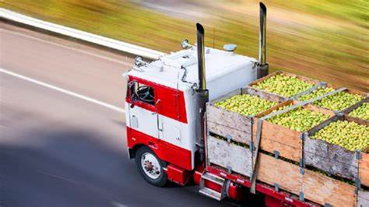
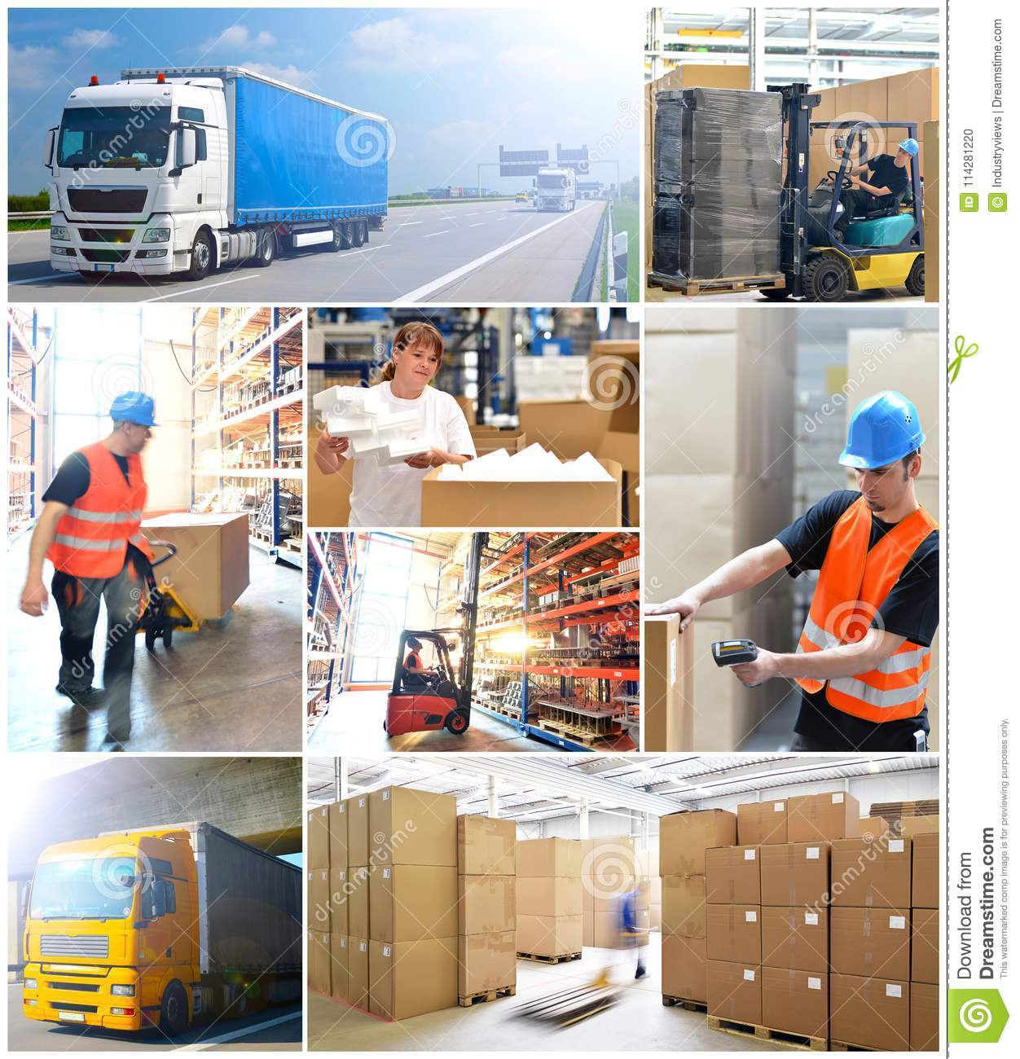
TRANSPORTATION AND STORAGE
Once the products are made as per the feedback from marketing, they have to be moved to the market.If they are to be consumed locally, there would be no problem
Depending upon the nature of the produce, they are moved by road, rail, air or sea. Perishable goods, like vegetables, milk and meat, need to be refrigerated to prevent spoilage.
Proper storage is another vital necessity of modern markets, where goods are produced in bulk and often in anticipation of a demand.

Slide 5
SELLING AND AFTER-SALES SERVICE:
The success of marketing is seen in the amount of sales and the profit made.
Even after the product has been sold, the manufacturer continues to be responsible to the consumer for the performance of the product.
If, within a certain period after the sale, the product develops defects or malfunctions, the producer could be liable to replace the product or repair it. This is called after-sales service.

Slide 6
TYPES OF MARKETS
There are different types of markets. They are weekly markets, neighbourhood shops, and supermarkets and malls, as well as online stores.
Weekly markets are held once a week, on a specified day, in a particular area. They are more often seen in rural areas, small towns and in the outskirts of big cities. Weekly markets do not have permanent shops. The market usually shifts to another location the next day. Farmers are able to sell their produce directly to the consumers through the weekly markets.
Neighbourhood markets consist of all those shops that cater to the immediate needs of the people of that locality or neighbourhood, such as grocery shops that sell milk, egg, bread etc.Though such shops may not offer too much choice, they are very convenient for the people of the neighborhood.
Increasingly, these days, the smaller markets and shops in towns and cities are being replaced by supermarkets and malls. One of the main advantages of supermarkets is the availability of most things under one roof. So consumers can buy their monthly provisions and the weekly vegetables and fruits from one place.

Slide 7
WHOLESALERS AND RETAILERS
Wholesalers
Wholesalers are people who buy things in bulk directly from the manufacturer and sell to retailers or to industrial, commercial or institutional users. 'Wholesalers rarely sell goods directly to the ordinary consumer.
Wholesalers also offer other services. They often reassemble, repack, sort, clean and grade goods. They repack bulk goods into smaller lots.
They also offer storage facilities and give credit to the retailers if required.
A wholesale market is a place where producers bring their goods to be sold.
Vegetable wholesale markets are very popular in big cities
Koyambedu Market in Chennai and Azadpur Mandi in Delhi are wholesale markets for vegetables.

Slide 8
WHOLESALERS AND RETAILERS
Retailers
Retailers sell goods in small lots from fixed locations such as shops, directly to the consumer. These are the shops from which most people buy things for direct consumption. Retailers either buy the goods in bulk directly from the manufacturer, or from the wholesaler.
Retailers represent the end of the supply-chain. To increase their profits, retailers add their costs to the price of the goods they sell. This pricing is called cost-plus pricing.
Retailers often charge different amounts from different types of consumers. Some retailers allow bargaining.
Some retailers give discount sales to attract customers or to get rid of unwanted stocks. In sales, the prices are usually marked down from the normal price.

Slide 9
WHOLESALERS AND RETAILERS
ROLE OF A RETAILER:
Link between producer and consumer
The main role of the retailer is to act as a link between the producer and the consumer.
By stocking various goods under one roof, the retailer becomes a one-stop shop for the customer. The retailer also acts as a publicity agent for the producers.
Attracting customers
The retailer is the person in direct contact with the consumer. Hence, he/she plays an important role in attracting customers towards a particular brand.
Retailers also attract customers by displaying products attractively. Just walk around the corridors of a supermarket or a mall.
Many companies pay retailers to put up special display counters of their products.

Slide 10
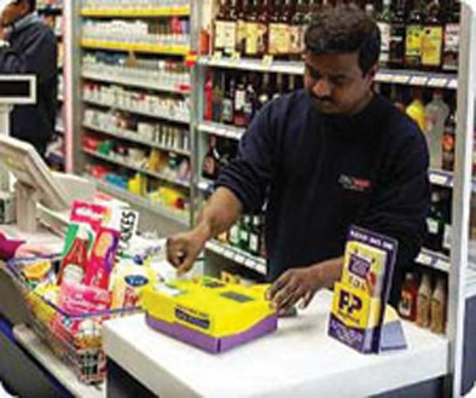
TYPES OF RETAILERS
Hawkers, vendors, mobile carts, ice-cream vendors, salesmen in running trains, vegetable vendors moving on the streets are all mobile retailers.
A medical shop, an auto spare-parts shop, stationery shop, etc. are called single-line shops.
A department store, as the name suggests, has many sections or departments in it.
A chain store usually sells goods of one kind and normally managed by the manufacturers themselves or franchised
.

Slide 11
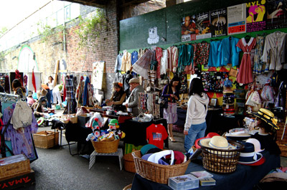
FACTORS DETERMINING PEOPLE'S CHOICE OF MARKETS
People's choice of markets depends on certain factors like
availability,
convenience,
quality,
prices and
the kind of credit being given

Slide 12
AWARE CONSUMERS
Customers these days are very aware of market trends
A manufacturer has to keep all this in mind while producing and marketing his or her goods in this competitive world.

Slide 13
THANKING YOU
ODM EDUCATIONAL GROUP

