Slide 1
MERGER
SUBJECT : (ENTREPRENEURSHIP) CHAPTER NUMBER: 4
CHAPTER NAME : ENTERPRISE GROWTH
STRATEGIES

Slide 2
MERGERS
A merger is a combination of two companies into one larger company. In merger, the acquiring company takes over the assets and liabilities of the merged company. All the combining companies and are dissolved and only the new entity continues to operate.
Merger commonly takes place in two forms:
Amalgamation
Absorption
So, X+ Y= X, Y merged into company X (absorption) X + Y= Z, Z is new company (amalgamation)

Slide 3
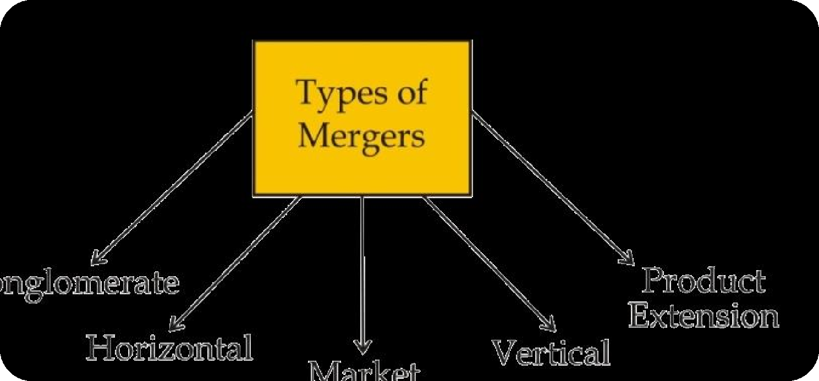
TYPES OF MERGER

Slide 4
CONGLOMERATE MERGERS:
In this type of merger, the firms which are involved in totally unrelated businesses come together. This merger can be of two types:
Pure conglomerate merger: This merger involves firms with nothing in common.
Mixed conglomerate merger: This involves firms that are looking for product extensions or market extensions.
HORIZONTAL MERGERS:
This merger occurs between companies in the same industry. It is generally between competitors, offering the same goods or services. For example: a merger between Tata Motors and Hyundai would be horizontal in nature.

Slide 5
MARKET EXTENSION MERGERS:
This type of merger takes place between companies that deal in the same products but in separate markets.
PRODUCT EXTENSION MERGERS:
A product extension merger takes place between two business organizations that deal in products that are
related to each other and operate in the same market.
VERTICAL MERGERS:
A merger between two companies producing different goods or services for one specific finished product. A
vertical merger occurs when two or more firms, operating at different levels within an industry's supply chain, merge operations.

Slide 6
THANKING YOU
ODM EDUCATIONAL GROUP

