Slide 1
SOUND STD-VII
SUBJECT-PHYSICS
CHAPTER NO- 06

Slide 2
LEARNING OBJECTIVE
Students will be able to
Define Characteristics of a sound wave
Differentiate Music And Noise

Slide 3
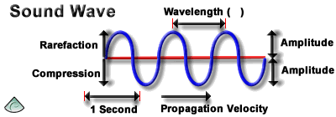
Characteristics of a sound wave
Sound waves have following characteristics: (1) Amplitude (2) wavelength (3) Frequency (4) Time period
(5)Velocity

Slide 4
Amplitude
The maximum displacement of each particle from its mean position is called amplitude.
It is denoted by A.
Its SI unit is metre (m).
Wavelength
The distance between two nearest (adjacent) crests or troughs of a wave is called its wavelength.
It is denoted by the Greek letter lamda (λ).
Its SI unit is metre.

Slide 5
Frequency
The number of vibrations per second is called frequency.
The SI unit of frequency is hertz (Hz).
The symbol of frequency is ν (nu).
Time period
The time taken to complete one vibration is called time period.
It is denoted by T.
Its SI unit is second (s).
The frequency of a wave is the reciprocal of the time period.
i.e., v = 1/T

Slide 6
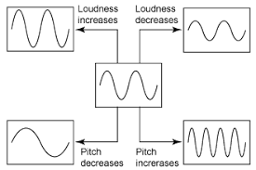
Pitch and loudness of Sound
Pitch: It represents shrillness or flatness of sound.
It depends on the frequency of vibration. Higher the frequency of sound wave, the higher will be the pitch of sound and vice-versa.
Loudness: It is a measure of the sound energy reaching the ear per second.
It depends on the amplitude of the sound wave.
It is measured in decibel ‘dB’.

Slide 7
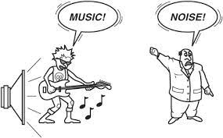
Music And Noise Music: It is the sound that is pleasant to hear. For example: Sound coming out of musical instruments) Noise: It is the sound that is unpleasant to hear. For example: Sound produced by vehicles.

Slide 8
HOME ASSIGNMENT
1. Which wave property determines (a) loudness, (b) pitch?
2. Guess which sound has a higher pitch: guitar or car horn?

Slide 9
THANKING YOU
ODM EDUCATIONAL GROUP

