Slide 1
SESSION : 7
CLASS : III
SUBJECT : ENGLISH
CHAPTER NUMBER: 6
CHAPTER NAME : THE ANT EXPLORER
SUBTOPIC : WRITING JUNCTION

Slide 3
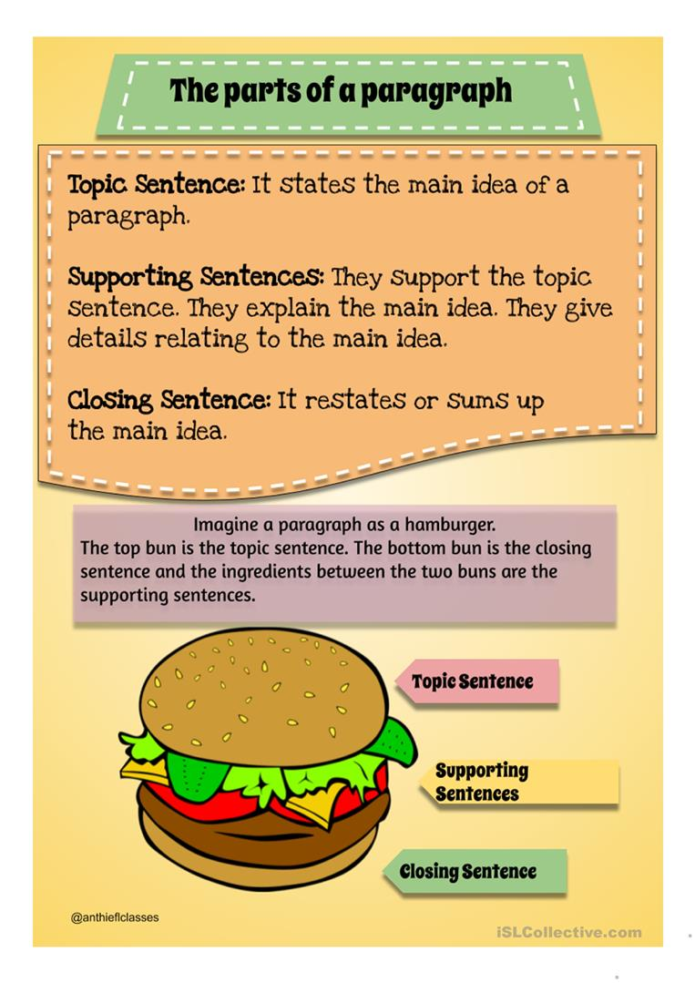

Slide 4
WRITING JUNCTION
PARAGRAPH WRITING
My Favourite Festival
India is a land of fairs and festivals. We celebrate many festivals every year.My favourite festival is Diwali. It often comes in the month of October and November. On this day lord Rama returned to Ayodhya after the exile of 14 years.Diwali is the festival of lights. I decorate my house with lights,lamps and diyas at night. We worship goddess Lakshmi and lord Ganesh. We enjoy many types of sweets and snacks with our friends and relatives.
Diwali teaches us to live in peace,pleasure and harmony with others. I love diwali very much.

Slide 5
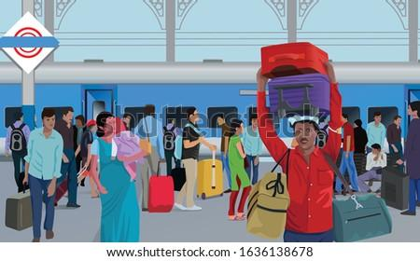
PICTURE DESCRIPTION
See the given picture and describe it in your own words.

Slide 6
LEARNING OUTCOME:
Students use the group of sentences and write a paragraph on a given topic.

Slide 7
HOMEWORK:
Write a paragraph “on your favourite person” in your English notebook .

Slide 8
THANKING YOU
ODM EDUCATIONAL GROUP

