Slide 1
SESSION : 4
CLASS : 3
SUBJECT- SCIENCE
CHAPTER NUMBER: 11
CHAPTER NAME : OUR EARTH AND ITS NEIGHBOURS
SUBTOPIC : STARS AND INDIAN ASTRONOMERS

Slide 2
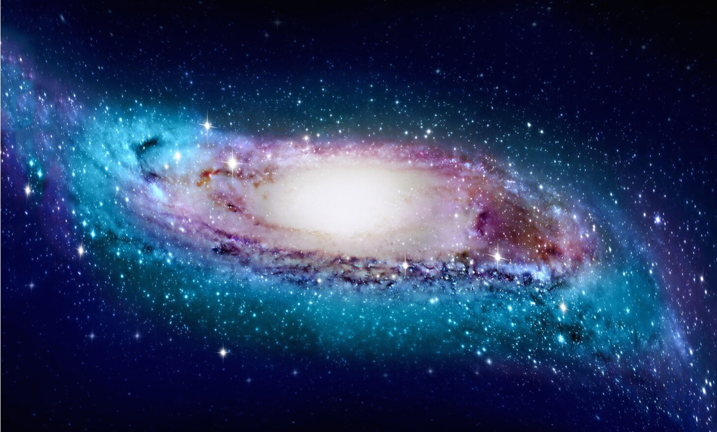
THE UNIVERSE
The sky is a part of an endless space called the universe.
The universe consists of gases, dust, heavenly objects like star and planets .
No one knows exactly how large the universe is.
The study of universe is known as cosmology.

Slide 3
STARS
Most of the bright twinkling objects you see in the sky at night are stars.
Stars are huge balls of hot, burning gas.
They give out heat and light.

Slide 4
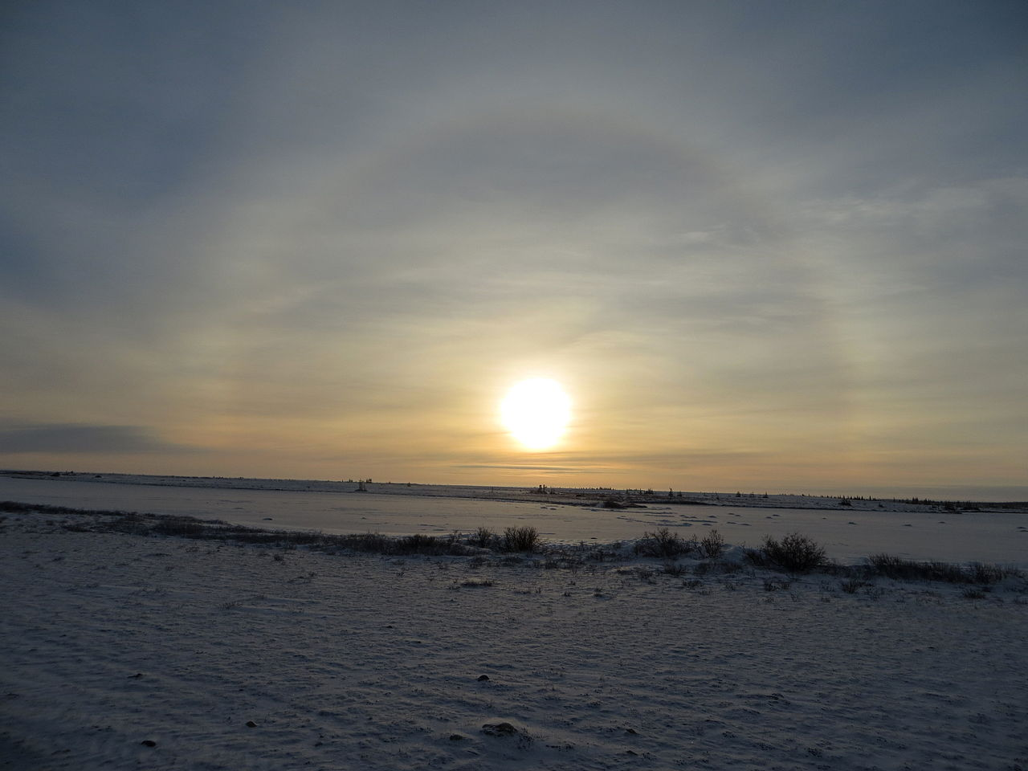
They look small because they are very far away from us.
Sun is the nearest star to earth.

Slide 5
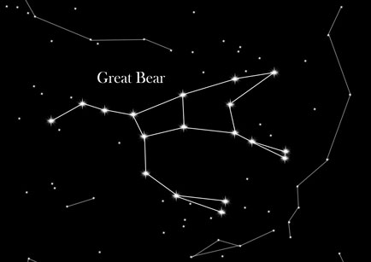
CONSTELLATIONS
Some of the stars appear to form beautiful pattern in the sky, such a group of stars is called a constellation.
Some of the constellation are easy to spot are Orion, the great bear and leo.
Constellation are usually named after people, animal, or famous characters in stories.

Slide 6
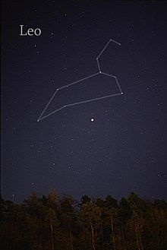
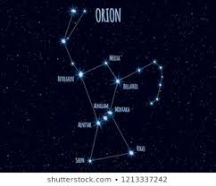
Some example of constellation

Slide 7
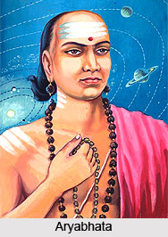
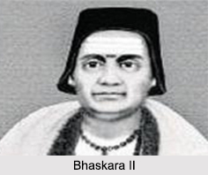
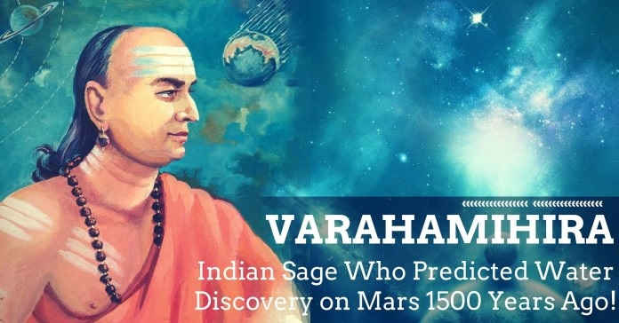
INDIAN ASTRONOMERS
Astronomers are people who study the sun, the moon, the stars and the planets.
Name of the astronomers are--
Aryabhata
Varahamihira
Bhaskara etc.

Slide 8
Answer the following:-
Q1. Why do stars look small?
Ans. Stars look small because they are very far away from us.
Q2. write 3 examples of constellation.
Ans. Orion, the great bear and Leo.
3. Write three Indian astronomers name.
Ans- Name of the astronomers are Aryabhata, Varahamihira and Bhaskara.

Slide 9
LEARNING OUTCOME:
The Learner will be able to know about:
stars and constellation
and Indian astronomers.

Slide 10
HOME ASSIGNMENT
Draw the different phases of moon in project record.

Slide 11
THANKING YOU
ODM EDUCATIONAL GROUP

