Slide 1
SESSION : 1
CLASS : III
SUBJECT : SCIENCE
CHAPTER NUMBER : 6
CHAPTER NAME : PARTS OF A PLANT
SUBTOPIC : INTRODUCTION, SHOOT AND ROOT,
THE ROOT

Slide 2
LEARNING OBJECTIVE :
To enable the learner to know about:
Introduction of the chapter Parts of a Plant.
About Shoot and Root
About the Root.

Slide 3
GET SET !
UNSCRAMBLE THE LETTERS TO MAKE A MEANINGFUL WORD. AFTER CLICK ON THE WORD.
SCRAMBLE | UNSCRAMBLE
TORO
EMST
TUIFR
WEROFL
FEAL
ROOT
STEM
FRUIT
FLOWER
LEAF

Slide 4
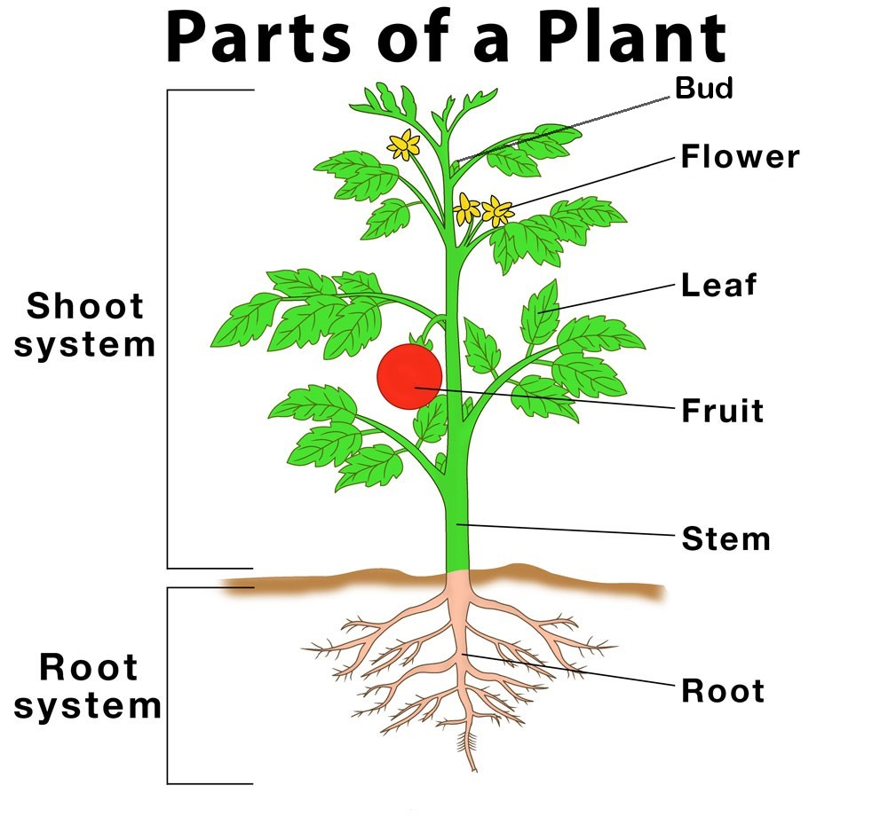
INTRODUCTION
Like our body parts the plant body too has different parts. They are root, stem, fruit, leaf, flower and bud.

Slide 5
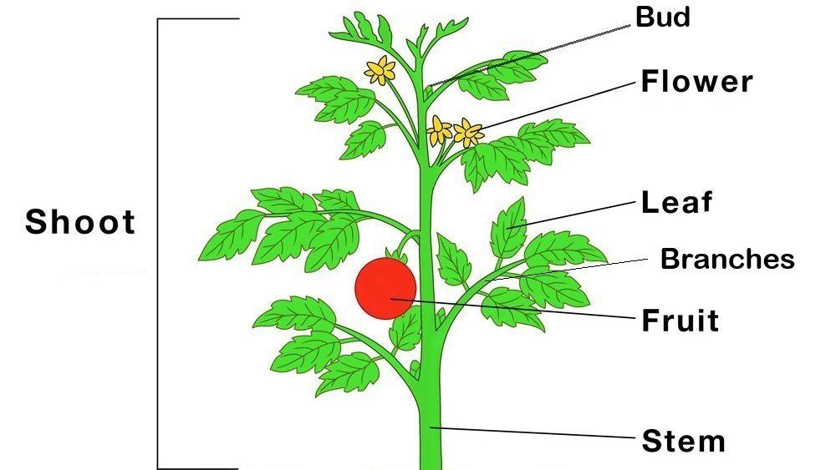
SHOOT AND ROOT
The part of a plant which grows above the ground is called the shoot. It has stem, branches,
leaves, buds, flower and fruits
The part which grows below the ground is called the root.

Slide 6
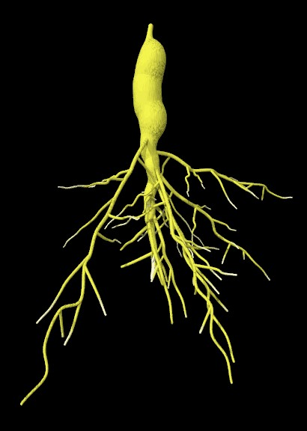
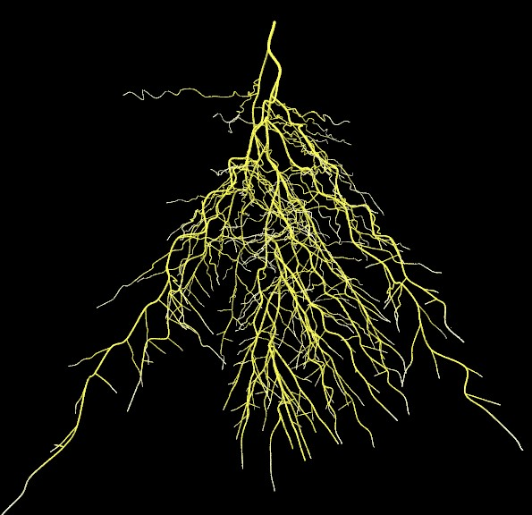
THE ROOT
There are two types of roots, tap root and fibrous root.
Tap root: When a main root grows from the end of the stem and many small roots grow from the main root is called as tap root. Plants like balsam, bean and mustard have tap root.
Fibrous root: When a number of roots grow from the end of the stem, it is fibrous root. Plants like grass , wheat , rice and onion have fibrous root.
Tap root
Fibrous root

Slide 7
LEARNING OUTCOME :
The learner will be able to know about:
Regarding different parts of the plant.
what is shoot and root ?
what are the different kinds of roots?

Slide 8
HOME ASSIGNMENT:
Draw a plant and label different parts of it in the notebook.

Slide 9
THANKING YOU
ODM EDUCATIONAL GROUP

