Slide 1
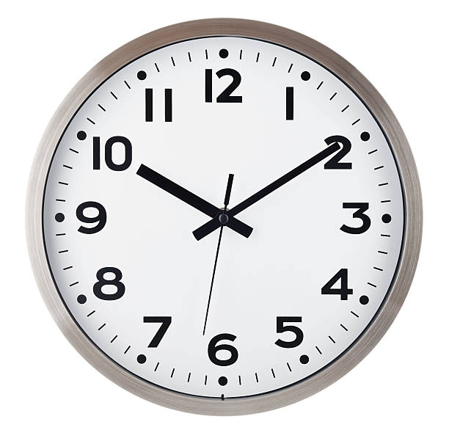
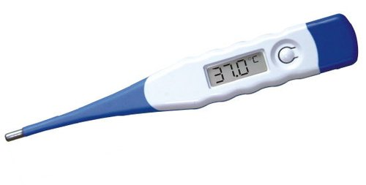
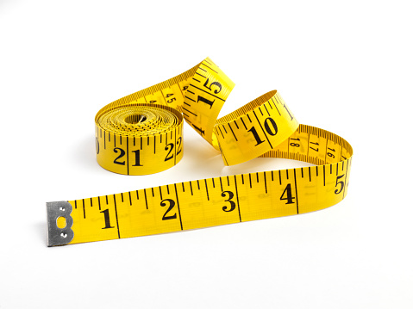
Each picture wants to speak . Please guide them by selecting correct statement from Help box.
1 4
3 3
2 2 5 5
HELP BOX
Tailor uncle’s friend, I always run to guide your time table, I am the friend of vegetable vendor,
You use me in your drawing class, Mom search for me when you get fever
I am the friend of vegetable vendor
You all want me in your drawing class
I always run to guide your time table.
Mom search for me when you get fever
Tailor uncle’s friend

Slide 2
SESSION : 1
CLASS : III
SUBJECT : SCIENCE
CHAPTER NUMBER : 9
CHAPTER NAME : MEASUREMENT
SUB-TOPIC : INTRODUCTION ON MEASUREMENT, MEASUREMENT OF LENGTH

Slide 3
LEARNING OBJECTIVE :
To enable the learners to know about–
why do we measure things?
standard and non-standard units of measurement.

Slide 4
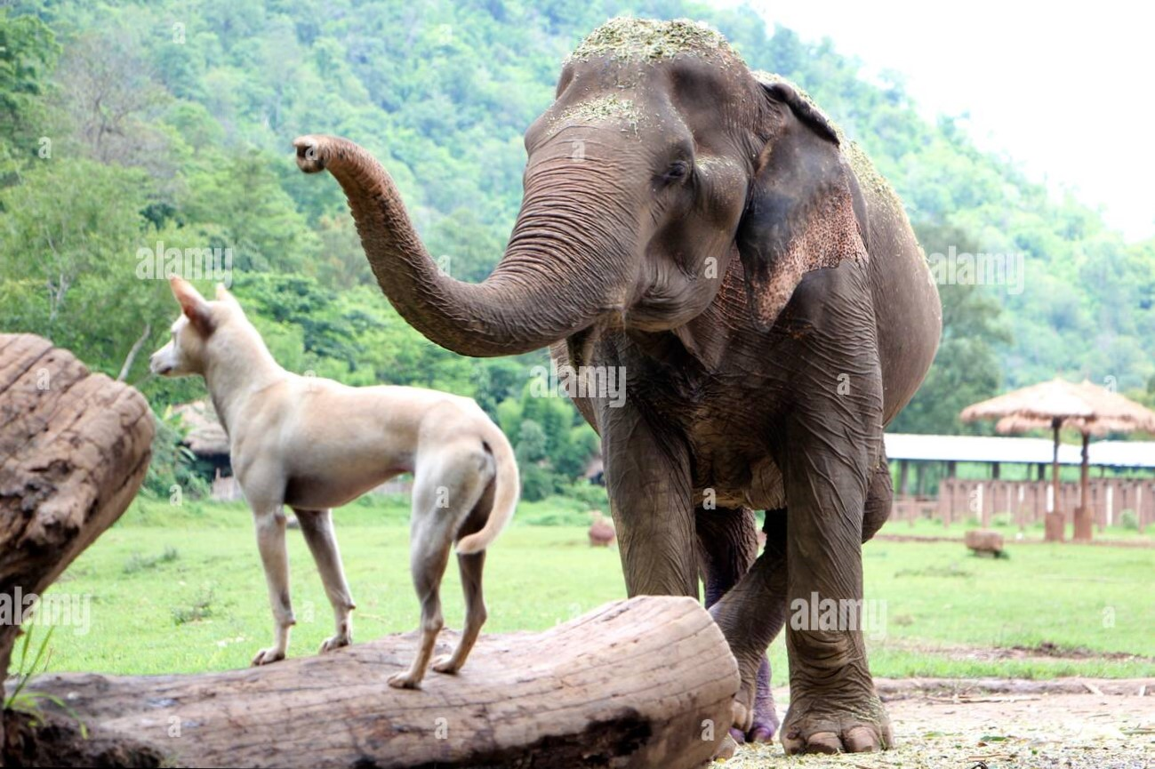
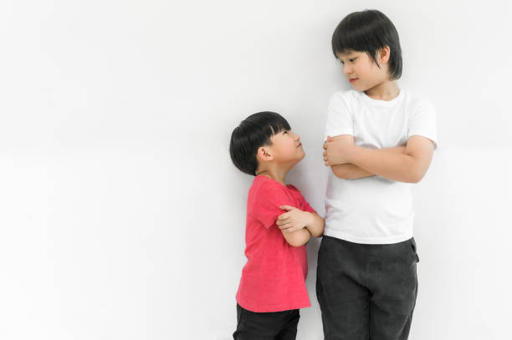
Observe the picture and answer the following.
A. Who is heavier ? B. Who is taller ? C. Which is cold ?
D. Which contains more milk?
How you could able to answer all these ?
Shyam
Ram
Shyam
Elephant
Coffee in glass
Bottle
Ans: Measurement

Slide 5
MEASUREMENT OF LENGTH.
In the past people used to measure lengths with their hands and feet.
They were using three types of measuring units.
The handspan.
The cubit
The footspan
Measurement using handspan, footspan or cubit is not accurate.
These are called non-standard units of
measuring length.

Slide 6
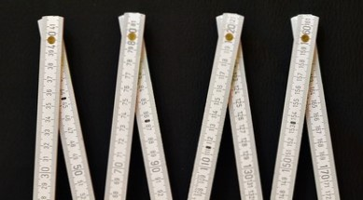
MEASUREMENT OF LENGTH:
We need standard unit of measuring length so that lengths are measured uniformly and correctly all over the world. Standard units are of equal size and do not change.
They are metre and centimetres
Short lengths are measured in centimetres.
Longer lengths are measured in metres.
Rulers,metre rods and measuring tapes are commonly used for measuring length
Ruler
Measuring Tape
Meter Rod

Slide 7
MEASUREMENT
NOTES
Measurement is finding out the size or amount of something.
Measurement using handspan, footspan or cubit is not accurate.
Handspan, footspan and cubit are called non-standard units for measuring length.
Length is measured in centimetres and metres.

Slide 8
Let’s Answer:
Answer the following questions.
1. Why do we measure things?
Ans :- We measure things to find out their size or amount.
2. How did people measure length, many years ago?
Ans:- People used to measure length many years ago by using their hands and feet.
3. Why do we need standard units to measure things?
Ans:- We need standard units for measuring things because they are fixed units and do not change when measured by different people or at different places.

Slide 9
LEARNING OUTCOME:
The learners will able to know about -
why do we measure things?
standard and non-standard units of measurement.

Slide 10
HOME ASSIGNMENTS
List out the things used for measuring length in notebook.

Slide 11
THANKING YOU
ODM EDUCATIONAL GROUP

