Slide 1
SESSION : 4
CLASS : III
SUBJECT : SCIENCE
CHAPTER NUMBER : 12
CHAPTER NAME : GOING INTO SPACE
SUB-TOPIC : SHORT Q/A

Slide 2
LEARNING OBJECTIVE :
Learners will be able to know–
about short question answers of the chapter.

Slide 3
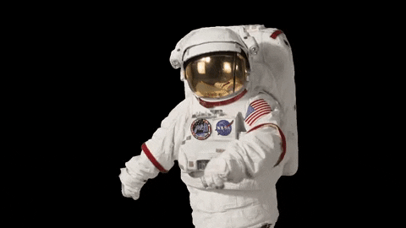
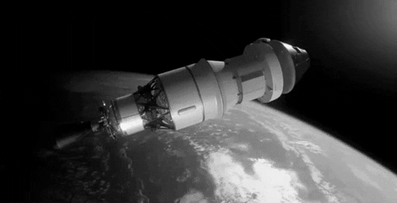
SPACE TRAVEL
The astronauts go into space in a spacecraft.
They wear special suits that contain a supply of air and also protects them from harmful rays.
They conduct experiments in the spacecraft.
They even have to repair the spacecraft when needed, while in space.

Slide 4
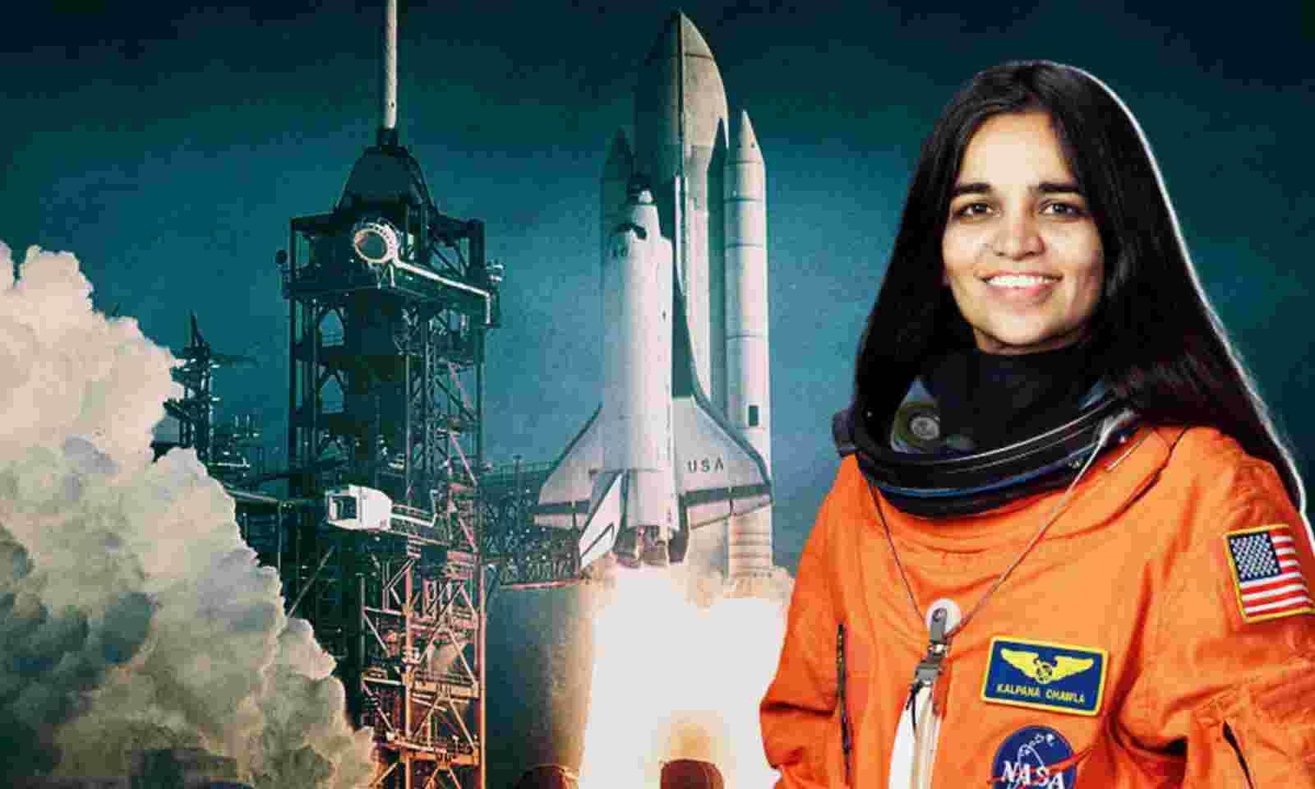
KALPANA CHAWLA
Kalpana Chawla was the first Indian woman to go into space. She went in 1997 in the space shuttle, Columbia.
She went into space again January 2003. However, she died on 1st February 2003, when her space shuttle crashed on the return journey.

Slide 5
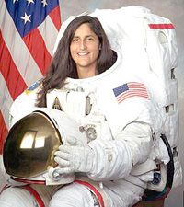
SUNITA WILLIAMS
Sunita Williams was the second woman of Indian origin to go into space.
She stayed in space in her spacecraft for 195 days.

Slide 6
LET US ANSWER
Tick ( ) the correct answer.
Beyond the layer of the earth is
atmosphere b. space c. force of gravity
2. They were the other two astronauts who travelled in the space craft with Neil Armstrong.
Edwin Aldrin and Kalpana Chawla
Michael Collins and Sunita Williams
Edwin Aldrin and Michael Collins

Slide 7
LET US ANSWER
Tick ( ) the correct answer.
3. Astronauts wear special suits that contain a supply of
petrol b. water c. air
4. Kalpana Chawla died when she was
going into space b. returning from space c. in space
5. If your weight on the moon is 7 kg, on earth it will be
a.41 kg b. 42 kg c.43 kg

Slide 8
LEARNING OUTCOME:
Learners will come to know -
about short question answers of the chapter.

Slide 9
THANKING YOU
ODM EDUCATIONAL GROUP

