Slide 1
SESSION : 7
CLASS : III
SUBJECT : SCIENCE
CHAPTER NUMBER : 8
CHAPTER NAME : MAN:THE LIVING MACHINE
SUB-TOPIC : LONG Q AND A- ANSWER THE FOLLOWING

Slide 2
LEARNING OBJECTIVE :
To enable the learners to solve the–
long Q and A- Answer the following

Slide 3
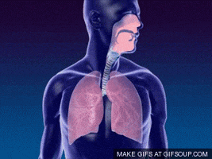
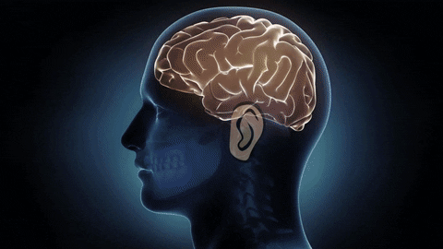
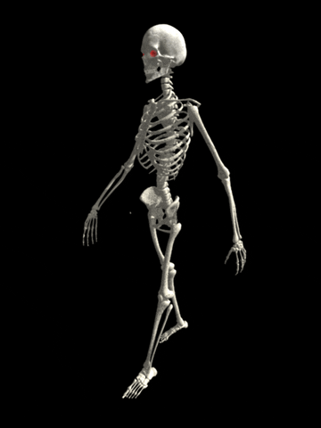
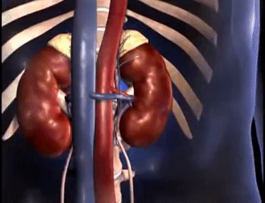
LET’S RECAPITULATE:
Match Column A with Column B.
Column A | Column B
 | Excretory System
 | Skeletal System
 | Sense Organs
 | Nervous System
 | Respiratory system

Slide 4
C. Answer the following questions.
1. How are the sense organs connected to the brain?
Ans: The sense organs connected to the brain through the nerves.
2. Is it right to keep the windows of our rooms closed all the time? Why?
Ans: It is not right to keep the windows of our rooms closed all the time because we need to breathe in fresh air.
3. What does oxygen do inside our body?
Ans : The oxygen burns up the food we eat and give us energy.

Slide 5
C. Answer the following questions.
4. Which two organ systems help the body and its parts to move ?
Ans : The skeletal system as well as the muscular system helps the body and its parts to move.
5. What is the function of the reproductive system?
Ans : The main function of the reproductive system is to produce babies as a result the life on the earth goes on.

Slide 6
LEARNING OUTCOME:
The learners will be able to solve the-
long Q and A- Answer the following

Slide 7
THANKING YOU
ODM EDUCATIONAL GROUP

