Slide 1
SESSION : 1
CLASS : V
SUBJECT : MATHEMATICS
CHAPTER NUMBER: 5
CHAPTER NAME : OPERATIONS ON LARGER NUMBERS
SUBTOPIC : Addition of large numbers
Exercise - 5 A Q. No 1 and 2

Slide 2
Addition of large numbers
Addition facts:
The numbers being added are called addends.
The answer of addition is called sum.
The change in the order of the addends does not change their sum.
Ex- 3 + 10 = 10 + 3 = 13
If three or more numbers are added in different groups, their sum remains the same in all cases.
Ex- (10 + 2) + 5 = 10 + (2 + 5)
The sum of any number and zero is the number itself.
Ex- 345 + 0 = 345
If we add 1 to a given number, then we can get the successor of the given number.

Slide 3
Addition of large numbers
Steps for addition:
Arrange the numbers in each column ( Ones under ones, tens under tens and so on)
Add the digits in column. ( Always start with ones)
If any carry over is there take it to the next column and add it with the digits in that column.
Continue till the last column

Slide 4
Example-
Add the following numbers and also write the number name of the answer.
3 65 68 418; 75 80 115; 10 24 37 000; 50 670
3 6 5 6 8 4 1 8
7 5 8 0 1 1 5
1 0 2 4 3 7 0 0 0
+ 5 0 6 7 0
Ans- 14 66 36 203
1
1
2
1
1
1
1
TC Cr TL L TTh Th H T O
1
4
6
6
3
6
2
0
3
Name- Fourteen crore sixty six lakh thirty six thousand
two hundred three

Slide 5
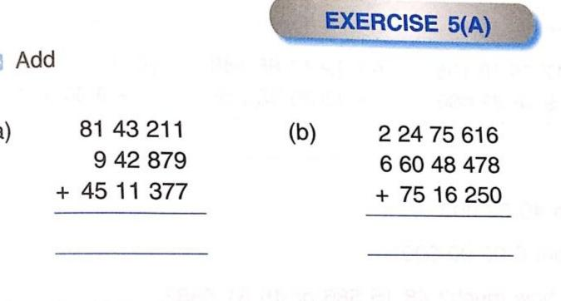
1
1
1
1
1
1
1
1
2
1
1
1
1
3
5
9
7
4
6
7
9
6
0
4
0
3
4
4
1,35, 97, 467
9,60, 40, 344

Slide 6
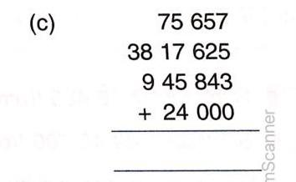
4
8
6
3
1
2
5
1
1
6
7
5
6
3
7
2
3
52 02 70 747
28 14 74 795

Slide 7
Q.NO-2-a
Arrange the following numbers in columns and add
Answer.
28 18 417; 43 35 318; 16 14 408
2 8 1 8 4 1 7
4 3 3 5 3 1 8
1 6 1 4 4 0 8
+ .
Ans- 87 68 143
1
1
1
2
TC Cr TL L TTh Th H T O
8
7
6
8
1
4
3

Slide 8
Q.NO-2-b
Arrange the following numbers in columns and add
Answer.
6 82 175; 30 42 225; 2 13 08 842
6 8 2 1 7 5
3 0 4 2 2 2 5
2 1 3 0 8 8 4 2
+ .
Ans- 2,50,33,242
1
1
1
1
1
1
TC Cr TL L TTh Th H T O
2
5
0
3
3
2
4
2

Slide 9
Q.NO-2-c
Arrange the following numbers in columns and add
Answer.
66 24 70 242; 7 78 18 478; 16 11 27 345
6 6 2 4 7 0 2 4 2
7 7 8 1 8 4 7 8
1 6 1 1 2 7 3 4 5
+ .
Ans- 90,14,16,065
2
1
1
1
1
1
1
1
TC Cr TL L TTh Th H T O
9
0
1
4
1
6
0
6
5

Slide 10
LEARNING OUTCOME
:- Students are able to add larger numbers with proper steps.

Slide 11
HOME WORK
Complete exercise - 5 A
Q. No 1, 2 and 3 in the notebooK

Slide 12
THANKING YOU
ODM EDUCATIONAL GROUP

