Slide 1
SESSION NO.: 2
CLASS: 5
SUBJECT: SCIENCE
CHAPTER NUMBER: 12
CHAPTER NAME: OUR LIFE SUPPORT
TOPIC: LAYERS OF ATMOSPHERE, COMPOSITION OF AIR, CONT...
Notes:
Composition of air
Properties of air
Do the oral Q& A of page no. 113
Water too supports life
Impurities in water
Removal of insoluble impurities
Empty bottles of mineral water should be crushed before throwing them into the dustbin. Why?
Removal of soluble impurities
Draw a labelled diagram of the process of distillation
Purification of drinking water
Draw the picture of purification of town water supply
Long Q & A
Learn the Q & A
Activity
Class test
Learn the Q & A

Slide 2
LEARNING OBJECTIVE
To enable the learner to:
learn the different layers of the atmosphere.
understand the importance of each layer of the atmosphere.
know the composition of air.
list the uses of gases in real life.

Slide 3
LET’S RECAP
What do you call the thick blanket of air that is surrounding our earth?
Burning candle slowly extinguishes when an inverted glass is put on it. Justify the statement.
Where does the gaseous exchange takes place in our body?
Mention some uses of air.

Slide 4
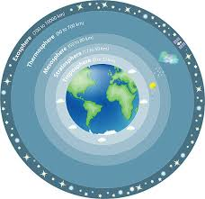
LAYERS OF ATMOSPHERE

Slide 5
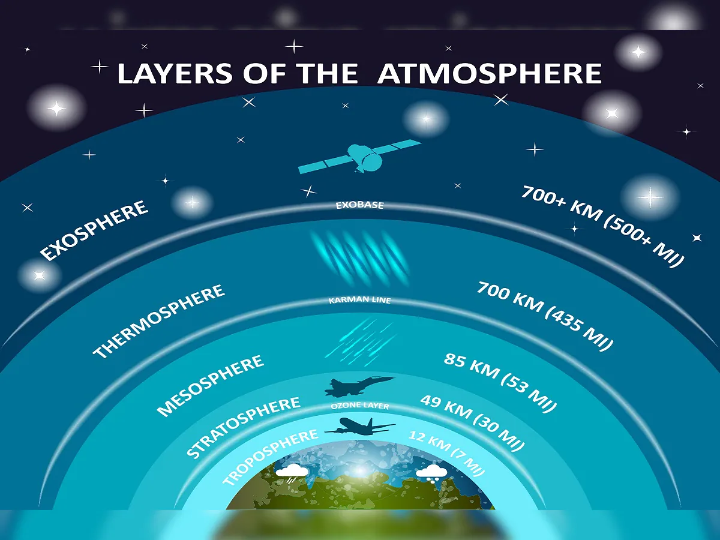
LAYERS OF ATMOSPHERE
Troposphere
Stratosphere
Mesosphere
Thermosphere
Exosphere

Slide 6
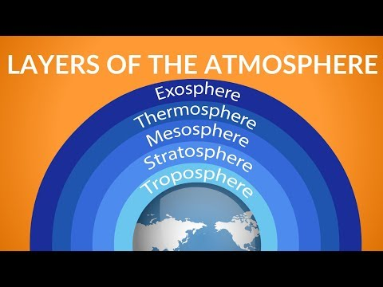
LAYERS OF ATMOSPHERE

Slide 7
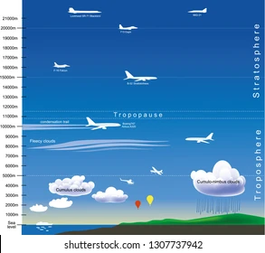
TROPOSPHERE
This is the first layer above the Earth's surface.
Weather changes takes place here.

Slide 8
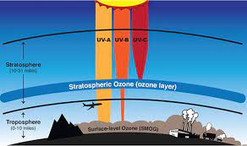
STRATOSPHERE
It is the second layer.
Here, jet aircraft fly.
Ozone gas is present in this layer.
Ozone absorbs harmful ultraviolet rays from the sun which causes skin cancer.

Slide 9
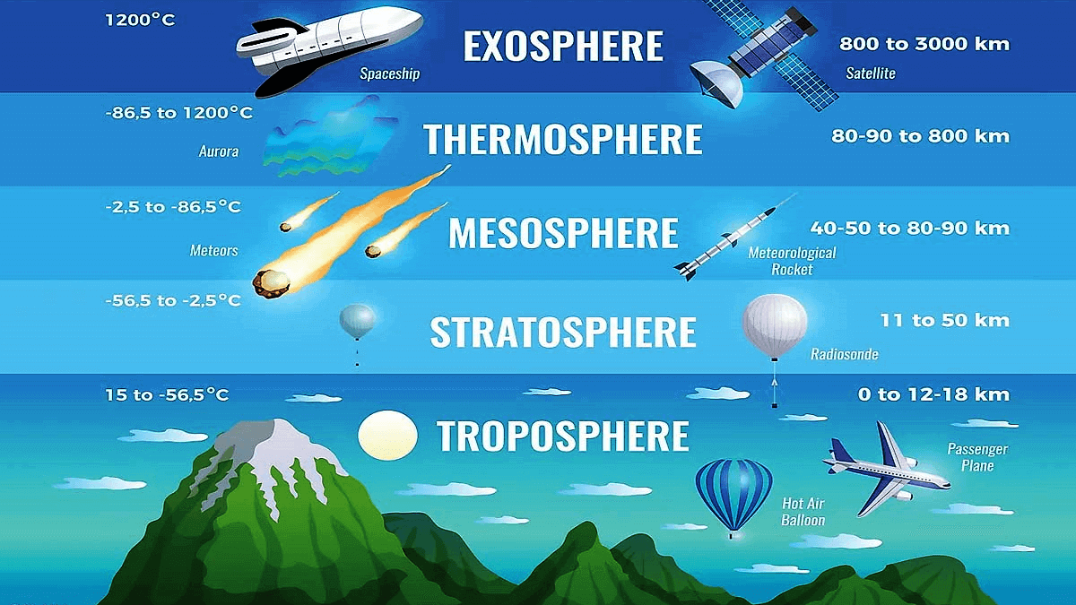
MESOSPHERE
This is the third layer.
Meteorites or small rocks moving above about in space burn out in this layer and therefore, do not reach the surface of the earth.

Slide 10
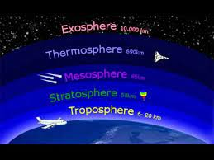
THERMOSPHERE
It is the fourth layer.
Space shuttles move about in this layer.

Slide 11
EXOSPHERE
This is the fifth layer of the atmosphere.

Slide 12
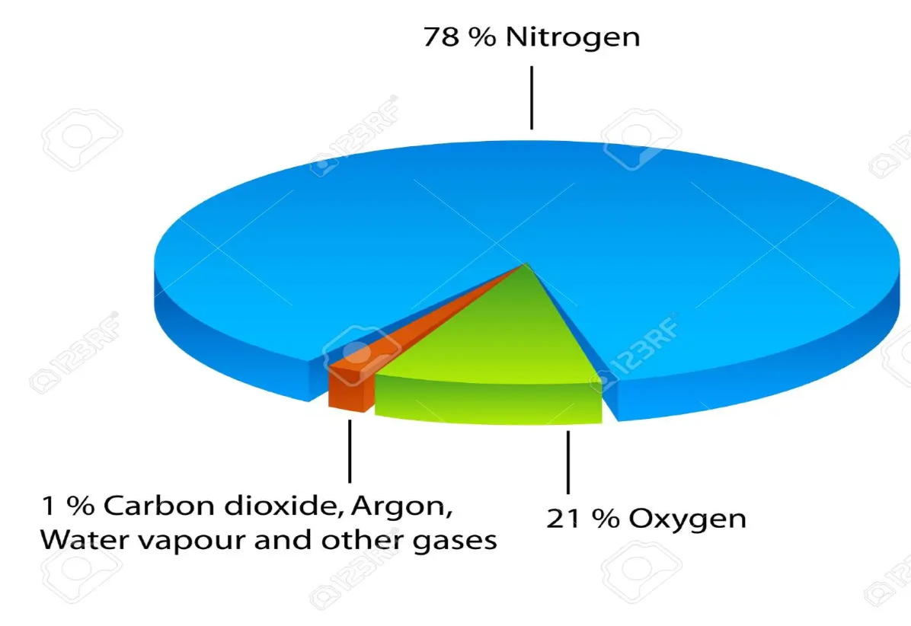
COMPOSITION OF AIR
The air we breathe contains various gases.
Air consists of 78% nitrogen, 21% oxygen and less than 1% of argon, carbon dioxide and other gases.
Air also contains water vapor, dust and smoke.

Slide 13
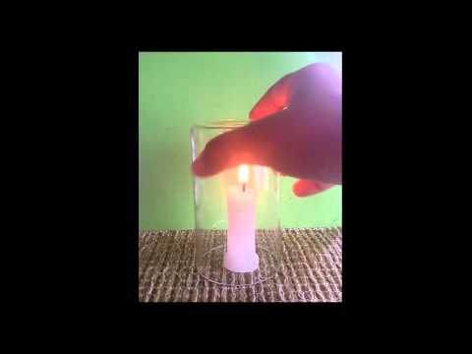
OXYGEN
It is the most important gas for the survival of living beings.
All living things need oxygen.
It is also needed for burning.

Slide 14
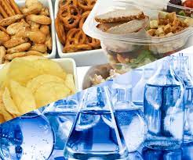
NITROGEN
Living things do not use nitrogen directly from the air.
Nitrogen is used by the plants with the help of bacteria in the soil.
Nitrogen is also added to the soil by using chemical fertilizers.
Animals get nitrogen from plants, meat and fish.

Slide 15
SUMMARY
The different layers of atmosphere are: troposphere, stratosphere, mesosphere, thermosphere and exosphere.
Air consists of 78% nitrogen, 21% oxygen and less than 1% of argon, carbon dioxide and other gases.
Air also contains water vapor, dust and smoke.
Oxygen is the most important gas for the survival of living beings and also needed for burning.
Living things do not use nitrogen directly from the air.
Nitrogen is used by the plants with the help of bacteria in the soil.
Nitrogen is also added to the soil by using chemical fertilizers.
Animals get nitrogen from plants, meat and fish.

Slide 17
The blanket of air that surrounds the earth is called the atmosphere. It has five layers. Troposphere is the layer closest to the earth’s surface. Here, weather changes takes place. Stratosphere is the layer next to troposphere and it contains ozone layer in it. Ozone layer protects us from the harmful rays of the Sun. Next to stratosphere we have mesosphere. This is the layer that burns out meteors or small rocks that comes towards us. Thermosphere lies just above mesosphere. Space shuttles move in this layer. Exosphere is the outermost layer of the atmosphere.
Which layer contains ozone?
Ans: Stratosphere

Slide 18
The blanket of air that surrounds the earth is called the atmosphere. It has five layers. Troposphere is the layer closest to the earth’s surface. Here, weather changes takes place. Stratosphere is the layer next to troposphere and it contains ozone layer in it. Ozone layer protects us from the harmful rays of the Sun. Next to stratosphere we have mesosphere. This is the layer that burns out meteors or small rocks that comes towards us. Thermosphere lies just above mesosphere. Space shuttles move in this layer. Exosphere is the outermost layer of the atmosphere.
2. Meteorites or rock pieces get burnt in this layer of atmosphere.
Ans: Mesosphere

Slide 19
The blanket of air that surrounds the earth is called the atmosphere. It has five layers. Troposphere is the layer closest to the earth’s surface. Here, weather changes takes place. Stratosphere is the layer next to troposphere and it contains ozone layer in it. Ozone layer protects us from the harmful rays of the Sun. Next to stratosphere we have mesosphere. This is the layer that burns out meteors or small rocks that comes towards us. Thermosphere lies just above mesosphere. Space shuttles move in this layer. Exosphere is the outermost layer of the atmosphere.
3. Name the outermost layer of the atmosphere.
Ans: Exosphere

Slide 20
HOMEWORK
Draw a picture to show the composition of air.
Do questions A & B in your notebook.

Slide 21
LEARNING OUTCOME
The learner will be able to:
learn the different layers of the atmosphere.
understand the importance of each layer of the atmosphere.
know the composition of air.
list the uses of gases in real life.

Slide 22
THANKING YOU
ODM EDUCATIONAL GROUP

