Slide 1
The Firebringer
SUBJECT : (English)
CHAPTER NUMBER: 5
CHAPTER NAME :The Firebringer

Slide 2
EXPECTED LEARNING OUTCOMES
GENERAL OBJECTIVES
Reading Comprehension followed by questions
Be acquainted with short story/Fiction
Understanding the plot
Understanding characters
Developing LSRW Skills
Know how to write a story- Beginning, middle and end
SPECIFIC OBJECTIVES/ EXTENDED OBJECTIVES
Develop LSRW
Appreciating the story, plot, characters
Developing skill of Critical appreciation
Focus on the underprivileged tribal of India
Be aware of the importance of asking questions
Be acquainted with typical vocabulary meant for story writing
Appreciating varieties of style and diction in literary writing

Slide 3
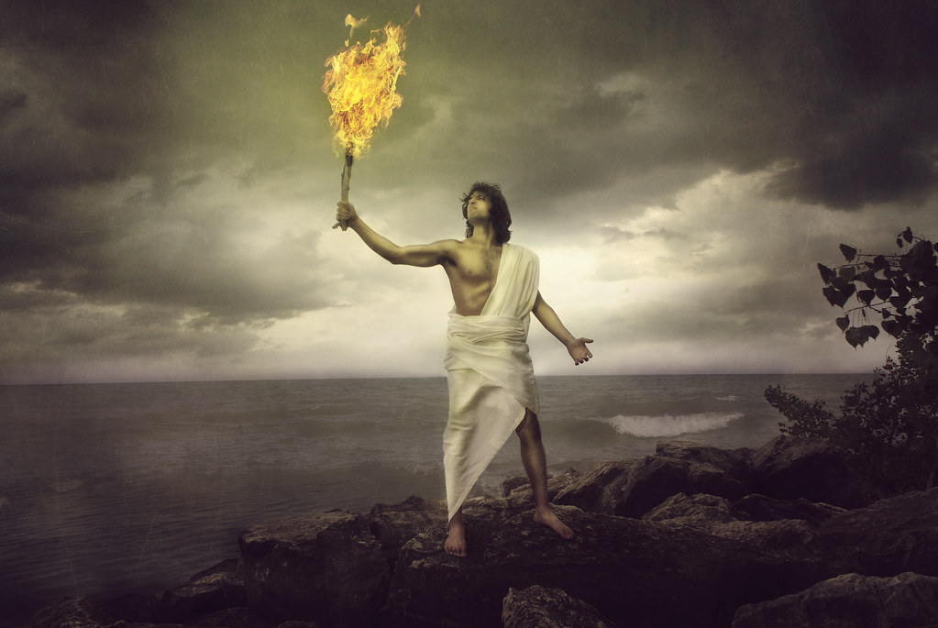
Brother don’t you....... It’s better to get rid of them.
Summary : Prometheus always had a soft corner for human beings. He could not see them suffering.
Human beings were not able to protect themselves from cold, hunger and beasts.
Thus Prometheus requested Zeus to give them the knowledge of fire.
However, Zeus had other intentions and denied Prometheus to share the knowledge of fire with human beings.

Slide 4
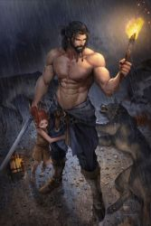
But... What should we do then......Let him suffer till the end of the time.
Summary : Prometheus was not happy with the decision taken by Zues. He decided to help human beings at any cost.
He went back to Mt. Olympus with the stalk and got the fire and met humans. He then taught them how to use the fire. Human beings were happy for the wonderful gift Prometheus had brought for them.

Slide 5
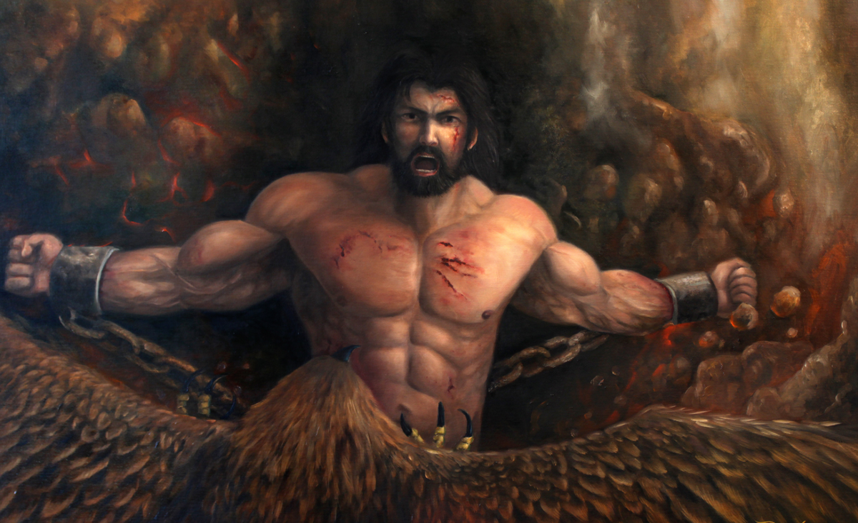
But... What should we do then......Let him suffer till the end of the time.
Summary :
Soon Zeus came to know about the deed of Prometheus and he was so mad at Prometheus that he ordered his soldiers to tie Prometheus with the chain to the highest mountain and let him suffer till the end of the time.

Slide 6
THANKING YOU
ODM EDUCATIONAL GROUP

