Slide 1

WELCOME TO
ONLINE STUDY CLASS-VI,
SUB:SOCIAL SCIENCE (CIVICS)
CHAPTER-1.
HUMAN DIVERSITY

Slide 2
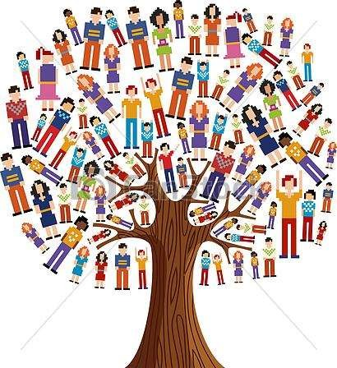
HUMAN DIVERSITY

Slide 3

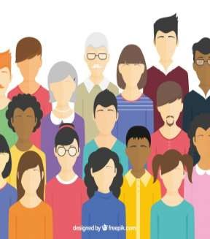
WHAT IS DIVERSITY?
Diversity: State of being different and unique is known as diversity.
It includes factors like age, gender, ability, race, religion, education, occupation and food.
Diversity as a beautiful component of life:
  Each of us are different. 2.We do things differently.
We pray differently, eat different meals, prefer different subjects etc.
It adds beauty with differences. 5.It helps with many options in life. 6.It gives ways to keep us engage and
entertained with differences.

Slide 4
THE NEED FOR DIVERSITY
Is it necessary to encourage diversities?
Humans have different ideas. Different ideas creates beautiful society which is diverse in nature.
Diversity adds colour to life. It adds beauty to our culture.
Humans have different skills, some are painter, carpenters, plumbers, some prefer to write and some to read.
Differences in interests and skills are a necessity for society. These varied interests and skills bring people together and make them interdependent.

Slide 5
THE NEED FOR DIVERSITY
Diversity enriches our lives. It breaks boredom of identical people of the society doing the same things, looking same, behaving the same and so on.
When we live with a diverse group of people, we learn from them.
We absorb different cultures, we become more tolerant and broad-minded.
Diversity leads to development of both the individual and the society.

Slide 6



