Slide 1
FACTORISATION
PERIOD 3
SUBJECT : MATHEMATICS
CHAPTER NUMBER: 13
CHAPTER NAME : FACTORISATION

Slide 2
Learning outcome
Students will be able to understand the concept of factorization
Understand the different method of factorization
.

Slide 3
Exercise -13 C

Slide 4
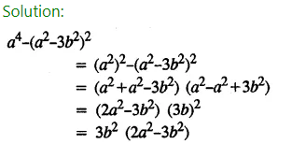
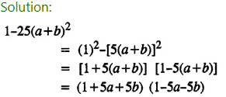

Slide 5
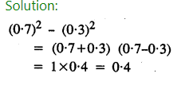
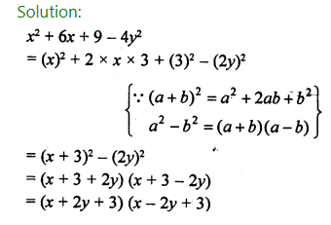
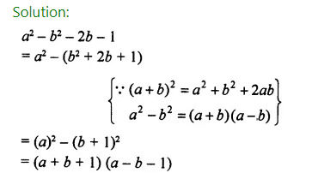

Slide 6
Home assignment
Exercise 13(C)

Slide 7
THANKING YOU
ODM EDUCATIONAL GROUP

