Slide 1
FACTORISATION
PERIOD 5
SUBJECT : MATHEMATICS
CHAPTER NUMBER: 13
CHAPTER NAME : FACTORISATION

Slide 2
Learning outcome
Students will be able to understand the concept of factorization
Understand the different method of factorization
.

Slide 3
Exercise -13 E

Slide 4
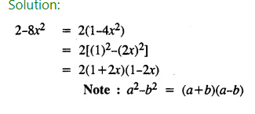
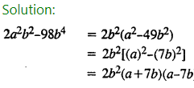
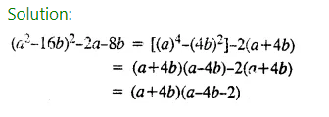
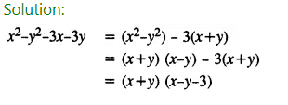

Slide 5
Home assignment
Exercise 13(E)

Slide 6
THANKING YOU
ODM EDUCATIONAL GROUP

