Slide 1
RATIO
SUBJECT : MATHEMATICS
CHAPTER NUMBER: 11
CHAPTER NAME :Ratio
SUB TOPIC: To divide a given Quantity into a Given Ratio
PERIOD NO:4

Slide 2
Learning outcomes
Students will be able to apply ratios .
Students will be able to divide a given quantity in a given ratio.

Slide 3
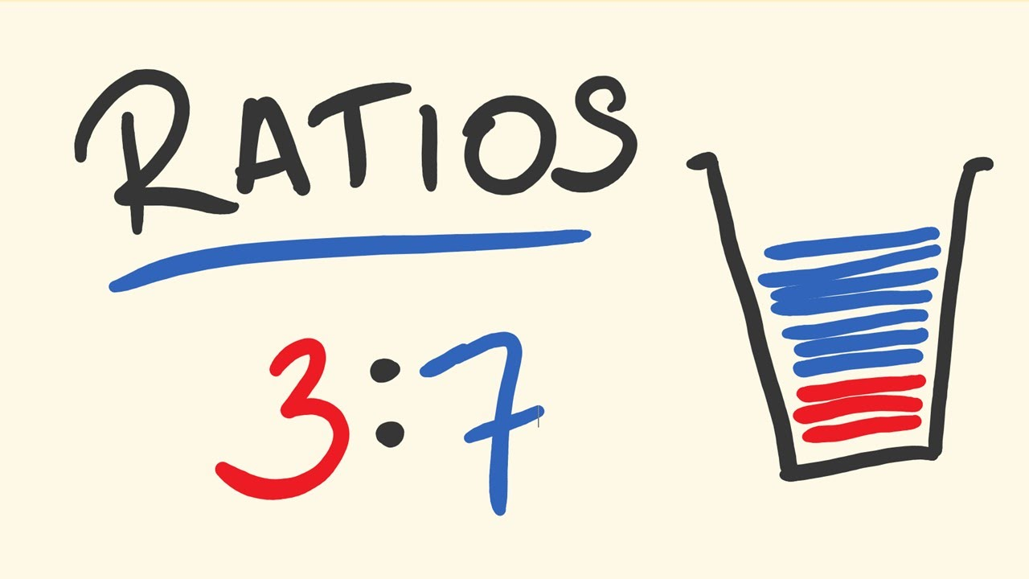
RATIO

Slide 4
Ratio
Concept of ratio will be explained using a video.
https://www.youtube.com/watch?v=3sVi2JhHvWM

Slide 6
Evaluation Questions Exercise 11C
1. Rs 120 is to be divided between Hari and Gopi in the ratio 5: 3. How much does each get?
Solution:Total amount = Rs 120
Amount divided between Hari and Gopi in the ratio = 5: 3
Hence,The sum of ratio is as follows:
Sum of ratio = 5 + 3= 8
Hence, Hari’s and Gopi’s share will be as follows:
Hari’s share = (120 × 5) / 8= Rs 75
Gopi’s share = (120 × 3) / 8= Rs 45
Therefore, Hari get Rs 75 and Gopi get Rs 45

Slide 7
Evaluation Question
3. Divide 81 into three parts in the ratio 2: 3: 4
Solution : Number = 81
Ratio = 2: 3: 4
Hence, the sum of ratio is calculated as follows
Sum of ratios = 2 + 3 + 4= 9
First divide = 2 / 9 × 81= 18
Second divide = 3 / 9 × 81= 27
Third divide = 4 / 9 × 81= 36
Therefore, 81 can be divided into 18, 27 and 36 in the ratio 2: 3: 4

Slide 8
Evaluation Question
5. A profit of Rs 2, 500 is to be shared among three persons in the ratio 6: 9: 10. How much does each person get?
6. The angles of a triangle are in the ratio 3: 7: 8. Find the greatest and the smallest angles.
7. The sides of a triangle are in the ratio 3: 2: 4. If the perimeter of the triangle is 27 cm, find the length of each side.
8. An alloy of zinc and copper weighs 12 ½ kg. If in the alloy, the ratio of zinc and copper is 1: 4, find the weight of copper in it.
9. How will Rs 31500 be shared between A, B and C; if A gets the double of what B gets, and B gets the double of what C gets?
10. Mr. Gupta divides Rs 81000 among his three children Ashok, Mohit and Geeta in such a way that Ashok gets four times what Mohit gets and Mohit gets 2.5 times what Geeta gets. Find the share of each of them.

Slide 9
Evaluation Question
5.Solution:
Total profit = Rs 2, 500
Ratio = 6: 9: 10
Sum of ratio = 6 + 9 + 10= 25
Share of first person = 6 / 25 × 2500
= 6 × 100= 600
Share of second person = 9 / 25 × 2500= 9 × 100= 900
Share of third person = 10 / 25 × 2500
= 10 × 100= 1000

Slide 10
Evaluation Question
6.Solution:Ratio = 3: 7: 8
Sum of angles of a triangle = 180⁰
Sum of ratios = 3 + 7 + 8= 18
Hence, the angles are calculated as
Smallest angle = 3 / 18 × 180⁰
= 3 × 10
= 30⁰
Greatest angle = 8 / 18 × 180⁰
= 8 × 10= 80⁰

Slide 11
Evaluation Question
7.Solution:
Ratio of the sides of a triangle is 3: 2: 4
Sum of ratios = 3 + 2 + 4= 9
Perimeter of a triangle = 27 cm
Length of first side = 27 / 9 × 3= 3 × 3= 9 cm
Length of second side = 27 / 9 × 2= 3 × 2= 6 cm
Length of third side = 27 / 9 × 4= 3 × 4= 12 cm

Slide 12
Evaluation Question
9.Solution:
Amount = Rs 31500
Let the share of C = 1
Share of B = double of C= 2 × 1= 2
Share of A = double of B= 2 × 2= 4
Therefore, given ratio will be
A: B: C = 4: 2: 1
Sum of ratios = 4 + 2 + 1= 7
A’s share = 4 / 7 × 31500= 4 × 4500= Rs 18000
B’s share = 2 / 7 × 31500= 2 × 4500
= Rs 9000
C’s share = 1 / 7 × 31500= 1 × 4500= Rs 4500

Slide 13
Evaluation Question
10.Solution:
Amount = Rs 81000
Let the share of Geeta = 1
Share of Mohit is 2.5 times of Geeta
Hence, share of Mohit becomes = 2.5
Share of Ashok is 4 times of Mohit
Hence, share of Ashok becomes = 4 × 2.5= 10
Ratio = 1: 2.5: 10= 1 × 2: 2.5 × 2: 10 × 2= 2: 5: 20
Thus, sum of ratios = 2 + 5 + 20= 27
Share of Geeta = 2 / 27 × 81000= 2 × 3000= Rs 6000
Share of Mohit = 5 / 27 × 81000= 5 × 3000= Rs 15000
Share of Ashok = 20 / 27 × 81000= 20 × 3000
= Rs 60000

Slide 14
Homework
HW
Ex.11 C

Slide 15
THANKING YOU
ODM EDUCATIONAL GROUP

