Slide 1
FUNDAMENTAL OPERATIONS
SUBJECT : MATHEMATICS
CHAPTER NUMBER:19
CHAPTER NAME :FUNDAMENTAL OPERATIONS
SUBTOPIC : Multiplication of Monomial and Polynomial.
PERIOD NO: 4

Slide 2
Learning outcomes
Students will be able to multiply polynomial by polynomial.
Students will develop application skill.

Slide 3
PREVIOUS KNOWLEDGE TEST
1. Multiply:
(i) a + b by ab
(ii) 3ab – 4b by 3ab
(iii) 2xy – 5by by 4bx

Slide 4
Negative numbers and Integers
Students will Learn multiplication of binomials with the help of a video .
https://www.youtube.com/watch?v=fGThIRpWEE4(9.4)

Slide 5
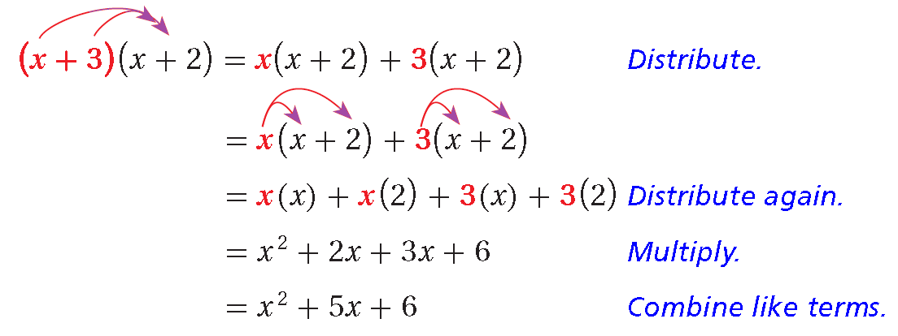
FUNDAMENTAL OPERATIONS

Slide 6
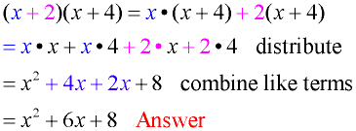
FUNDAMENTAL OPERATIONS

Slide 7
Evaluation Question EX-19 C
5. Multiply: (i) – x + y – z and – 2x
(ii) xy – yz and x²yz²
(iii) 2xyz + 3xy and – 2y²z
(iv) – 3xy² + 4x²y and – xy
(v) 4xy and – x²y – 3x² y²
Solution: (i) – x + y – z and – 2x
The multiplication of the given expression is calculated as,
(- x + y – z) × – 2x = – x × – 2x + y × – 2x – z × – 2x
On further calculation, we get 2x¹⁺¹ – 2xy + 2xz = 2x² – 2xy + 2xz
Hence, the multiplication of (- x + y – z) and – 2x is 2x² – 2xy + 2xz

Slide 8
Evaluation Question EX-19 C
Solution: (ii) xy – yz and x²yz²
The multiplication of the given expression is calculated as,
(xy – yz) × (x²yz²) = xy × x²yz² – yz × x²yz²
= x¹⁺²y¹⁺¹z² – x²y¹⁺¹z¹⁺² = x³y²z² – x²y²z³
Hence, the multiplication of (xy – yz) and x²yz² = x³y²z² – x²y²z³
(iii) 2xyz + 3xy and – 2y²z
The multiplication of the given expression is calculated as,
(2xyz + 3xy) × – 2y²z = 2xyz × – 2y²z + 3xy × – 2y²z
On further calculation, we get
= – 4xy¹⁺²z¹⁺¹ – 6xy¹⁺²z = – 4xy³z² – 6xy³z
Hence, the multiplication of 2xyz + 3xy and – 2y²z = – 4xy³z² – 6xy³z

Slide 9
Evaluation Question EX-19 C
Solution: (iv) – 3xy² + 4x²y and – xy
(- 3xy² + 4x²y) × (– xy )= 3x¹⁺¹y²⁺¹ – 4x²⁺¹y¹⁺¹
On calculation, we get 3x²y³ – 4x³y²
Hence, the multiplication of – 3xy² + 4x²y and – xy = 3x²y³ – 4x³y²
(v) 4xy and – x²y – 3x² y²
(- x²y – 3x²y²) × 4xy = – x²y × 4xy – 3x²y² × 4xy
On further calculation, we get – 4x²⁺¹y¹⁺¹ – 12x²⁺¹y²⁺¹
= – 4x³y² – 12x³y³
Hence, the multiplication of 4xy and – x²y – 3x² y² = – 4x³y² – 12x³y³

Slide 10
Evaluation Question EX-19 C
6. Multiply:
(i) 3a + 4b – 5c and 3a
(ii) – 5xy and – xy² – 6x²y
Solution:
(i) 3a + 4b – 5c and 3a
(3a + 4b – 5c) × 3a = 3a × 3a + 4b × 3a – 5c × 3a
On further calculation, we get 9a¹⁺¹ + 12ab – 15ac
= 9a² + 12ab – 15ac
Therefore, the multiplication of 3a + 4b – 5c and 3a = 9a² + 12ab – 15ac

Slide 11
Evaluation Question EX-19 C
Solution: (ii) – 5xy and – xy² – 6x²y
– 5xy × (- xy² – 6x²y) = – 5xy × – xy² – 5xy × – 6x²y
= 5x¹⁺¹y¹⁺² + 30x¹⁺²y¹⁺¹ = 5x²y³ + 30x³y²
Therefore, the multiplication of – 5xy and – xy² – 6x²y = 5x²y³ + 30x³y²
7. Multiply:
(i) x + 2 and x + 10 (ii) x + 5 and x – 3
(iii) x – 5 and x + 3 (iv) x – 5 and x – 3
(v) 2x + y and x + 3y

Slide 12
Evaluation Question EX-19 C
Solution: (i) x + 2 and x + 10
The given expression is calculated as follows
(x + 2) × (x + 10) = x × (x + 10) + 2 × (x + 10)
= x² + 10x + 2x + 20 = x² + 12x + 20
Hence, the multiplication of (x + 2) and (x + 10) = x² + 12x + 20
(ii) x + 5 and x – 3
The given expression is calculated as follows
(x + 5) × (x – 3) = x × (x – 3) + 5 × (x – 3)
On simplification, we get x² – 3x + 5x – 15
= x² + 2x – 15
Hence, the multiplication of (x + 5) and (x – 3) = x² + 2x – 15

Slide 13
Evaluation Question EX-19 C
Solution: (iii) x – 5 and x + 3
The given expression is calculated as follows
(x – 5) × (x + 3) = x × (x + 3) – 5 × (x + 3)
On further calculation, we get x² + 3x – 5x – 15 = x² – 2x – 15
Hence, the multiplication of (x – 5) and (x + 3) = x² – 2x – 15
(iv) x – 5 and x – 3
The given expression is calculated as,
(x – 5) × (x – 3) = x × (x – 3) – 5 × (x – 3)
On further calculation, we get x² – 3x – 5x + 15 = x² – 8x + 15
Hence, the multiplication of (x – 5) and (x – 3) = x² – 8x + 15

Slide 14
Evaluation Question EX-19 C
Solution: (v) 2x + y and x + 3y
The given expression is calculated as,
(2x + y) × (x + 3y) = 2x × (x + 3y) + y × (x + 3y)
On simplification, we get 2x² + 6xy + xy + 3y²
= 2x² + 7xy + 3y²
Hence, the multiplication of (2x + y) and (x + 3y) = 2x² + 7xy + 3y²
8. Multiply:
(i) 3abc and – 5a²b²c (ii) x – y + z and -2x
(iii) 2x – 3y – 5z and -2y (iv) – 8xyz + 10 x²yz³ and xyz
(v) xyz and – 13xy²z + 15x²yz – 6xyz²

Slide 15
Evaluation Question EX-19 C
Solution: (i) 3abc and – 5a²b²c
The given expression is calculated as follows,
3abc × – 5a²b²c = 3 × – 5 × a × a² × b × b² × c × c
On further calculation, we get – 15 × a¹⁺² × b¹⁺² × c¹⁺¹
= – 15 × a³ × b³ × c² = – 15a³b³c²
Therefore, the multiplication of 3abc and – 5a²b²c = – 15a³b³c²
(ii) x – y + z and -2x
The given expression is calculated as follows,
(x – y + z) × – 2x = x × – 2x – y × – 2x + z × – 2x
On simplification, we get = – 2x¹⁺¹ + 2xy – 2xz = – 2x² + 2xy – 2xz
Therefore, the multiplication of x – y + z and -2x = – 2x² + 2xy – 2xz

Slide 16
Evaluation Question EX-19 C
Solution: (iii) 2x – 3y – 5z and -2y
The given expression is calculated as follows,
(2x – 3y – 5z) × – 2y = 2x × – 2y – 3y × – 2y – 5z × – 2y
On further calculation, we get – 4xy + 6y¹⁺¹ + 10yz = – 4xy + 6y² + 10yz
Therefore, the multiplication of 2x – 3y – 5z and -2y = – 4xy + 6y² + 10yz
(iv) – 8xyz + 10 x²yz³ and xyz
The given expression is calculated as follows,
(- 8xyz + 10x²yz³) × xyz = – 8xyz × xyz + 10x²yz³ × xyz
On further calculation, we get – 8x¹⁺¹y¹⁺¹z¹⁺¹ + 10x²⁺¹y¹⁺¹z³⁺¹
= – 8x²y²z² + 10x³y²z⁴
Therefore, the multiplication of – 8xyz + 10 x²yz³ and xyz = – 8x²y²z² + 10x³y²z⁴

Slide 17
Evaluation Question EX-19 C
Solution: (v) xyz and – 13xy²z + 15x²yz – 6xyz²
The given expression is calculated as follows,
xyz × (- 13xy²z + 15x²yz – 6xyz²) = xyz × – 13xy²z + xyz ×15x²yz – xyz × 6xyz²
On simplification, we get
= – 13x¹⁺¹y¹⁺²z¹⁺¹ + 15x¹⁺²y¹⁺¹z¹⁺¹ – 6x¹⁺¹y¹⁺¹z¹⁺²
We get,
= – 13x²y³z² + 15x³y²z² – 6x²y²z³
Therefore, the multiplication of xyz and – 13xy²z + 15x²yz – 6xyz² = – 13x²y³z² + 15x³y²z² – 6x²y²z³

Slide 18
Evaluation Question EX-19 C
9. Find the product of:
(i) xy – ab and xy + ab (ii) 2abc – 3xy and 2abc + 3xy
Solution: (i) xy – ab and xy + ab
The product of the given expression is calculated as,
(xy – ab) × (xy + ab) = xy × (xy + ab) – ab × (xy + ab)
On simplification, we get
= xy × xy + xy × ab – ab × xy – ab × ab = x²y² + abxy – abxy – a²b²
= x²y² – a²b²
Hence, the product of (xy – ab) and (xy + ab) = x²y² – a²b²

Slide 19
Additional Homework
1. 6a – (- 5a – 8b) + (3a + b)
2. (p – 2q) – (3q – r)
HW
Ex.19 C Q. NO 5 TO 9

Slide 20
THANKING YOU
ODM EDUCATIONAL GROUP

