Slide 1
NUMBERS IN INDIAN AND INERNATIONAL SYSTEMS
SUBJECT : MATHEMATICS
CHAPTER NUMBER: 03
CHAPTER NAME : NUMBERS IN INDIAN AND INTERNATIONAL SYSTEMS
SUB TOPIC :Hindu-Arabic System of Numeration, International System of Numeration
PERIOD NO:1

Slide 2
Learning outcomes
*Students will be able to write numbers in Hindu-Arabic system of numeration.
*Students will be able to write numbers in international system of numeration

Slide 3
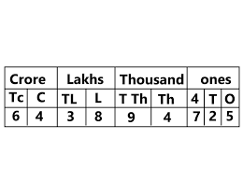
Hindu-Arabic System of Numeration, International System of Numeration

Slide 4
International Place Value Chart

Slide 5
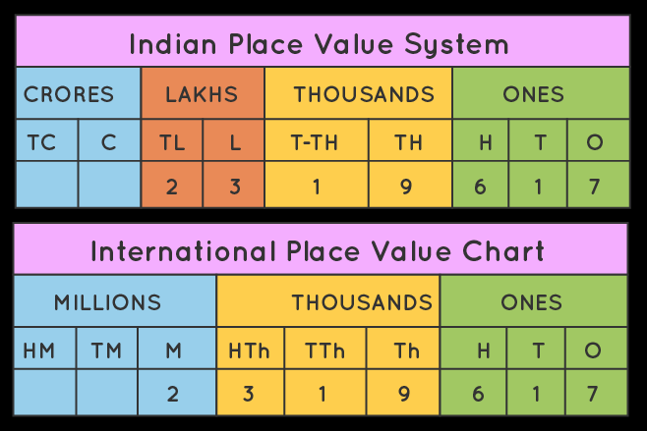
Comparison of Indian and International place value System

Slide 6
Hindu Hindu-Arabic System of Numeration and International System of Numeration will be explained with the help of video
https://www.youtube.com/watch?v=-NCphKgoE3M
https://www.youtube.com/watch?v=jKo_NrYcAaA

Slide 7
Some Points to Remember
1.Do not write the periods in plural:
Never write 5493 as five thousands four hundreds ninety three.
Correct form is : Five thousand four hundred ninety three.
2. Do not use the word 'and before tens and ones:
Do not read 5493 as five thousand four hundred and ninety three.
Correct form is : Five thousand four hundred ninety three.
3. Do not put commas when writing the numeral :
Never write 2468 as two thousand, four hundred, sixty eight.
Correct way is : Two thousand four hundred sixty eight.

Slide 8
Evaluation Question
1. Write the following numerals using Indian System or International system (as required) in words: (i) 4, 35, 342 = ………….. (ii) 36, 71, 430 = ………….. (iii) 4, 28, 30, 004 = ………….. (iv) 75, 132, 684 = …………… (v) 815, 906 = …………….
Solution:
The given numbers in Indian System words can be written as follows:
(i) 4, 35, 342 = Four lakh, thirty five thousand, three hundred forty two
(ii) 36, 71, 430 = Thirty six lakh, seventy one thousand four hundred thirty
(iii) 4, 28, 30, 004 = Four crore, twenty eighty lakh, thirty thousand four
(iv) 75, 132, 684 = Seventy five million, one hundred thirty two thousand, six hundred eighty four
(v) 815, 906 = Eight hundred fifteen thousand, nine hundred six

Slide 9
Evaluation Question
2. Write the following numbers, placing the commas, according to Indian system : (i) 835629 = ………… (ii) 35640254 = ………… (iii) 2826040 = ………
Solution:
Numbers placing the commas, according to Indian system can be written as follows:
(i) 835629 = 8, 35, 629
(ii) 35640254 = 3, 56, 40, 254
(iii) 2826040 = 28, 26, 040

Slide 10
Evaluation Question
3.Write the following numbers, by placing the commas, according to International system : (i) 6509820 = ……….. (ii) 428140584 = ………… (iii) 63560981 = ……….
Solution:
Numbers placing the commas, according to International system are
(i) 6509820 = 6, 509, 820
(ii) 428140584 = 428, 140, 584
(iii) 63560981 = 63, 560, 981

Slide 11
Home assignment
AHA
1. The successor of 1 million is
(a) 2 millions (b) 1000001 (c) 100001 (d) 10001
2. Place commas correctly and write the numerals:
(a) Seventy three lakh seventy five thousand three hundred seven.
(b) Nine crore five lakh forty one.
(c) Seven crore fifty two lakh twenty one thousand three hundred two.
(d) Fifty eight million four hundred twenty three thousand two hundred two.
(e) Twenty three lakh thirty thousand ten.
3. Insert commas suitably and write the names according to Indian System of Numeration :
(a) 87595762 (b) 8546283
(c) 99900046 (d) 98432701
HW
EX.3. Q.NO.4

Slide 12
THANKING YOU
ODM EDUCATIONAL GROUP

