Slide 1
INTRODUCTION TO TRIGONOMETRY
PPT-4
SUBJECT : MATHEMATICS
CHAPTER NUMBER: 08
CHAPTER NAME : INTRODUCTION TO TRIGONOMETRY

Slide 2
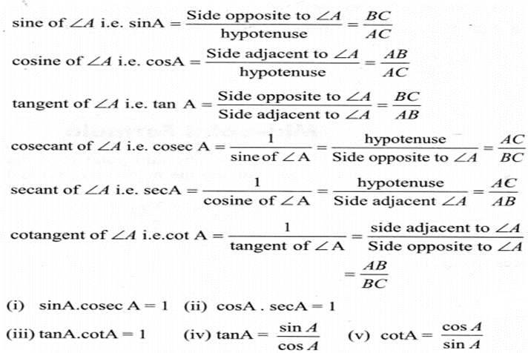
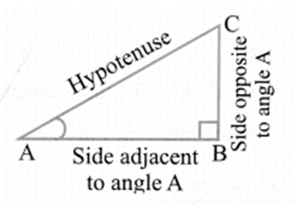
PREVIOUS KNOWLEDGE TEST
Trigonometric Ratios
Trigonometric ratios of an acute angle in a right triangle express the relationship between the angle and the length of its sides. Let ∆ABC be a triangle right angled at B. Then the trigonometric ratios of the angle A in right ∆ABC are defined as follows.

Slide 3
Learning outcome
1 . Students will be able to know the trigonometric ratios of some specific angles.
2. Students will be able to know the relations between t- ratios.
3. Students will be able to apply and analyze trigonometric ratios of some specific angles in solving real life problems.

Slide 4
Trigonometric Ratio of some specific angles (30°,45 °& 60°)
https://youtu.be/3XWzgeqYfQ8(9.12)

Slide 5
Trigonometric Ratio of some specific angles ;( 0°,& 90°)
https://youtu.be/SMHIXFqd3s4( 8.30)

Slide 6
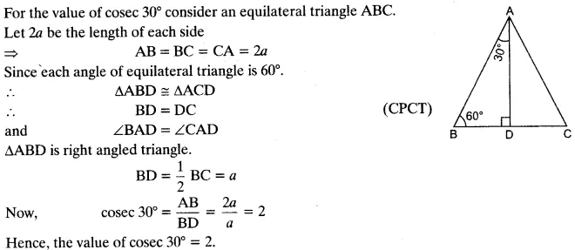
1.Find the value of cosec 30° geometrically.

Slide 7
3.Find the value of sec 45° geometrically

Slide 8
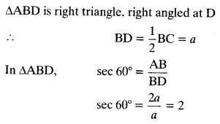
2.Find the value of sec 60° geometrically

Slide 9
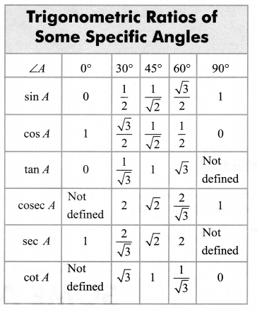
The values of the trigonometric ratios of an angle do not vary with the lengths of the sides of the triangle, if the angle remains same.

Slide 10
4.$\text{Evaluate}\text{; (}\text{i}\text{) }\text{sin}\text{ 60° }\text{cos}\text{ 30° + }\text{sin}\text{ 30° }\text{cos}\text{ 60°}$

Slide 11
4.$\text{Evaluate}\text{;(}\text{ii}\text{) 2 }\tan^{2}\text{ 45° + }\cos^{2}\text{ 30° – }\sin^{2}\text{ 60°}$

Slide 12
4.$\text{Evaluate}\text{ ;}\frac{cos 45° }{sec 30° + cosec 30° }$

Slide 13
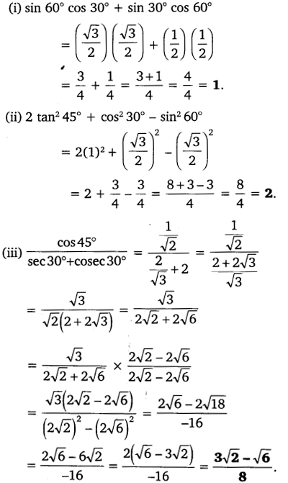

Slide 14
HOME ASSIGNMENT Ex. 8.2 Q. No 1
AHA
1. In ∆ PQR, right-angled at Q , PQ = 3 cm and PR = 6 cm. Determine ∠ QPR and ∠ PRQ.

Slide 15
THANKING YOU
ODM EDUCATIONAL GROUP

