Slide 1
BIOREACTORS AND DOWNSTREAM PROCESSING
SUBJECT : BIOLOGY
CHAPTER NUMBER: 11
CHAPTER NAME : BIOTECHNOLOGY : PRINCIPLE AND PROCESSES

Slide 2
BIOREACTORS :
OBTAINING THE FOREIGN GENE PRODUCT
When a piece of alien DNA is inserted into a cloning vector and transfer it into bacterial, plant or animal cell, then alien DNA gets multiplied.
In almost all recombinant technologies, the ultimate aim is to produce desirable protein.
It includes making the recipient cells competent to receive, take up DNA present in its surrounding etc. The recombinant DNA bearing gene for resistance to an antibiotic is transferred into E.coli cells, the host cell become transformed into amphicillin-resistance cells and is marked as transformant.
The foreign DNA multiplies in plant or animal cell to produce desirable protein.
Expression of foreign genes in host cells involve, optimized condition to obtain recombinant protein.
Any protein encoding gene is expressed in a heterologous host is called a recombinant protein.

Slide 3
BIOREACTORS :
The cell containing recombinant DNA will produce a novel protein product (desirable product/Recombinant protein).
The cells harboring cloned genes of interest may be grown on a small scale in the laboratory.
For large scale production of the desirable product (antibiotics, vaccines, enzymes), optimum conditions are to be provided.
The recombinant cell is multiplied in a continuous culture system in which used medium is drained out from one side while fresh medium is added from the other to maintain the cells in their physiological active phase.
Continuous culture − Used culture media is drained from one side and fresh culture media is added from the other side.
Cells are kept throughout in their log/exponential phase.
Larger biomass is produced by this method leading to higher yield.

Slide 4
BIOREACTORS :
Bioreactors − Large vessels in which large volumes (100 − 1000 litres) of culture can be produced.
Optimal growth conditions for microbes are present (temperature, pH, substrate, salts, vitamins, etc.).
A bioreactor has the following components –
agitator system
oxygen delivery system
foam control system
temperature and pH control system
sampling ports.

Slide 5
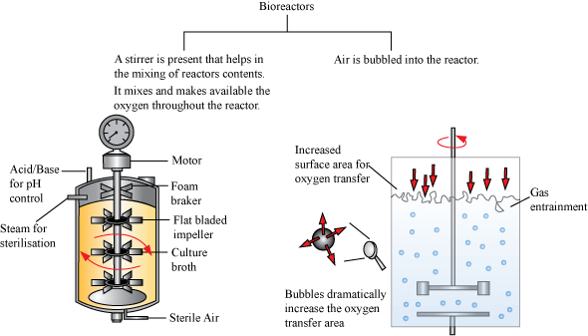
BIOREACTORS:

Slide 6
DOWNSTREAM PROCESSING :
Biosynthesis of many compounds such as enzymes, alcohols, and antibiotics take place within the bioreactor.
The products so obtained are crude and require separation, purification, and finishing, which is done under downstream processing (DSP).
The processes include separation and purification. which are collectively referred to a s downstream processing.
The product has to be formulated with suitable preservatives.
Such formulation has to undergo thorough clinical trials a s in case of drugs. Strict quality control testing for each product is also required
DSP makes a crude bio product marketable.
After such proper processing the product is being sent to market.

Slide 7
THANKING YOU
ODM EDUCATIONAL GROUP

