Slide 1
POPULATION GROWTH, GROWTH MODELS
SUBJECT : BIOLOGY
CHAPTER NUMBER: 13
CHAPTER NAME : ORGANISMS AND POPULATION

Slide 2
POPULATION GROWTH :
The size of a population which keeps on changing depends on various factors:
Food availability
Predation pressure
Weather condition over a period of time
Fluctuation in the population density is due to changes in four basic processes.
NATALITY: Number of births during a given period in the population that are added to the initial population density.
MORTALITY: Number of deaths in the population during a given time period.
IMMIGRATION: Number of individuals of the same species that have come into the habitat from elsewhere during a specific time period.
EMIGRATION: Number of individuals of the population who left the habitat and gone elsewhere during the time period under consideration.

Slide 3
POPULATION GROWTH :
Representing Population Density :
N_{t+1}=N_{t} + [(B+I) – (D+E)]
N_{t} = Population density at time t
N_{t+1}= Population density at time t+1
B = Birth rate
I = Immigration
D = Death rate
E = Emmigration
Population density will increase if the number of births plus the number of immigrants (B + I) is more than the number of deaths plus the number of emigrants (D + E), otherwise, it will decrease.

Slide 4
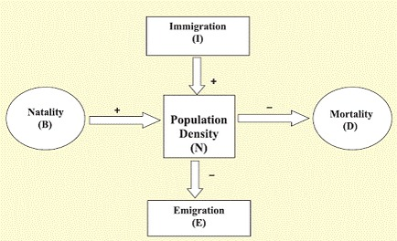
POPULATION GROWTH :

Slide 5
POPULATION GROWTH MODELS:
The growth models can be used to predict the growth of a population with time.
Growth of population takes place according to availability of food, habit condition and presence of other biotic and abiotic factors.
There are two growth models:
Exponential growth
Logistic Growth

Slide 6
EXPONENTIAL GROWTH :
In this kinds growth occurs when food and space is available in sufficient amount. While resources in the habitat are unlimited, each species has the ability to realize fully its innate potential to grow in number.
The population grows in an exponential or geometric fashion. Equation for exponential growth:
dN/dt = (b – d) × N
Let (b–d) = r, then
dN/dt = rN
N= Population size
b = Birth rate
d = Death rate
r = intrinsic rate of natural increase

Slide 7
EXPONENTIAL GROWTH :
It can also be represented as:
N_{t} = N₀ e^{rt}
N_{t} = Population density after time t
N₀ = Population density at time zero
r = intrinsic rate of natural increase
e = the base of natural logarithms (2.71828).

Slide 8
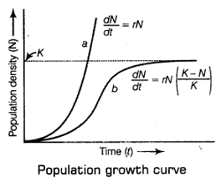
POPULATION GROWTH CURVE :
When N in relation to time is plotted in graph, it results in a J-shaped curve.
a-when responses are not limiting the growth, plot is exponential.
b-when responses are limiting the growth, the plot is logistic.
k-carrying capacity

Slide 9
LOGISTIC GROWTH :
None of the population have unlimited resources at their disposal to support the exponential growth.
Populations with limited resources leads to competition among individuals for the resources.
Eventually, the ‘fittest’ individual will survive and reproduce.
Carrying capacity (K):
It states that a given habitat has enough resources to support a maximum possible number, beyond which no further growth is possible.
A population growing in a habitat with limited resources exhibit initially a lag phase, followed by phases of acceleration and deceleration finally an asymptote when the population density reaches K.
A plot of N in relation to time (t) results in a sigmoid curve and is also called as Verhulst-Pearl Logistic Growth.

Slide 10
LOGISTIC GROWTH :
The logistic growth can be represented by the following equation:
dN/dt = rN [(K-N)/K]
N = Population density at time t
r = Intrinsic rate of natural increase
K = Carrying capacity
Since resources for growth for most animal populations are finite and become limiting sooner or later, the logistic growth model is considered a more realistic one.

Slide 11
THANKING YOU
ODM EDUCATIONAL GROUP

