Slide 1
DNA FINGER PRINTING & IT’S APPLICATION
BASIS & METHOD OF DNA FINGERPRINTING,
DNA POLYMORHISM:
SUBJECT : BIOLOGY
CHAPTER NUMBER: 06
CHAPTER NAME : MOLECULAR BASIS OF INHERITANCE

Slide 2
DNA FINGERPRINTING:
INTRODUCTION :
As stated in the preceding section, 99.9 percent of base sequence among human is the same.
But actually all are unique in their phenotypic appearance.
It is these differences in sequence of DNA which make every individual unique.
To find out genetic differences between two individuals or among individuals of a population, sequencing the DNA every time would be a daunting and expensive task.
DNA fingerprinting is a very quick way to compare DNA sequences of any two individuals.
This technique was invented by Alec Jeffreys (U.K) in 1984 and he is known as father of DNA fingerprinting.

Slide 3
DNA FINGERPRINTING:
BASIS OF DNA FINGERPRINTING:
DNA fingerprinting involves identifying differences in some specific regions In DNA sequence called as repetitive DNA. because In these sequences a small stretch of DNA is repeated many times.
Repetitive DNA is separated from bulk genomic DNA since it appears as a distinct peak during density gradient centrifugation.
Major peak : Formed by bulk DNA. Smaller peak : Satellite DNA.
Depending on base composition (A: T rich or G: C rich) .length of segment and number of repetitive units, satellites are of two types—micro-satellites and mini satellites.
Satellites do not code for proteins, but have a major role to play in DNA fingerprinting.
These sequence show high degree of polymorphism and form the basis of DNA fingerprinting.

Slide 4
DNA FINGERPRINTING:
POLYMORPHISM :
Polymorphism (variation at genetic level) is actually a result of mutation.
A germ cell mutation (which can pass on to the next generation through sexual reproduction) gives rise to polymorphism in populations.
In other words, an inheritable mutation if observed in higher frequencies in a population is known as polymorphism. Allelic sequence annotation has traditionally been described as a DNA polymorphism if more than one variant (allele) at a locus occurs in human population with a frequency greater than
0. 0 I.
In simple terms if an inheritable mutation is observed in a population at high frequency it is referred to as DNA polymorphism.
Polymorphisms arise normally in non-coding sequences may not have any immediate effect/impact but these mutation keep on accumulating generation after generation and form one of the basis of variability /polymorphism.

Slide 5
DNA FINGERPRINTING:
METHODOLOGY OF DNA FINGERPRINTING :
First of all, DNA from an individual is isolated from blood sample, hair or other tissues.
DNA is cut with restriction endonucleases.
Fragments are separated according to their size and molecular weight on gel electrophoresis.
Fragments separated on electrophoresis gel are blotted (immobilized) on a synthetic membrane such as nylon or nitrocellulose.
Immobilized fragments are hybridised with a VNTR probe.
Hybridised DNA fragments can be detected by (X-ray films)autoradiography.

Slide 6
DNA FINGERPRINTING:
METHODOLOGY OF DNA FINGERPRINTING :
VNTR (variable number of tandem repeats) are satellite DNAs that show high degree of polymorphism.
VNTRs are used as probes in DNA fingerprinting.
VNTRs vary in size from 0.1 to 20 kb.
Hence, in the autoradiogram, band of different sizes will be obtained.
These bands are characteristic for an individual. They are different in each individual, except identical twins.

Slide 7
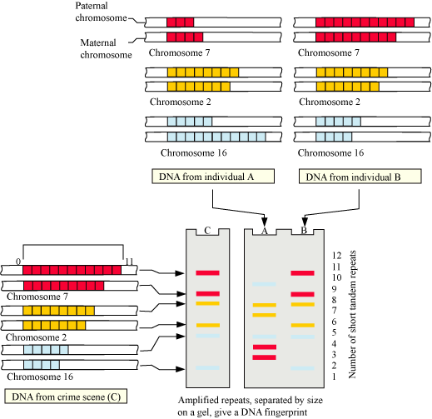
SCHEMATIC REPRESENTATION OF DNA FINGERPRINTING

Slide 8
DNA FINGERPRINTING:
APPLICATIONS OF DNA FINGERPRINTING:
DNA fingerprinting is widely used in forensics since every DNA of every tissue from an individual has the same degree of polymorphism.
DNA fingerprinting forms the basis of paternity testing since a child inherits polymorphism from both its parents.
It can be used for studying genetic diversity in a population and evolution.

Slide 9
THANKING YOU
ODM EDUCATIONAL GROUP

