Slide 1
RICE GENOME PROJECT
SUBJECT : BIOLOGY
CHAPTER NUMBER: 06
CHAPTER NAME : MOLECULAR BASIS OF INHERITANCE

Slide 2
RICE GENOME PROJECT :
INTRODUCTION :
Rice (Oryza sativa) is one of the most important crops in the world.
Rice, wheat, and maize together account for about half of the world's food production, and rice itself is the principal food of half of the world's population .
Rice is the obvious choice for the first whole genome sequencing of a cereal crop.

Slide 3
RICE GENOME PROJECT :
INTRODUCTION :
An International Rice Genome sequencing project (IRGSP) was conceived in September 1997.
Some 32 institutions of ten countries participated in it .
The Indian participants were IARI and university of Delhi.
The tools used in sequencing were BAC (bacterial artificial chromosomes) and PAC (P1- phage derived artificial chromosome).
The map based draft sequence was released in December , 2002.

Slide 4
RICE GENOME PROJECT :
Rice has the smallest genome amongst the major cereals with only 389 million base pairs.
The number of genes is, however high ,some 37544.
Many of them occur in clustered gene families.
Nearly 0.4% of nuclear genes contain organelle DNA segments.
Number of transposons is quite high, some 35%.
18.9 million SNPs and 80,127 polymorphic sites occur in the genome.
There are five varietal groups in rice :
(1) Basmati (2) Indica (3) Aus (4) Tropical and Japonica (5) Temporate japonica

Slide 5
RICE GENOME SEQUENCING:

Slide 6
DNA FINGERPRINTING:
METHODOLOGY OF DNA FINGERPRINTING :
First of all, DNA from an individual is isolated from blood sample, hair or other tissues.
DNA is cut with restriction endonucleases.
Fragments are separated according to their size and molecular weight on gel electrophoresis.
Fragments separated on electrophoresis gel are blotted (immobilized) on a synthetic membrane such as nylon or nitrocellulose.
Immobilized fragments are hybridised with a VNTR probe.
Hybridised DNA fragments can be detected by (X-ray films)autoradiography.

Slide 7
DNA FINGERPRINTING:
METHODOLOGY OF DNA FINGERPRINTING :
VNTR (variable number of tandem repeats) are satellite DNAs that show high degree of polymorphism.
VNTRs are used as probes in DNA fingerprinting.
VNTRs vary in size from 0.1 to 20 kb.
Hence, in the autoradiogram, band of different sizes will be obtained.
These bands are characteristic for an individual. They are different in each individual, except identical twins.

Slide 8
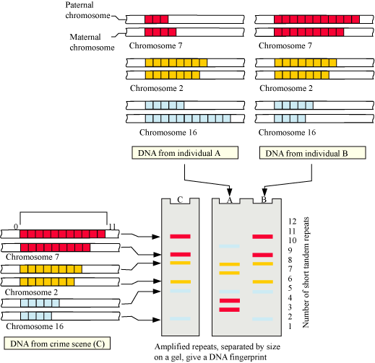
SCHEMATIC REPRESENTATION OF DNA FINGERPRINTING

Slide 9
DNA FINGERPRINTING:
APPLICATIONS OF DNA FINGERPRINTING:
DNA fingerprinting is widely used in forensics since every DNA of every tissue from an individual has the same degree of polymorphism.
DNA fingerprinting forms the basis of paternity testing since a child inherits polymorphism from both its parents.
It can be used for studying genetic diversity in a population and evolution.

Slide 10
THANKING YOU
ODM EDUCATIONAL GROUP

