Slide 1
THE ADAPTER MOLECULE & PROCESS OF TRANSLATION
TRANSLATION MACHINERY, STEPS IN TRANSLATION
SUBJECT : BIOLOGY
CHAPTER NUMBER: 06
CHAPTER NAME : MOLECULAR BASIS OF INHERITANCE

Slide 2
THE ADAPTER MOLECULE :
t RNA (TRANSFER RNA) :
It was clear to Francis Crick that there has to be a mechanism to read the code and also to link it to the amino acids because amino acids have no structural specialities to read the code uniquely.
He postulated the presence of on adapter molecule (t RNA) that would on one hand read the code and on other hand would bind to specific amino acids.
The tRNA then called snRNA (soluble RNA) was known before the genetic code was postulated .
The tRNA is a small RNA with length of 70-85 nucleotides which is folded over itself.
The secondary structure of tRNA has been depicted that looks like a clover-leaf.
In actual structure the tRNA is a compact molecule which looks like inverted L .

Slide 3
THE ADAPTER MOLECULE :
t RNA (TRANSFER RNA) :
The t RNA take part in transferring amino acids from cellular pool to ribosome for polymerisation to form polypeptide as per the code over m RNA. Hence t RNA is known as adapter molecule.
The tRNA has two recognition sites :
Anticodon site : This site is complementary to a codon of mRNA.
(B) Amino acid binding site : This site is present at 3’ end of tRNA with CCA-OH group.
The tRNA contains two loops TΨC loop and DHU loop.
TΨC loop is for attaching of ribosomes and the DHU loop for binding with the amino acid activating enzymes.

Slide 4
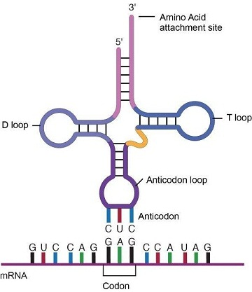
FIGURE SHOWING ADAPTER MOLECULE :

Slide 5
TRANSLATION MACHINERY :
It is the process in which coded genetic message brought by mRNA from DNA is changed into polypeptide chain with a sequence of amino acids similar to the sequence of codons present over mRNA.
Translation machinery consists of various materials required for translation like ribosomes, amino acids , mRNA, tRNA.
RIBOSOMES :
Ribosomes are made up of rRNA and some protein molecules. Prokaryotic ribosomes are of 70S type and eukaryotic are of 80S type.
Ribosomes possess both smaller and larger subunit which remain in dissociated form in cytoplasm. The smaller subunit in prokaryotes is 30S and larger subunit is 50S,whereas in eukaryotes the smaller subunit is 40S and larger subunit is 60S.
The subunits of ribosome binds to mRNA and then provide for attachment of tRNA for protein synthesis .
In eukaryotes the synthesis of polypeptide occurs generally with one ribosome whereas in prokaryotes many ribosomes (polysomes) remain attached to mRNA for synthesis of multiple copies of same polypeptide

Slide 6
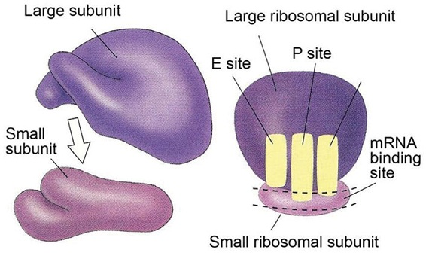
FIGURE SHOWING THE STRUCTURE OF RIBOSOME:

Slide 7
TRANSLATION MACHINERY :
mRNA :
mRNA functions as template , which is flanked by a start codon and a stop codon.
The number of cistron depends on monocistronic and polycistronic DNA which synthesis polypeptides as per the information of DNA .
AMINO ACIDS :
Twenty amino acids participate in building proteins. They are called protein amino acids.
Inspite of their number being small, they can produce different types of proteins.
AMINO ACYL tRNA SYNTHETASE :
This is an important enzyme for combining a particular tRNA to its particular amino acid.
Each tRNA possess a specific site for attachment of this enzyme and there is a separate synthetase enzyme for each type of tRNA.

Slide 8
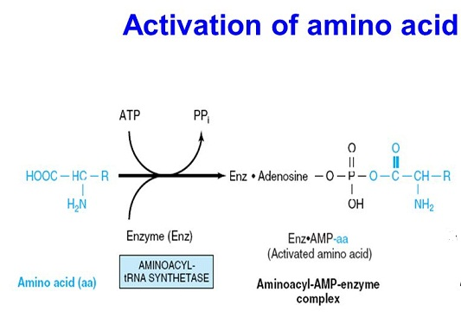
STEPS IN TRANSLATION :
ACTIVATION OF AMINO ACIDS :
It is carried out by enzyme aminoacyl synthetase. In the presence of ATP an amino acid combines with specific aminoacyl tRNA synthetase to form a complex which activates the amino acids.

Slide 9
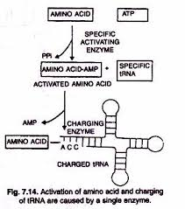
STEPS IN TRANSLATION :
CHARGING OR AMINOACYLATION OF tRNA :
tRNA specific for activated amino acid attaches itself with the help of its loop to aminoacyl AMP enzyme complex.
This attachment occurs at CCA-OH group of 3’ end of tRNA.
It produces new complex called aminoacyl tRNA complex. Then the synthetase separates from the complex.
The tRNA with its attached amino acid is called charged tRNA.

Slide 10
THANKING YOU
ODM EDUCATIONAL GROUP

