Slide 1
PROCESS OF TRANSLATION
STEPS IN TRANSLATION
SUBJECT : BIOLOGY
CHAPTER NUMBER: 06
CHAPTER NAME : MOLECULAR BASIS OF INHERITANCE

Slide 2
TRANSLATION :
Translation is the process in which coded genetic message brought by mRNA from DNA is changed into polypeptide chain with a sequence of amino acids similar to the sequence of codons present over mRNA.
The translation machinery triggers the process of protein synthesis along with two important steps like activation of amino acids and the charging of tRNA .
A cistron is coded as translational unit over the mRNA. It is flanked by start codon and a stop codon.
This translational unit is read by single ribosome in eukaryotes and polysomes (polyribosome) in prokaryotes and specific amino acids are coded.
The process of translation consists of 3 steps :
Initiation.
Elongation.
Termination.
Like that of transcription it requires many initiation factors ,enzymes and termination factors.

Slide 3
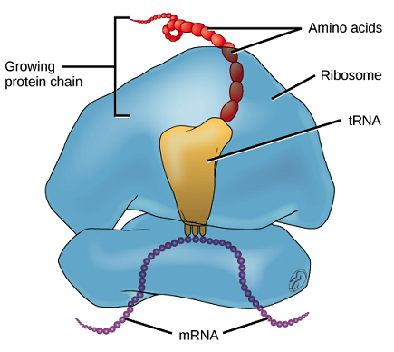
TRANSLATION MACHINERY :

Slide 4
TRANSLATION :
INITIATION :
The step is accomplished with the help of factors called as initiation factors.
The 5’ region of mRNA provides the site for attachment of small subunit of ribosome
.
This association brings the initiation or start codon of mRNA over P site of ribosome.
As start codon AUG codes for methionine , the amino acid is brought by a charged tRNA .
This met- charged tRNA reaches P-site of ribosome . The anticodon of tRNA establishes linkage with AUG codon.
After this larger subunit attaches to smaller subunit having initiation complex and then the complete ribosome moves along the mRNA chain for further process.

Slide 5
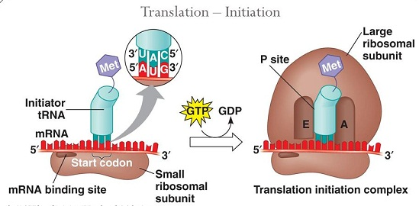
FIGURE SHOWING TRANSLATION - INITIATION :

Slide 6
TRANSLATION :
ELONGATION :
After formation of complete ribosome-mRNA-tRNA complex an aminoacyl acceptor A site is established next to P site.
The A site exposes the mRNA codon next to AUG (after AUG upon mRNA)new aminoacyl tRNA complex reaches and binds to A site of ribosome.
when subsequent .amino acids remain close enough to each other, it leads to formation of a peptide bond.
The ribosome also acts as a catalyst for the formation of peptide bond.
In bacteria 23SrRNA act as the enzyme (ribozyme) which allows the peptide bond formation.
Soon after the formation of peptide bond the tRNA of P site becomes free and moves to E site and then slips away from the complex.
The peptidyl bearing tRNA on A site comes to lie on P site and the A site now become free for new codon.

Slide 7
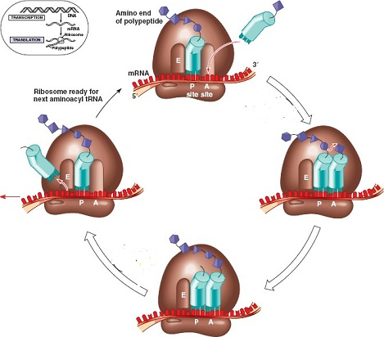
FIGURE SHOWING TRANSLATION-ELONGATION :

Slide 8
TRANSLATION :
TERMINATION :
When the A site of ribosome reaches the termination or stop codon the protein synthesis process stops.
The 3 stop codons (UAA, UAG, UGA) do not code for any amino acids so no charged tRNA gets attracted by those codons.
At the end a release factor binds to the stop codon terminating translation and releasing the complete polypeptide from the ribosome.
It brings the about separation of polypeptide from terminal tRNA.
The two ribosomal subunits also dissociates under the influence of release factor.
This leads to the process of termination of translation.

Slide 9
FIGURE SHOWING TRANSLATION- TERMINATION :

Slide 10
THANKING YOU
ODM EDUCATIONAL GROUP

