Slide 1
BIOMOLECULES
CLASSIFICATION OF ENZYMES, COFACTORS
SUBJECT : (BIOLOGY)
CHAPTER NUMBER: 9
CHAPTER NAME : BIOMOLECULES

Slide 2
Classification and Nomenclature of Enzymes
Enzymes are divided into 6 classes each with 4-13 subclasses and named accordingly by a four-digit number.
Earlier, enzymes were assigned names based on the one who discovered it. With further researches, classification became more comprehensive.
According to the International Union of Biochemists (I U B), enzymes are divided into six functional classes and are classified based on the type of reaction in which they are used to catalyze.
The six types of enzymes are oxidoreductases, hydrolases, transferases, lyases, isomerases, ligases.

Slide 3
Following are the enzymes classifications in detail:
Types | Biochemical Property
Oxidoreductases | The enzyme Oxidoreductase catalyzes the oxidation reaction where the electrons tend to travel from one form of a molecule to the other.
Transferases | The Transferases enzymes help in the transportation of the functional group among acceptors and donors molecules.
Hydrolases | Hydrolases are hydrolytic enzymes, which catalyze the hydrolysis reaction by adding water to cleave the bond and hydrolyze it.
Lyases | Adds water, carbon dioxide or ammonia across double bonds or eliminate these to create double bonds.
Isomerases | The Isomerases enzymes catalyze the structural shifts present in a molecule, thus causing the change in the shape of the molecule.
Ligases | The Ligases enzymes are known to charge the catalysis of a ligation process.

Slide 4
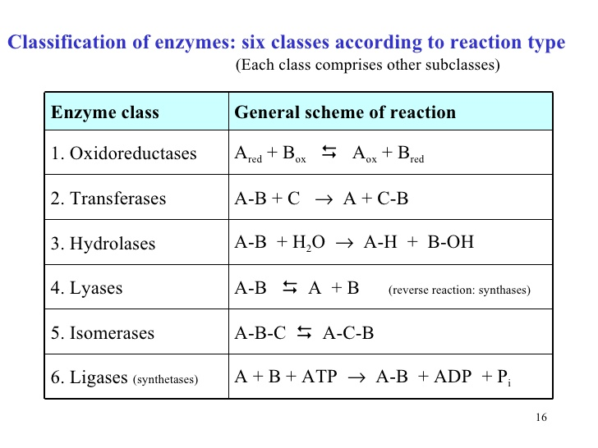

Slide 5
.
Oxidoreductases
These catalyze oxidation and reduction reactions,e.g. pyruvate dehydrogenase, which catalyzes the oxidation of pyruvate to acetyl coenzyme A.
S reduced + S’ oxidised S oxidised + S’ reduced.
Transferases
These catalyze the transfer of a chemical group from one compound to another.
An example is a transaminase, which transfers an amino group from one molecule to another.
S - G + S’ S + S’ - G
Hydrolases
They catalyze the hydrolysis of a bond. For example, the enzyme pepsin hydrolyzes peptide bonds in proteins.
Enzymes catalysing hydrolysis of ester, ether, peptide, glycosidic, C-C, C-halide or P-N bonds.
Lyases
These catalyze the breakage of bonds without catalysis, e.g. aldolase (an enzyme in glycolysis) catalyzes the splitting of fructose-1, 6-bisphosphate to glyceraldehyde-3-phosphate and dihydroxyacetone phosphate.

Slide 6
Isomerases
They catalyze the formation of an isomer of a compound.
Example: phosphoglucomutase catalyzes the conversion of glucose-1-phosphate to glucose-6-phosphate (transfer of a phosphate group from one position to another in the same compound) in glycogenolysis (conversion of glycogen to glucose for quick release of energy.
Ligases
Ligases catalyze the joining of two molecules. For example, DNA ligase catalyzes the joining of two fragments of DNA by forming a phosphodiester bond.

Slide 7
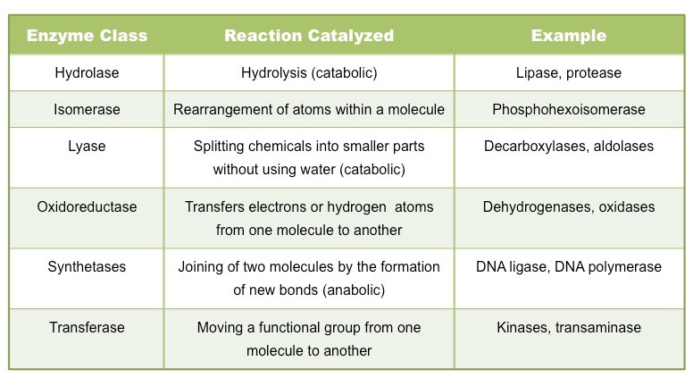

Slide 8
Cofactors
Enzymes are composed of one or several polypeptide chains.
However, there are a number of cases in which non-protein constituents called cofactors are bound to the the enzyme to make the enzyme catalytically active.
In these instances, the protein portion of the enzymes is called the apoenzyme.
An enzyme without a cofactor is called an apoenzyme. An apoenzyme and its cofactor together constitute the holoenzyme.
Three kinds of cofactors may be identified: prosthetic groups, co-enzymes and metal ions.
Prosthetic groups are organic compounds and are distinguished from other cofactors in that they are tightly bound to the apoenzyme.
For example, in peroxidase and catalase, which catalyze the breakdown of hydrogen peroxide to water and oxygen, haem is the prosthetic group and it is a part of the active site of the enzyme.

Slide 9
Co-enzymes are also organic compounds but their association with the apoenzyme is only transient, usually occurring during the course of catalysis.
Furthermore, co-enzymes serve as co-factors in a number of different enzyme catalyzed reactions.
The essential chemical components of many coenzymes are vitamins, e.g., coenzyme nicotinamide adenine dinucleotide (NAD) and NADP contain the vitamin niacin.
A number of enzymes require metal ions for their activity which form coordination bonds with side chains at the active site and at the same time form one or more cordination bonds with the substrate, e.g., zinc is a cofactor for the proteolytic enzyme carboxypeptidase.
Catalytic activity is lost when the co-factor is removed from the enzyme which testifies that they play a crucial role in the catalytic activity of the enzyme

Slide 10
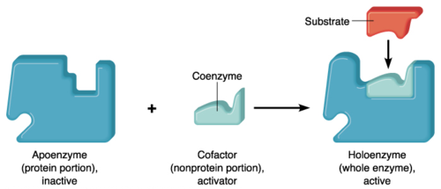

Slide 11
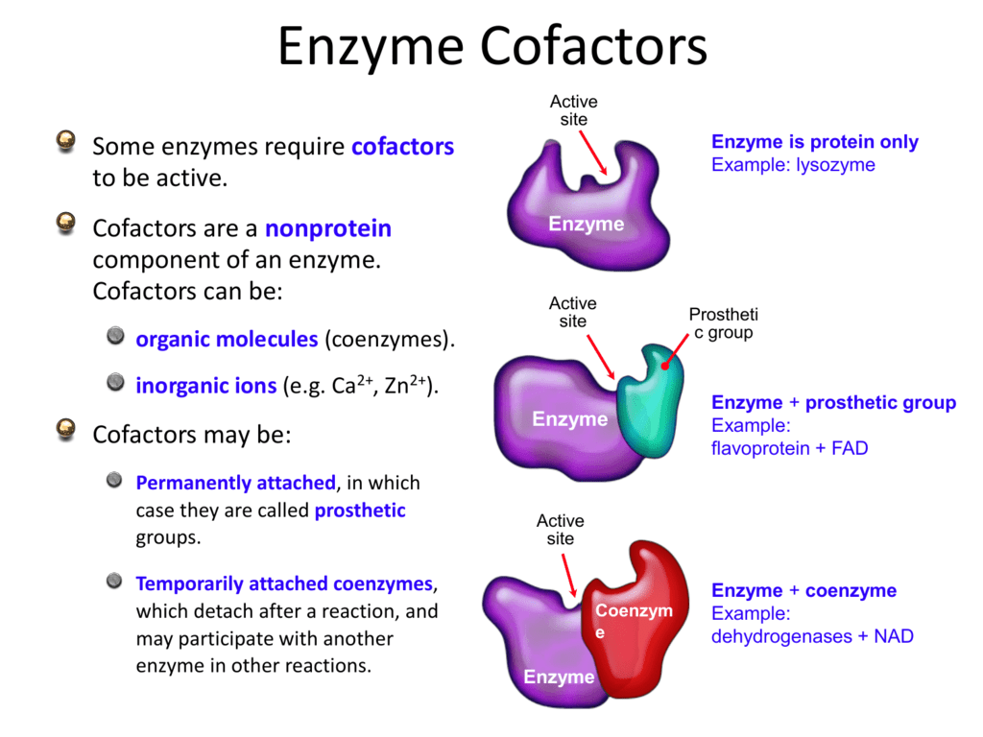

Slide 12
Coenzyme | Cofactor
Meaning
It carries chemical groups between enzymes | They bind to an enzyme
Also known as
Cosubstrates | Helper molecules
Bind
Coenzyme loosely bound to enzymes | Some cofactors covalently bound the enzyme
Removal
Can be easily removed | It can be removed only by denaturation
Form
Chemical molecule | Chemical compound
Characteristic
Organic substances | Inorganic substances
Types
It is a type of cofactor | Two types of cofactors: Coenzyme and prosthetic groups
Function
They act as carriers | Increase the speed of reaction
Examples
Biotin, Vitamin, Coenzyme A | Metal ions such as k+, Zn 2+

Slide 13
THANKING YOU
ODM EDUCATIONAL GROUP

