Slide 1
BIOMOLECULES
AMINOACIDS
SUBJECT : (BIOLOGY)
CHAPTER NUMBER: 9
CHAPTER NAME : BIOMOLECULES

Slide 2
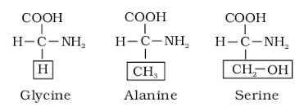
AMINOACIDS
Aminoacids are organic compounds containing an amino group an acidic group as substituent's on the same carbon i.e., the α carbon. Hence, they are called α –amino acids.
They are substituted methanes. There are four substituents group occupying the four valency positions.
These are hydrogen,carboxyl group, amino group and a variable group designated as R group.
Based on the nature of R group there are many amino acids. However, those which occur in proteins are only of twenty types.
The R group in these proteinaceous amino acids could be a hydrogen (the amino acid is called glycine), a methyl group (alanine), hydroxy methyl (serine), etc.

Slide 3
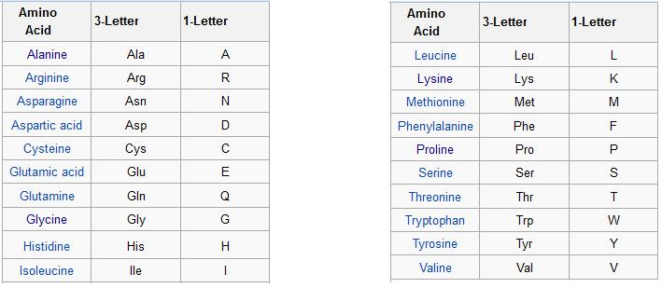
α-amino acids
All α-amino acids have trivial names, which usually reflect the property of that compound or its source.
Glycine is so named since it has sweet taste (in Greek glykos means sweet)
Tyrosine was first obtained from cheese (in Greek, tyros means cheese)
Amino acids are generally represented by a three letter symbol, sometimes one letter symbol is also used. There are 20 α-amino acids known.
Symbols for 20 α-amino acids are given below:

Slide 4
AMINO ACIDS CLASSIFICATION
The physical and chemical properties of aminoacids are essentially of amino group, carboxyl and the R functional groups.
Amino acids are classified as acidic, basic or neutral depending upon the relative number of amino and carboxyl groups in their molecule.
Equal number of amino and carboxyl groups makes it neutral. Ex: valine, glycine, alanine, serine
More number of amino than carboxyl groups makes it basic. Ex: lysine
More carboxyl groups as compared to amino groups makes it acidic. Ex: glutamic acid
Similarly there are aromatic aminoacids like tyrosine, phenylalanine, tryptophan.

Slide 5
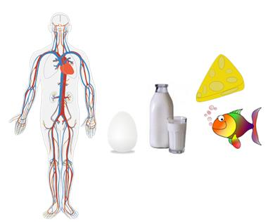
Amino acids are further classified as essential & Non-essential amino acids depending upon their synthesis.
The amino acids, which can be synthesised in the body, are known as nonessential amino acids. The number is 13 but one in adult and two in children are slow to be formed. Examples: Alanine, Cysteine, Glutamate
Those which cannot be synthesised in the body and must be obtained through diet are called essential amino acids (7 in number). Examples: Histidine, Valine, Lysine
Semi essential amino acids: Human adults require an additional aminoaci named threonine while children need two more (arginine and histidine).
Histidine can be obtained from egg, soya, peanuts, sesame
Lysine can be obtained from egg, soya, fish
Valine can be obtained from egg, soya, sesame
Protein having coded aminoacids are protein aminoacids while those non coded aminoacids are rare aminoacid.

Slide 6
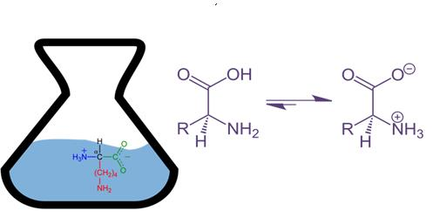
Zwitter Ion
A particular property of amino acids is the ionizable nature of – NH₂ and –COOH groups.
Hence in solutions of different pHs, the structure of amino acids changes.
When Amino acid is put in aqueous solution, Carboxyl group loses H+ and NH₂ group gains H+.
Overall remains neutral, but CO⁻ and NH₃⁺ are formed,
Amino acid shows amphoteric behavior, i.e. it acts like both acid and base. This behavior is seen only in aqueous medium.

Slide 7
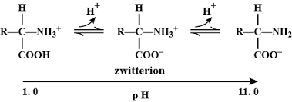

Slide 8
THANKING YOU
ODM EDUCATIONAL GROUP

