Slide 1
PHOTOSYNTHESIS IN HIGHER PLANTS
CHEMIOSMOTIC HYPOTHESIS AND CALVIN CYCLE
SUBJECT : BIOLOGY
CHAPTER NUMBER: 13
CHAPTER NAME : PHOTOSYNTHESIS IN HIGHER PLANTS

Slide 2
KEYWORDS
CHEMIOSOMIS
C3 CYCLE

Slide 3
Chemiosmotic Hypothesis
“The chemiosmotic hypothesis suggests that the action of ATP synthase is coupled with that of a proton gradient.
It is the action of the proton gradient that causes a proton motive force that allowsATP synthase to phosphorylate ADP and inorganic phosphate to ATP.”
Peter Mitchell in the year 1961 postulated this hypothesis which explains the mechanism of synthesis of ATP during photosynthesis, in chloroplast.
During light reaction or photochemical phase, ATP and NADP are generated and these are the key components used in dark reaction for production of sugar molecule.
According to chemiosmotic hypothesis, ATP production is the outcome of photon gradient across the membrane of thylakoids.
The essential components required in this process are proton gradient, proton pump and ATP synthase (enzyme that helps ATP synthesis).

Slide 4
The activation of electrons and their transport to determine the steps that cause a proton gradient to develop.
(a) Since splitting of the water molecule takes place on the inner side of the membrane, the protons or hydrogen ions that are produced by the splitting of water accumulate within the lumen of the thylakoids.
(b) As electrons move through the photosystems, protons are transported across the membrane.
This happens because the primary accepter of electron which is located towards the outer side of the membrane transfers its electron not to an electron carrier but to an H carrier.
Hence, this molecule removes a proton from the stroma while transporting an electron.
When this molecule passes on its electron to the electron carrier on the inner side of the membrane, the proton is released into the inner side or the lumen side of the membrane.

Slide 5
(c) The NADP reductase enzyme is located on the stroma side of the membrane.
Along with electrons that come from the acceptor of electrons of PS I, protons are necessary for the reduction of NADP+ to NADPH+ H+ .
These protons are also removed from the stroma.
Hence, within the chloroplast, protons in the stroma decrease in number, while in the lumen there is accumulation of protons.
This creates a proton gradient across the thylakoid membrane as well as a measurable decrease in pH in the lumen.

Slide 6
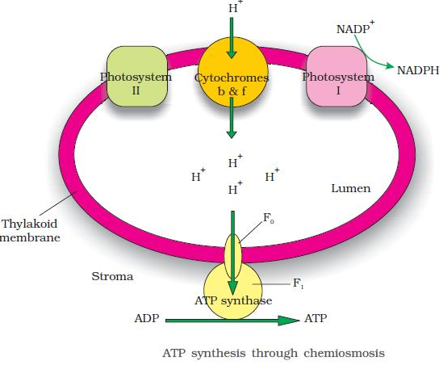

Slide 7
Importance of Proton Gradient
The Proton Gradient is important in this process because it is the breakdown of this gradient result in release of energy.
This gradient is broken down due to the movement of proton across membrane via transmembrane channel of F_{o} of ATPase.
The ATPase enzyme consists of two parts: one called the F0 is embedded in the membrane and forms a transmembrane channel that carries out facilitated diffusion of protons across the membrane.
The other portion is called F1 and protrudes on the outer surface of the thylakoid membrane on the side that faces the stroma.
The break down of the gradient provides enough energy to cause a conformational change in the F1 particle of the ATPase, which makes the enzyme synthesise several molecules of energy-packed ATP.

Slide 8
Chemiosmosis requires a membrane, a proton pump, a proton gradient and ATPase.
Energy is used to pump protons across a membrane, to create a gradient or a high concentration of protons within the thylakoid lumen.
ATPase has a channel that allows diffusion of protons back across the membrane; this releases enough energy to activate ATPase enzyme that catalyses the formation of ATP.
Along with the NADPH produced by the movement of electrons, the ATP will be used immediately in the biosynthetic reaction taking place in the stroma, responsible for fixing CO₂ , and synthesis of sugars.

Slide 9
Where are the ATP and NADPH used?
We are aware of the products of light reaction, i.e. ATP, NADPH and O₂.
Amongst these O₂diffuses out of chloroplast and ATP and NADPH helps in driving the process leading to food synthesis and forming sugars.
It is also referred as biosynthetic phase of photosynthesis and this process does not depend on the presence of light, rather it depends on the product of light reaction.
It is carried out in stroma of chloroplast.
Definition of Biosynthetic Phase
“Biosynthetic Phase is the process by which carbon dioxide is reduced to carbohydrates and the process is termed as carbon fixation; it makes use of the ATP and NADPH produced in the light phase.
This process occurs in the stroma of chloroplasts with the help of series of enzyme-catalysed reactions.”

Slide 10
How ATP and NADPH are used in Biosynthetic Phase?
CO₂ is combined with H₂O to produce sugar.
Scientist were very eager to find out how this reaction proceeded and just after Second World War, the use of radioisotope 14C led to the discovery that the first CO₂ fixation product was 3 – Carbon Organic Acid.
Melvin Calvin contributed in answering this and therefore, the complete biosynthetic pathway is named as Calvin Cycle.
The first identified product was PGA, i.e. 3 – Phosphoglyeric Acid.
Scientist also worked hard to understand if all plants have PGA as a first product of CO₂fixation, or some other product is found in plants.
In this direction, several experiments were carried out and it resulted in the discovery of another group of plants, where the first stable product was organic acid.
This acid was identified as Oxaloacetic Acid (OAA). Thus, assimilation of CO₂ during photosynthesis is carried out in two main ways:
The C₃ pathway The C₄ pathway

Slide 11
The Calvin Cycle
In Calvin Cycle, Carbon atoms from CO₂ are fixed and are used to form three – Carbon Sugar.
This process is dependent on ATP and NADPH formed from light reactions.
The light reaction is carried out in thylakoid membrane while the Calvin Cycle takes place in stroma.
The Calvin cycle can be described in three stages:
Carboxylation – It is the fixation of CO₂ in stable organic intermediate.
It is an important stage in Calvin Cycle where CO₂ is utilized for carboxylation of RuBP in the presence of enzyme RuBP carboxylase.
It results in the formation of 2 molecules of 3-PGA.
RuBPcarboxylase also helps in oxygenation activity and is therefore also referred as RuBP carboxylase – oxygenase (RuBisCO).

Slide 12
Reduction – This stage includes series of reactions that result in the formation of glucose.
This step utilizes 2 molecules of ATP (for phosphorylation) and two molecules of NADPH(for reduction per CO₂ molecule).
The fixation of 6 molecules of CO₂ and 6 turns of cycle result in the removal of 1 molecule of glucose from pathway.
Regeneration – This stage includes regeneration of CO₂ acceptor molecule and requires 1 ATP for phosphorylation to form RuBP.

Slide 13
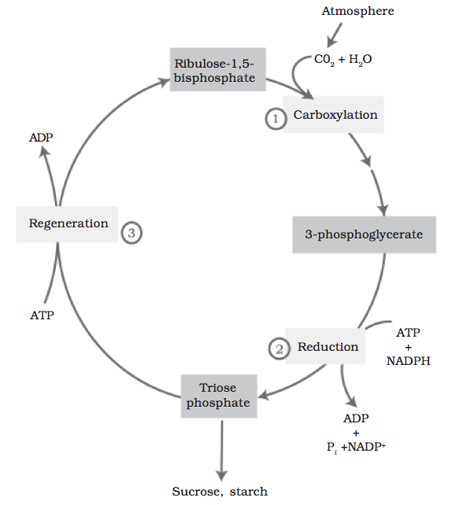
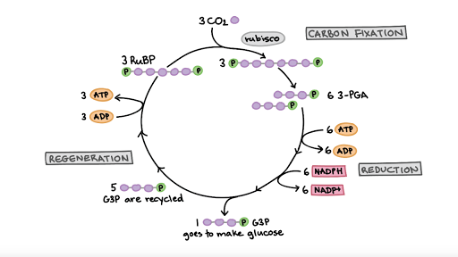
The cycle starts with carboxylation, followed by reduction and then, finally regeneration.
The last stage includes regeneration of CO₂ acceptor molecule and requires 1 ATP for phosphorylation to form RuBP.

Slide 14
Reactions in Calvin Cycle
Thus, the reactions are divided in three different stages:
Carbon Fixation – A CO₂ molecule combines with 5 C acceptor molecule and RuBP.
This step makes 6 Carbon compound that splits into 2 molecules of 3 Carbon compound and 3PGA. The reaction is catalyzed by RuBP carboxylase or oxygenase.
Reduction – At the second stage, ATP and NADPH are converted to 3 PGA molecules into molecules of a three carbon sugar and G3P (glyceraldehyde–3–phosphate).
Regeneration – At the final stage, 3GP molecules go to make glucose while other may be recycled to regenerate RuBP acceptor.
The process of regeneration requires ATP along with complex network of reactions.
For exiting cycle, three CO₂ molecules enter the cycle for exiting 3GP molecule.
This provides three new atoms of fixed carbon.
Entering of 3CO₂ molecules, results in regeneration of 3 molecules of RuBP acceptor.

Slide 15
THANKING YOU
ODM EDUCATIONAL GROUP

