Slide 1
PHOTOSYNTHESIS IN HIGHER PLANTS
C4 CYCLE, PHOTORESPIRATION , FACTORS AFFECTING PHOTOSYNTHESIS
SUBJECT : BIOLOGY
CHAPTER NUMBER: 13
CHAPTER NAME : PHOTOSYNTHESIS IN HIGHER PLANTS

Slide 2
The C₄ Pathway
Plants that carry out C₄ pathways comprise of specific enzyme that are located in two different cell types, i.e. Mesophyll Cells and Bundle – Sheath Cells.
This pathway is the method that is used by plants to convert atmospheric carbon dioxide in chemical compound containing four carbons.
This pathway is used by the plants in subtropical areas such as Sugar Cane, Maize, Millet, Papyrus and Sorghum.
These plants are special and have several type of leaf anatomy, i.e. they can tolerate higher temperature and also show response to high light intensity.

Slide 3
The particularly large cells around the vascular bundles of the C₄ pathway plants are called bundle sheath cells, and the leaves which have such anatomy are said to have ‘Kranz’ anatomy. ‘Kranz’ means ‘wreath’ and is a reflection of the arrangement of cells.
The bundle sheath cells may form several layers around the vascular bundles; they are characterised by having a large number of chloroplasts, thick walls impervious to gaseous exchange and no intercellular spaces.
The leaves of C4 plants – maize or sorghum – to observe the Kranz anatomy and the distribution of mesophyll cells.

Slide 4
This pathway is cyclic in nature. The primary CO₂ acceptor is 3-Carbon Molecule PEP (phosphoenol pyruvate) and is present in mesophyll cells.
PEPcase or PEP carboxylase is the enzyme that is responsible for this fixation.
It is important to note that the mesophyll cells do not have RuBisCO enzyme and C₄ acid OAA is formed within cells.
After this, 4 - carbon compounds like aspartic acid or malic acid are formed in mesophyll cells which are then transported to bundle sheath cells, where C₄ acids are broken down to release Carbon Dioxide (CO₂) and three carbon molecules.
These 3 Carbon molecules are transported back to mesophyll cells where it gets converted in PEP, thereby completing the cycle.
The CO₂released enters in bundle sheath cells and thereby the Calvin pathway.
These bundle sheath cells have surplus of an enzyme called RuBisCO (Ribulose Biphosphate Carboxylase – Oxygenase) and is deficient in PEPcase.

Slide 5
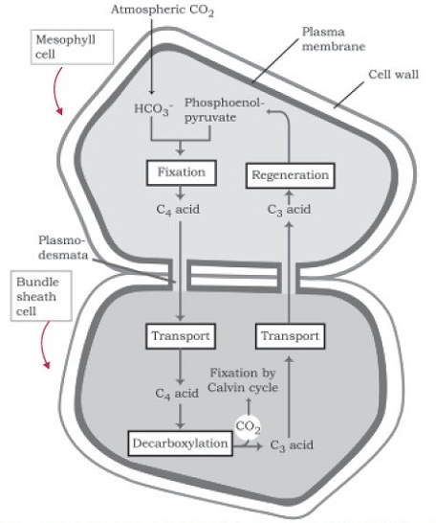
C₄ pathway

Slide 6
Photorespiration
Photorespiration is a biochemical process in plants in which, especially under conditions of water stress, oxygen inhibits the Calvin cycle, the carbon fixation portion of photosynthesis.
Photorespiration results in light dependent uptake of O₂ and release of CO₂ and is associated with metabolism and synthesis of small molecule named glycolate.
This process simultaneously takes place in green plants along with photosynthesis.
Its end result decreases the net amount of CO₂ and both photosynthesis and photorespiration works opposite to each other.

Slide 7
Factors affecting Photorespiration
The rate of photorespiration increases at any time when the level of carbon dioxide is low and oxygen is high.
Such condition occurs when stomata remain partially closed or completely closed and photosynthesis is underway.
Majority of time, the stomata of plants are open, resulting in lowering down the rate of photorespiration.
But when plants become water stressed, they close stomata to prevent loss of water via transpiration.
Thus, on the other hand, restricts the normal exchange of gases.
The level of CO₂ gradually rises as water splits during light reaction.
In desert and dry tropical areas, photorespiration is reduced due to water stress and this on the other hand, results in lowering down the potential of plant growth.
Some plants have adapted to this problem by modifying the way they carry out photosynthesis.
One of the common adaptations is called C₂ Metabolism in which plants develop different leaf anatomy called Kranz Anatomy.

Slide 8
Factors affecting Photosynthesis
When several factors affect any [bio] chemical process, Blackman’s (1905) Law of Limiting Factors comes into effect.
This states the following: If a chemical process is affected by more than one factor, then its rate will be determined by the factor which is nearest to its minimal value: it is the factor which directly affects the process if its quantity is changed.
For example, despite the presence of a green leaf and optimal light and CO₂ conditions, the plant may not photosynthesise if the temperature is very low.
This leaf, if given the optimal temperature, will start photosynthesising.

Slide 9
There are several factors that affect the rate of photosynthesis. These factors are both internal and external factors:
Temperature – When carbon dioxide, light and other factors are not limiting, photosynthesis rate increases with the rise in temperature. The most preferred range of temperature is 6° C – 37° C.
High temperature results in inactivation of enzymes and thereby affects enzymatically controlled dark reactions.
Carbon Dioxide Concentration – It is the major limiting factor and its concentration is very low in atmosphere, i.e. 0.03 – 0.04%.
Increase in concentration to 0.05% causes increase in fixation rate of CO₂.
Added to this, the C₃ and C₄ plants differently respond to the concentration of carbon dioxide.
“The fact that C₃ plants respond to higher CO₂concentration by showing increased rate of photosynthesis leading to higher productivity has been used for some greenhouse crops like bell pepper and tomatoes.”
Such plants are allowed to grow in CO₂ enriched environment that leads to higher yields.

Slide 10
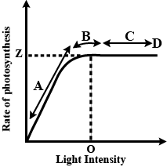
Light – The light varies as per quality, duration and intensity and has significant impact on the rate of photosynthesis.
For instance, there is a linear relationship between incident light and CO₂ fixation at low light intensities.
Added to this, increase in the incident light beyond point causes breakdown of chlorophyll and decrease in photosynthesis.

Slide 11
Oxygen – Oxygen inhibits photosynthesis in C₃ plants but C₄ plants show little effect.
This is so because C₄ plants carry out photorespiration and high oxygen stimulates it.
The rate of photosynthesis increases with the reduction of concentration of oxygen.
Water – It is an essential raw material for the assimilation of carbon. Less than one percent of absorbed water is utilized in photosynthesis.
The decrease of water content in soil decreases the rate of photosynthesis as well.
This is so because it results in dehydration of protoplasm and also results in stomatal closure.
Added to this, it impairs enzymatic efficiency, affects its colloidal state, inhibits respiration, etc.

Slide 12
THANKING YOU
ODM EDUCATIONAL GROUP

