Slide 1
BIOMOLECULES
CONCEPT OF METABOLISM, THE LIVING STATE
SUBJECT : (BIOLOGY)
CHAPTER NUMBER: 9
CHAPTER NAME : BIOMOLECULES

Slide 2
DYNAMIC STATE OF BODY CONSTITUENTS – CONCEPT OF METABOLISM
Metabolism is defined as the total amount of the biochemical reactions involved in maintaining the living conditions of the cells in an organism.
All living organisms require energy for different essential processes and for producing new organic substances.
The entire process of nutrition has two main parts- ingestion of food and utilization of food for energy.
In every living organism, let it be a simple prokaryotic bacterial cell or a eukaryotic cell, the process of nutrition is the same.

Slide 3
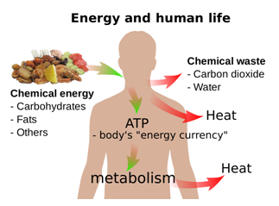

Slide 4
Concept of Metabolism
Here comes the concept of metabolism.
Metabolism is the sum total of all the chemical reactions taking place in the cells of the living organisms. This involves both breaking and making of biomolecules.
Catabolism and anabolism are two types of metabolism.
Catabolism (breaking of bonds) involves the breaking of biomolecules while anabolism (making of bonds) is the building of new compounds required by the cells.
The food which we eat happens to be useless until and unless it undergoes metabolic changes.
During metabolism, biomolecules present in the food get utilized to extract the energy from the cell.
In addition, conversion and formation of the biomolecules take place.
In other words, the transformation of one compound results in the formation of another molecule.
For example, the proteins we obtained from the food are metabolized into amino acids, which are later utilized to synthesize another protein required by the cell.

Slide 5
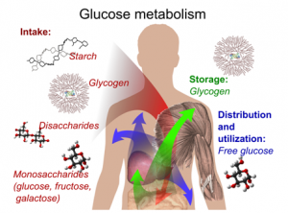
.

Slide 6
Each of the metabolic reactions results in the transformation of biomolecules.
A few examples for such metabolic transformations are: removal of CO2 from amino acids making an amino acid into an amine, removal of amino group in a nucleotide base; hydrolysis of a glycosidic bond in a disaccharide, etc.
We can list tens and thousands of such examples.
Majority of these metabolic reactions do not occur in isolation but are always linked to some other reactions.
In other words, metabolites are converted into each other in a series of linked reactions called metabolic pathways.
These metabolic pathways are similar to the automobile traffic in a city.
These pathways are either linear or circular. These pathways crisscross each other, i.e., there are traffic junctions.
Flow of metabolites through metabolic pathway has a definite rate and direction like automobile traffic.

Slide 7
This metabolite flow is called the dynamic state of body constituents.
The most important is that this interlinked metabolic traffic is very smooth and without a single reported mishap for healthy conditions.
Another feature of these metabolic reactions is that every chemical reaction is a catalysed reaction.
There is no uncatalysed metabolic conversion in living systems.
Even CO2 dissolving in water, a physical process, is a catalysed reaction in living systems.
The catalysts which hasten the rate of a given metabolic conversation are also proteins.
These proteins with catalytic power are named enzymes.

Slide 8
All metabolic changes take place in multiple reactions and follow a particular pathway called the metabolic pathway.
The metabolic pathway includes a series of reactions.
The metabolite flow, the rate, and direction at which metabolism takes place are called the dynamic state of body constituents.
All metabolic reactions are catalyzed by a set of proteinaceous compounds called enzymes.
Hence, metabolism is an enzyme-catalyzed reaction which provides biomolecules, needed by the cells for growth, maintenance, and repair etc.
The purposes of metabolic pathways in the below three points:
To extract energy from the food for cellular activities.
To convert food to building blocks, to synthesize biomolecules such as carbohydrates, proteins, lipids and nucleic acids.
To eliminate waste and toxic products.

Slide 9
Metabolism:The Basis For Living And Living State
Metabolism is the sum total of chemical reactions taking place in the cells of the living organisms.
All metabolic changes that take place are in multiple reactions and follow a particular pathway called the metabolic pathway.
This metabolic pathway includes a series of reactions which involve both breaking and making of biomolecules.
In other words, metabolism results in either complex compounds, being formed from simple molecules or simple micromolecules, being formed from complex molecules.

Slide 10
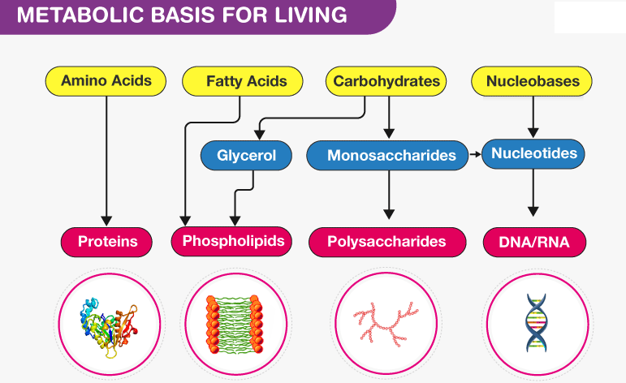
Metabolic Basis For Living

Slide 11
Metabolic pathways involve the extraction of energy by breaking molecules and using this energy to synthesize the building blocks.
The process of metabolism occurs in two phases namely anabolism and catabolism.
The metabolic pathway in which a complex molecule is produced from simple molecules is called an anabolic pathway.
Since it involves the synthesis of metabolites, it is also known as the biosynthetic pathway.
For example, amino acids become proteins.
The catabolic pathway is another metabolic pathway where a more complex structure is broken down into simple molecules.

Slide 12
Glycolysis is an example of the catabolic pathway where more complex 6-C glucose molecule is reduced to 3-C pyruvic acid.
Anabolism takes place at the expense of energy i.e., anabolic pathways need energy input and consume energy.
Catabolism liberates energy.
Energy is released when glucose is converted to lactic acid.
In living organisms, the liberated energy packs are stored and reserved for later use.
Living systems use this stored energy for making new bonds (anabolism), mechanical work and other purposes in the form of adenosine triphosphate (ATP).

Slide 14
Metabolism and The Living State
Every living organisms use and release the energy.
As we know, each living organism, be it a prokaryotic protozoan or eukaryotic fungi, are composed of thousands of biomolecules/metabolites.
But the proportion varies.
Within an organism, the concentration of one biomolecule may be more or less than the concentration of another biomolecule.
And this non-equilibrium state of metabolites keeps them in a steady state. As they say, ‘systems at equilibrium cannot perform work’.
A living system can never be in equilibrium as they are continuously undergoing metabolism; energy is released and used continuously.
Metabolism helps to maintain a non-equilibrium steady-state in organisms and thus, they are in living state.
It can be concluded that to be in a living state, it is important to be in a non-equilibrium state.

Slide 15
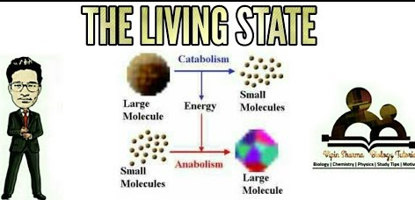
Hence the living state is a non-equilibrium steady-state to be able to perform work; living process is a constant effort to prevent falling into equilibrium. This is achieved by energy input.
Metabolism provides a mechanism for the production of energy.
Hence the living state and metabolism are synonymous.
Without metabolism there cannot be a living state.

Slide 16
THANKING YOU
ODM EDUCATIONAL GROUP

