Slide 1
WELCOME TO THE ONLNE CLASS
SUBJECT—MATHS
TOPIC – NUMBER NAMES 3,4

Slide 2
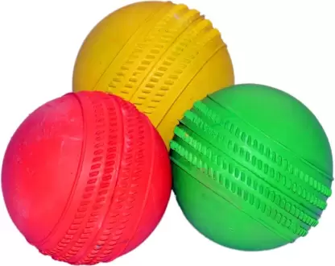
THREE

Slide 3
FOUR

Slide 4
THANKING YOU
ODM EDUCATIONAL GROUP

