Slide 1
ODM Public School welcomes you to the Mid Term Parents Teachers Meet 2023 Class - III B
Class Teacher - Sumitamayee Sahoo

Slide 2
Subject Teachers
English - Pooja Ma’am
Hindi - Rohini & Bushra Ma’am
Odia - Sumita Ma’am
Maths - Gitabali Ma’am
Science - Vandana Ma’am
Social Science - Mita Ma’am

Slide 3
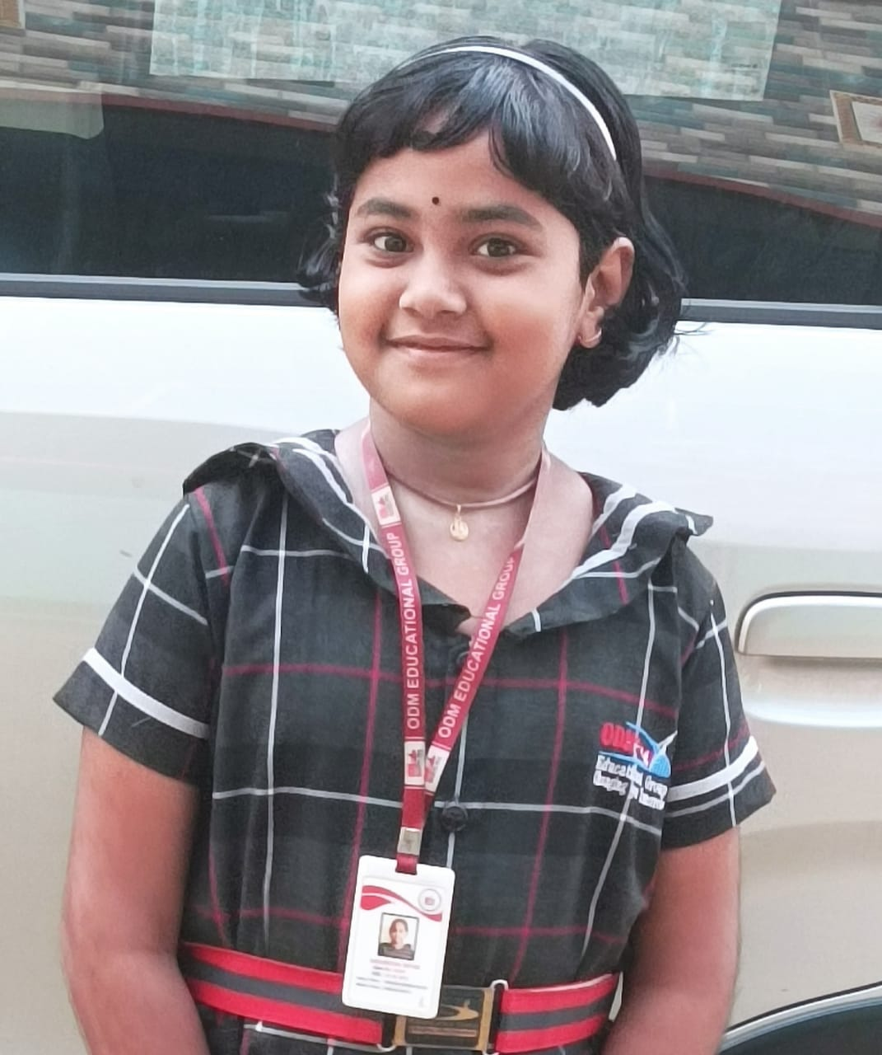
Awesome
She is a determined child and a hard worker, just needs a little push in Math and she will rock.
Aakanksha Nayak

Slide 4
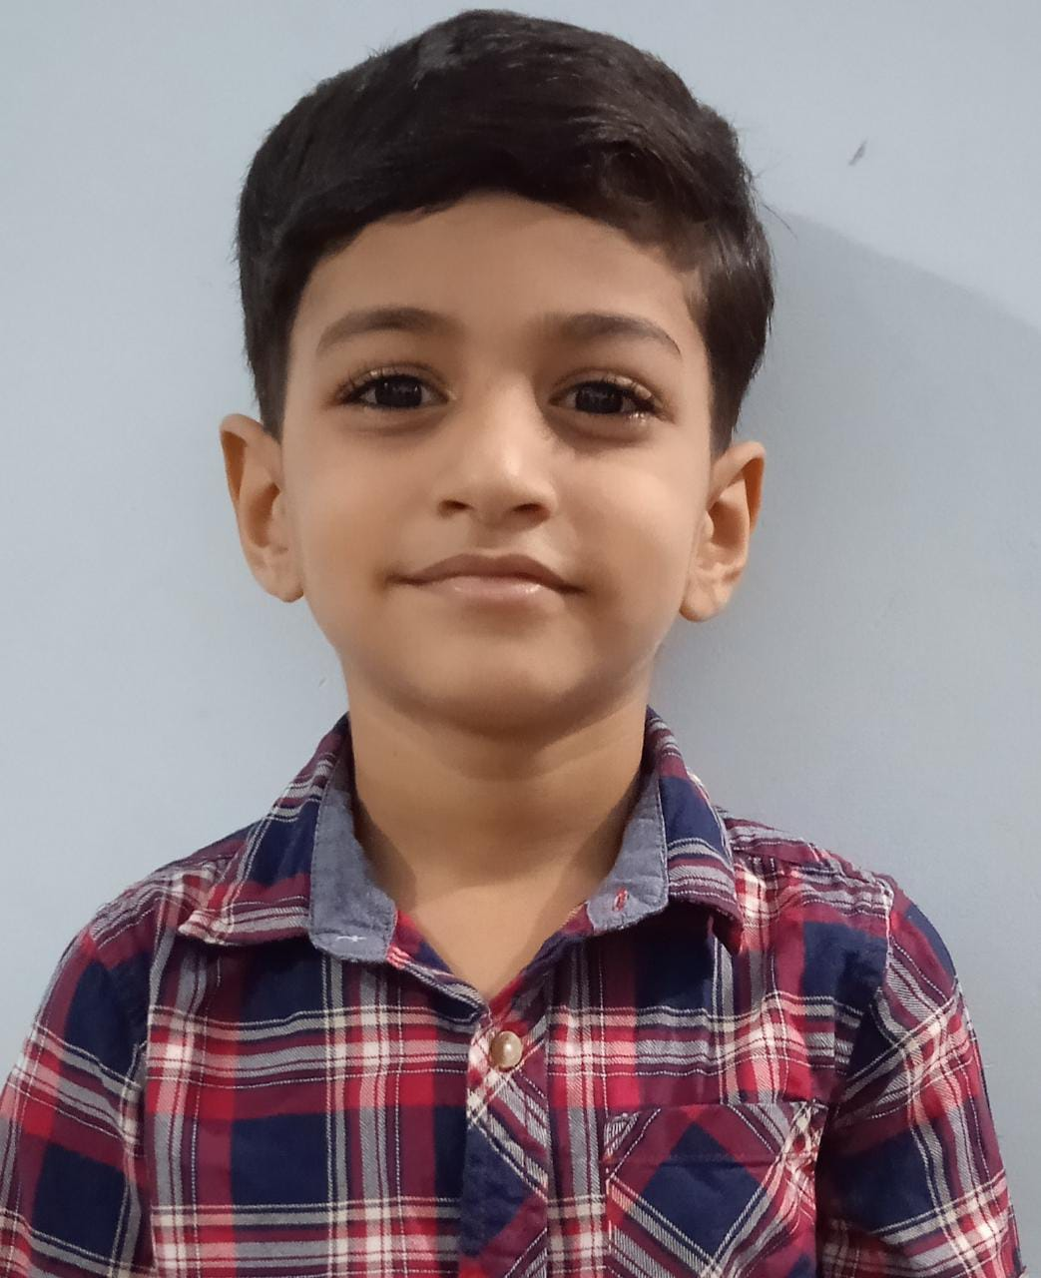
Smart
He is smart and actively participate in co-curricular activities. But he needs to improve his sub-Hindi and English, he will definitely rock.
AMITYA TRIPATHY

Slide 5
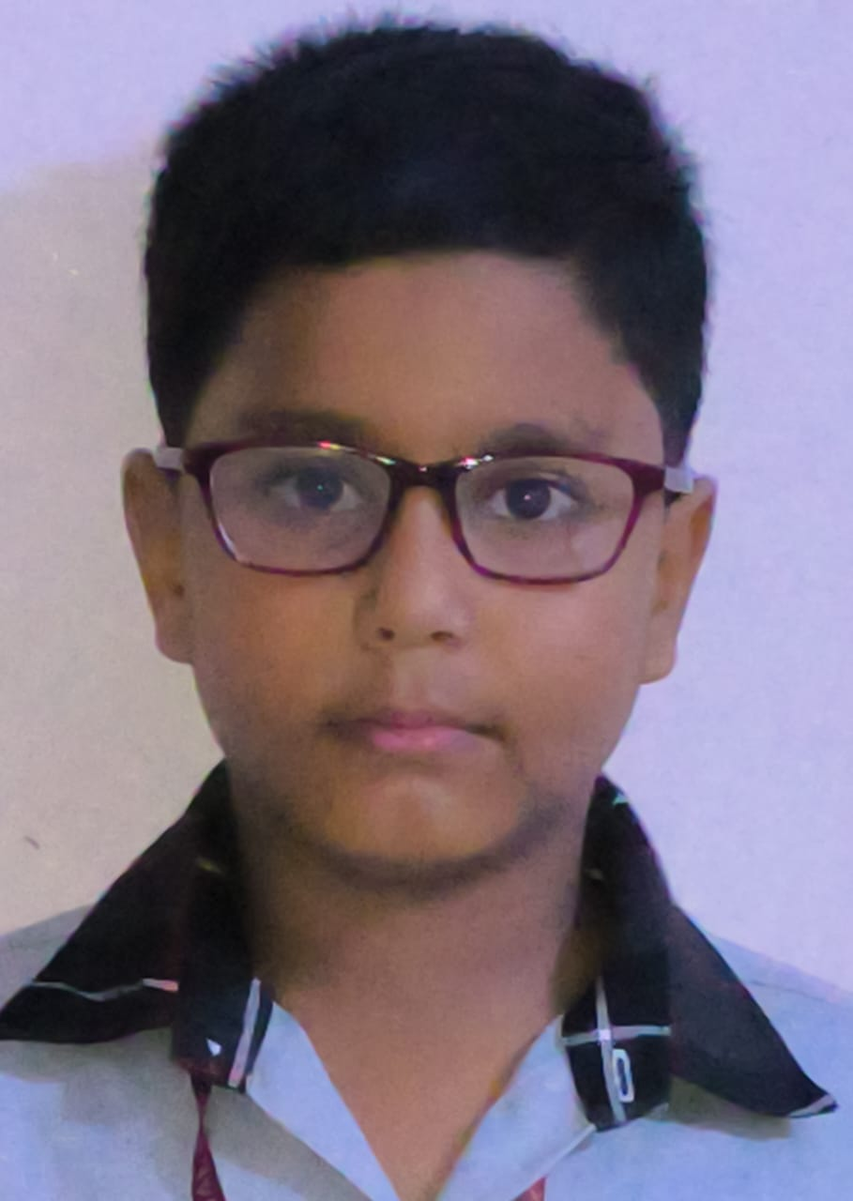
Evergreen
He is doing great in all subjects except Maths and will definitely do wonders in the upcoming exam.
AMLAN PRADHAN

Slide 6
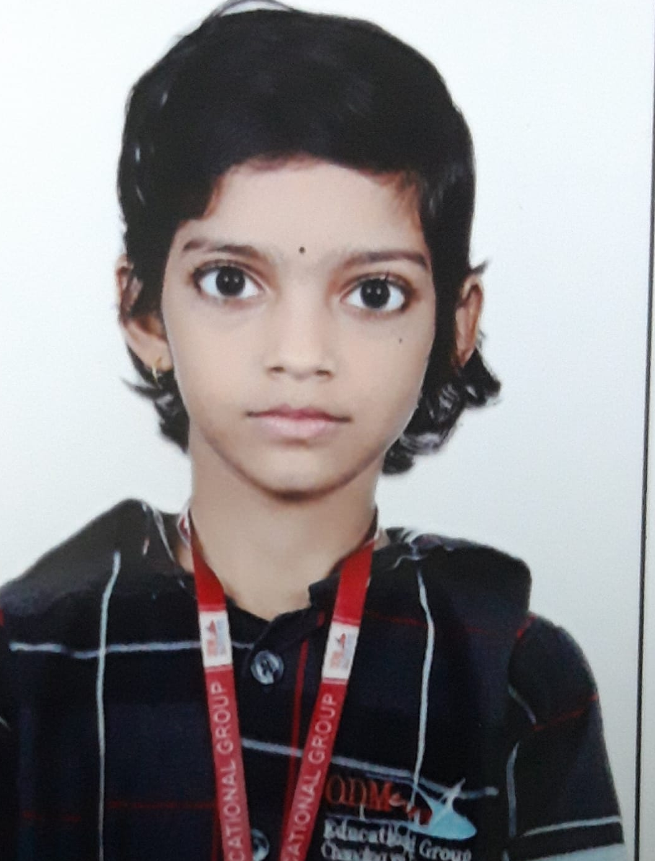
Ambitious
She is doing great in her studies just needs to be more active in co-curricular activities.
ANAHITA GAURAV

Slide 7
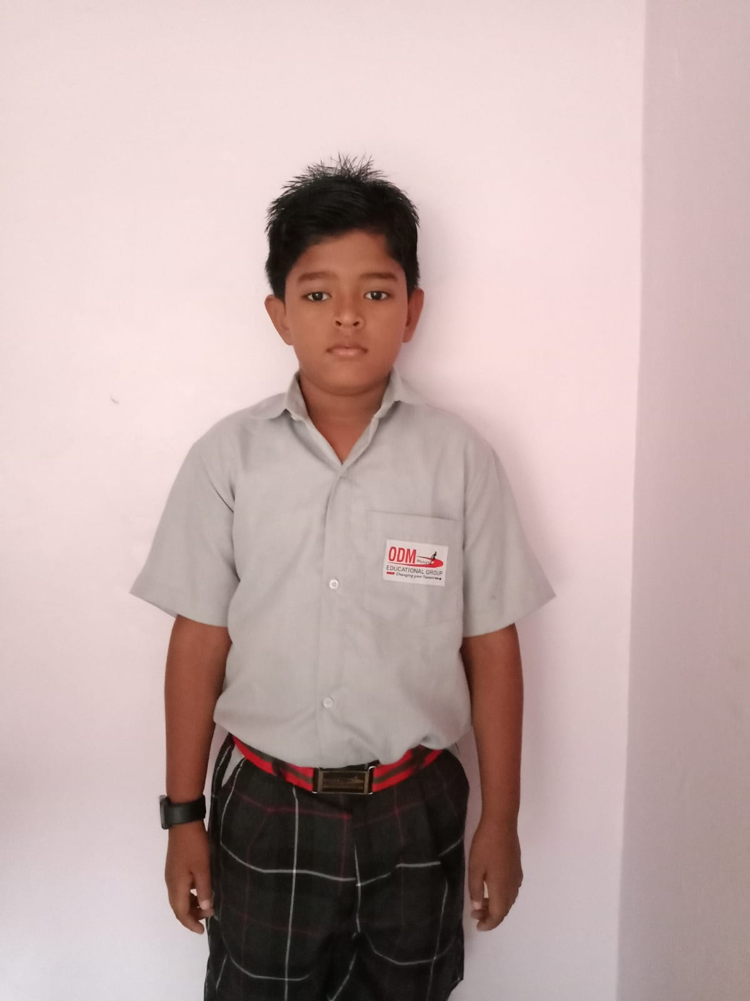
Capable
He is great in all subjects except Maths and will definitely do wonders in the upcoming exam.
ANAND SAHOO

Slide 8
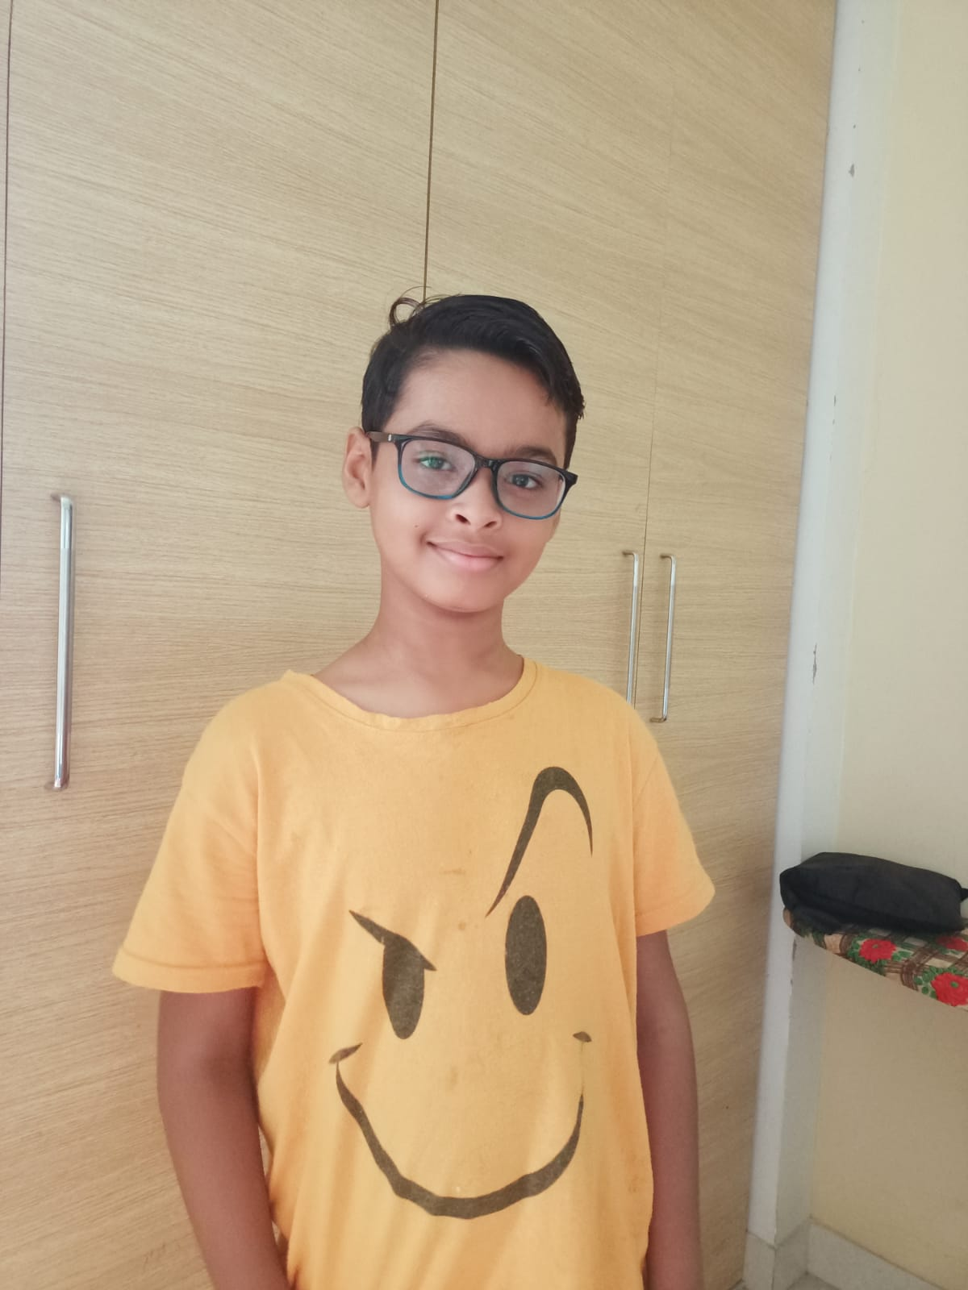
Curious
He is a active child and has done well in all subjects except Hindi and SST , he has to work on it which he will do.
ANIRBHAN ROUT

Slide 9
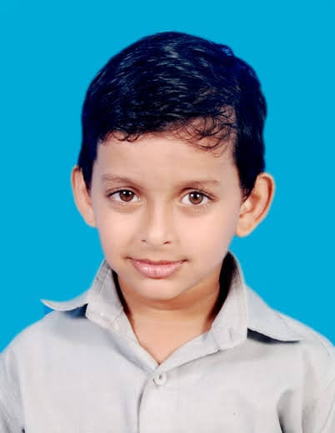
Affectionate
He is an active boy with the capability of doing great in his studies.
ANSUMAN PANDA

Slide 10
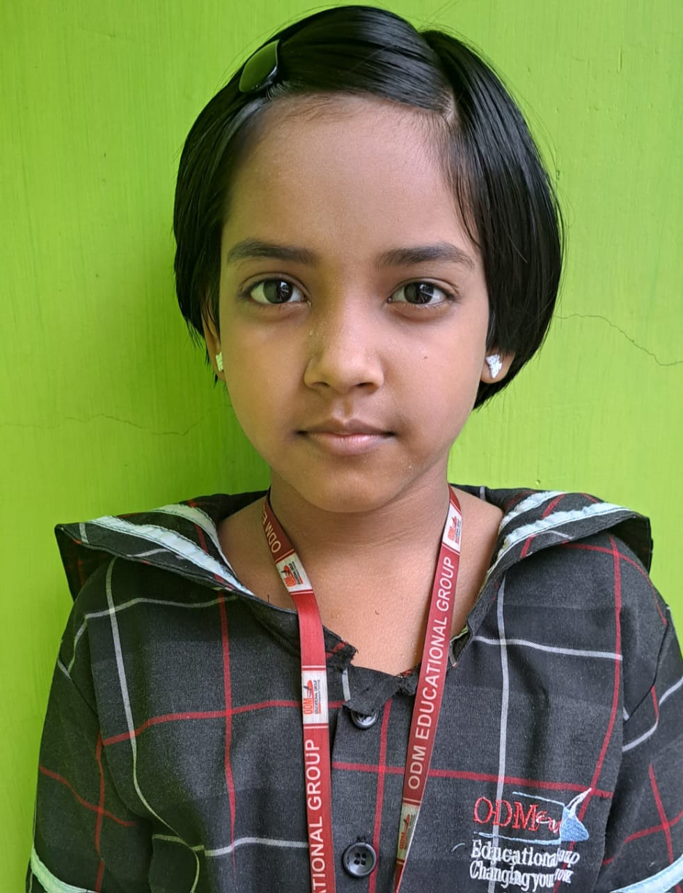
Sincere
She is a good girl with sincerity, but has to build up confidence to grow and excel.
ANWESHA BARIK

Slide 11
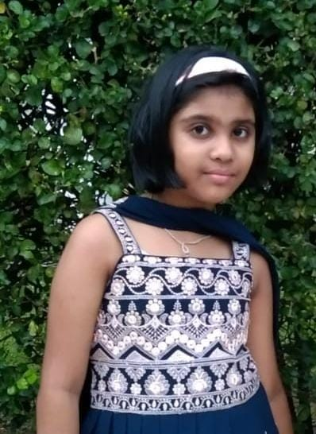
Hard Working
She is a hard working girl with the ability of excelling well just a little care and push and she will do great.
ARADHYA SINGH

Slide 12
Capable
She is a determined child just needs a little push, hard work & concentration in SST & Science. Just a little hardwork and care will help her to grow and do better.
ARPITA SATAPATHY

Slide 13
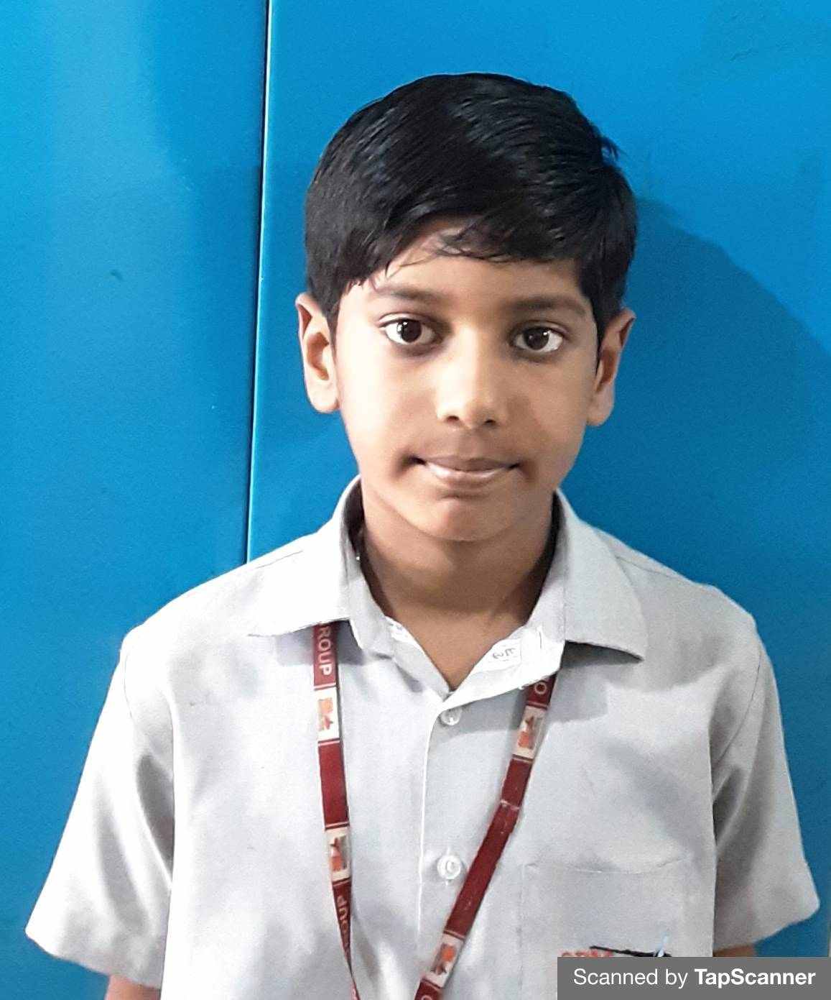
Curious
He is a active boy with good studies, just a little bit of care in Language will make him confident and he will grow better.
ARYA ADIPTA SAHU

Slide 14
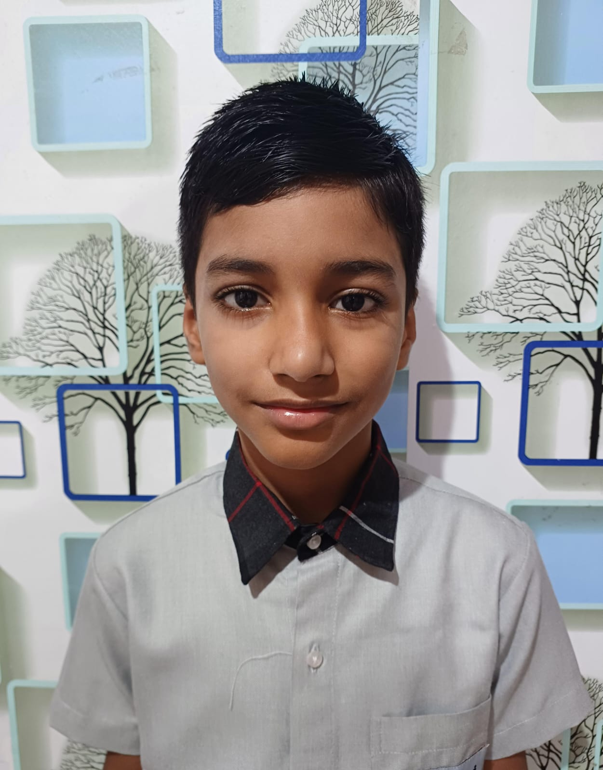
Ambitious
He is a focused child with confidence and sincerity in the things that he does. He has done well and will continue with that.
ATHARV JHA

Slide 15
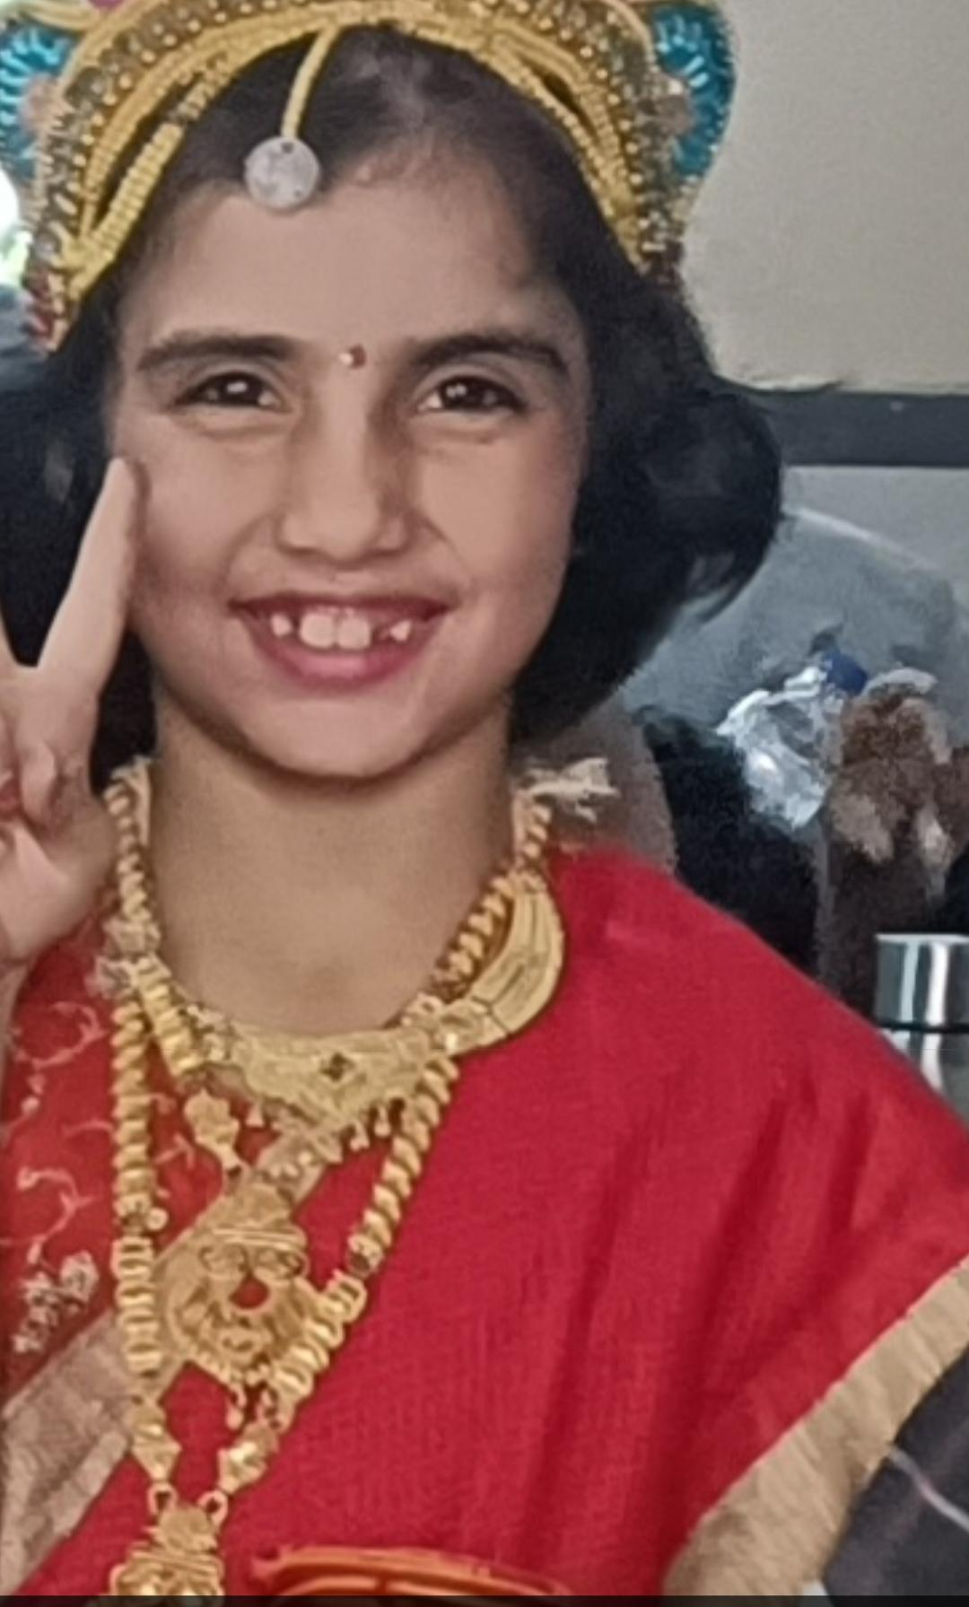
Amiable
She is a friendly girl and very empathetic towards others. She just needs to be focused and practice well in order to excel in her studies, which she will definitely do by working hard.
AVNI THAKUR

Slide 16
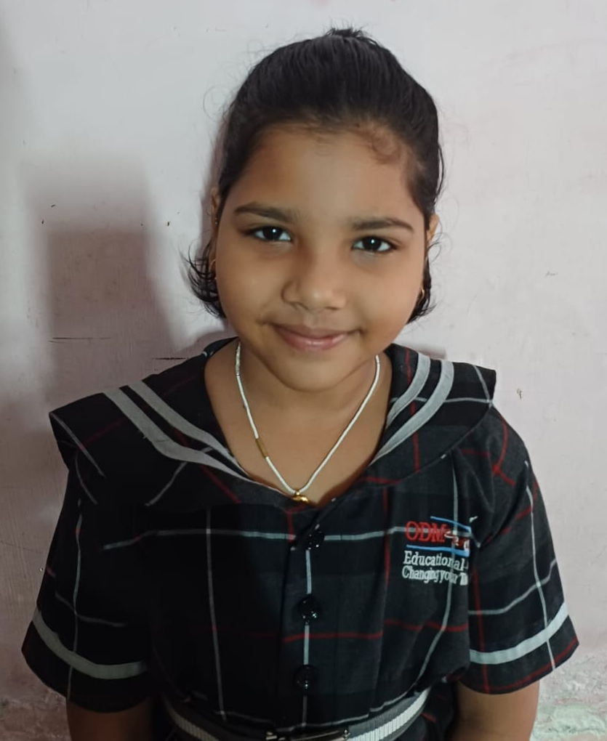
Diligent
She is a sincere and hard working girl, who stays focused, just a little push is required and then she would grow well.
AYESHA NAYAK

Slide 17
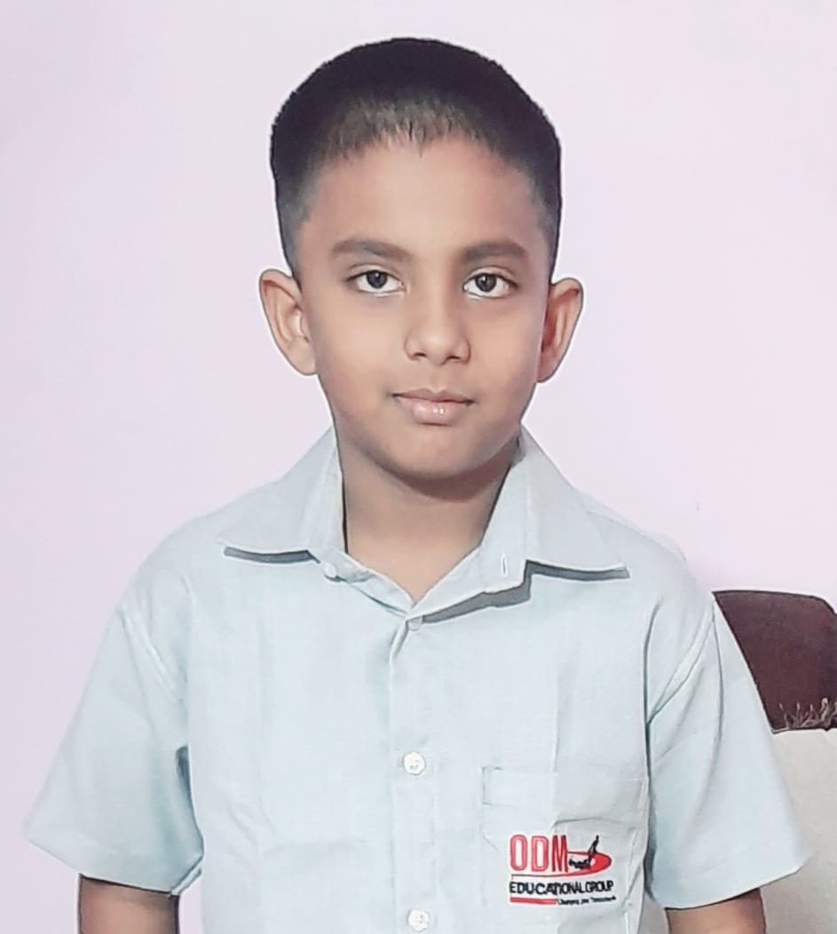
Courteous
He is a sincere boy who completes his work perfectly, just keep going.
AYUSHMAN BARAL

Slide 18
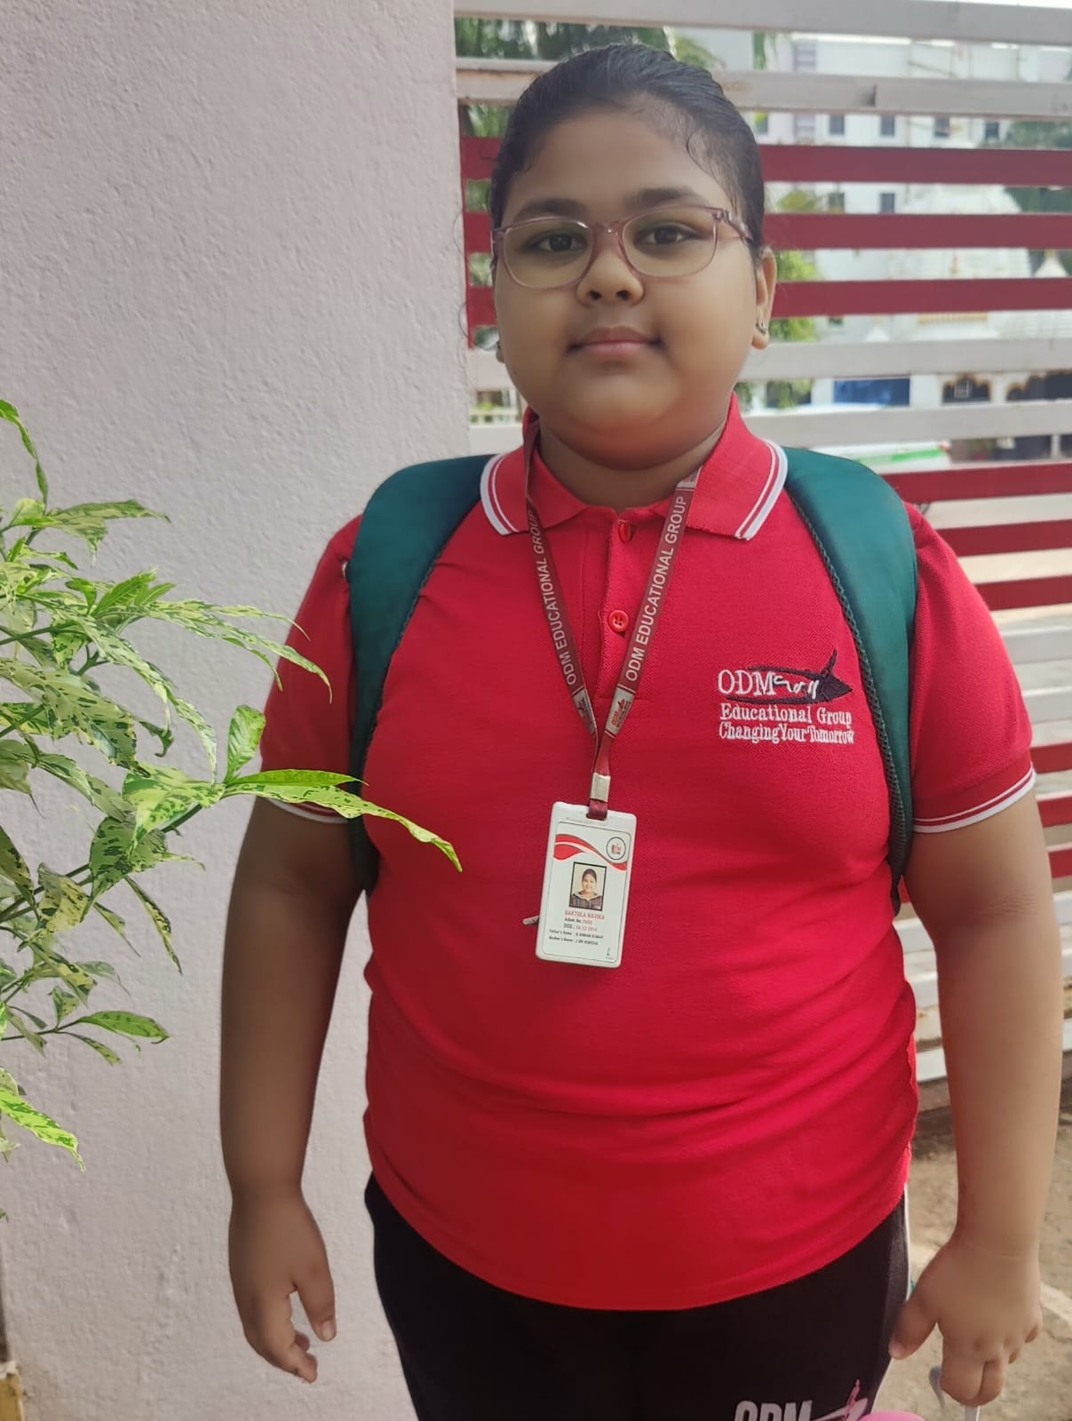
She is doing great in some subjects except Maths , Hindi and will definitely do wonders in the upcoming exam.
Amiable
BAKTULA NAVIKA

Slide 19
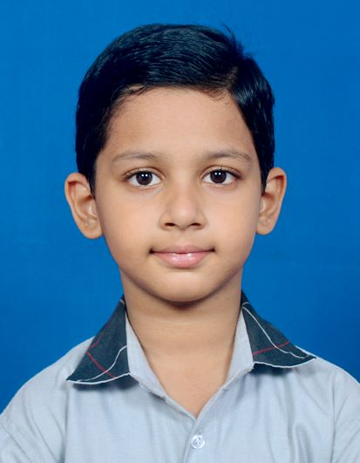
Curious
He is a hard working boy with a nature of curiosity which got him with good result. He just needs a little patience and concentration to do great in his academics.
BHABYARAJ BISOI

Slide 20
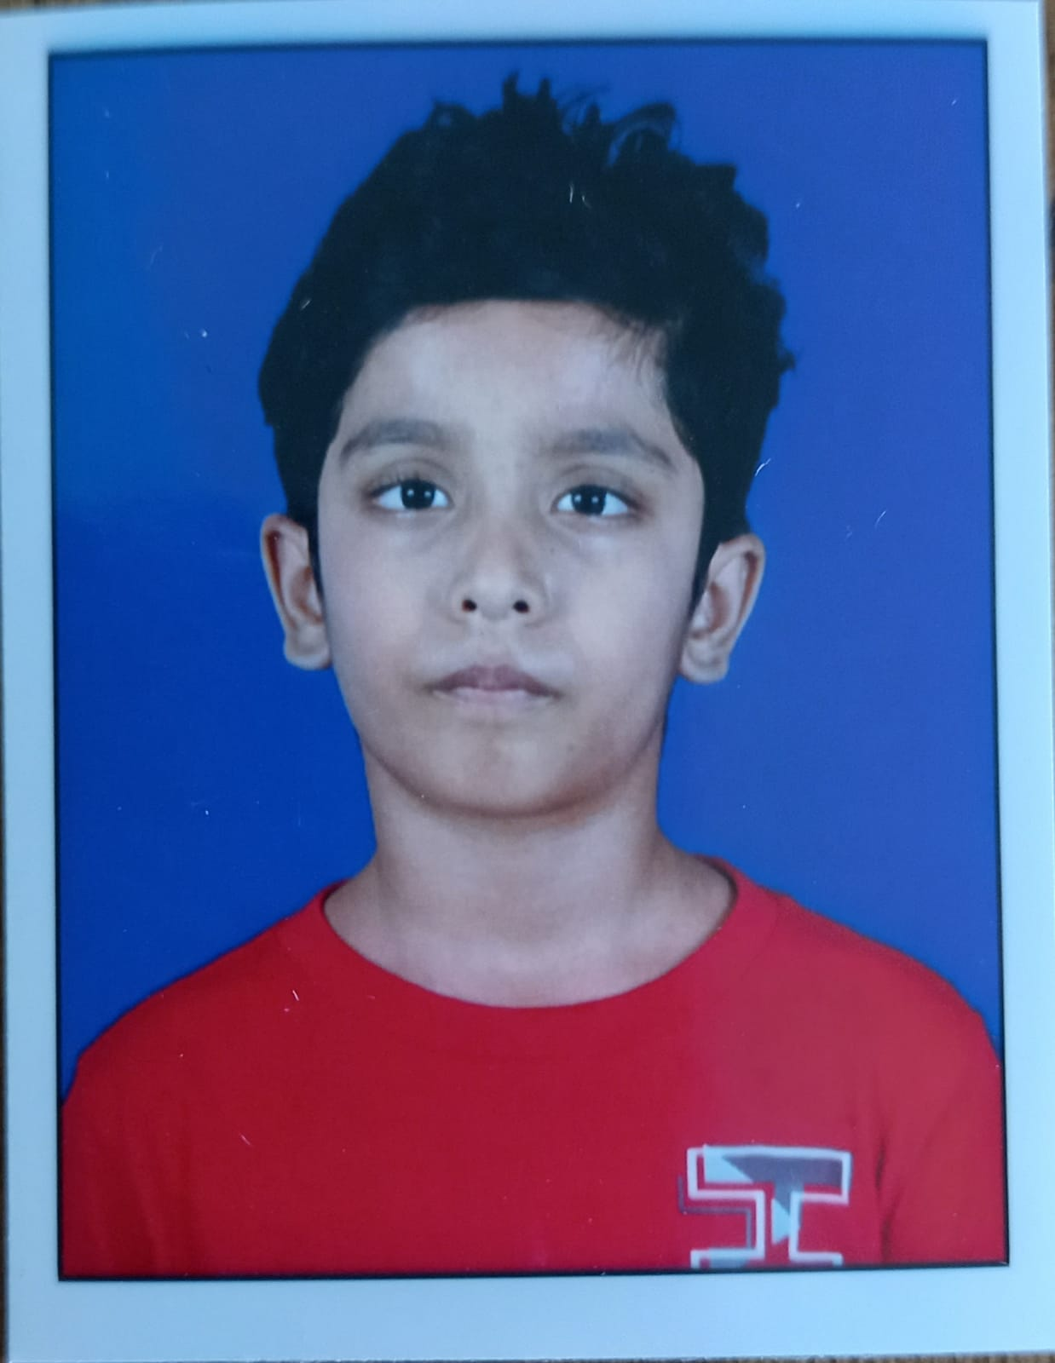
Intuitive
He is doing great in academics and will definitely do wonders in the upcoming exam.
BISWAASH SAHOO

Slide 21
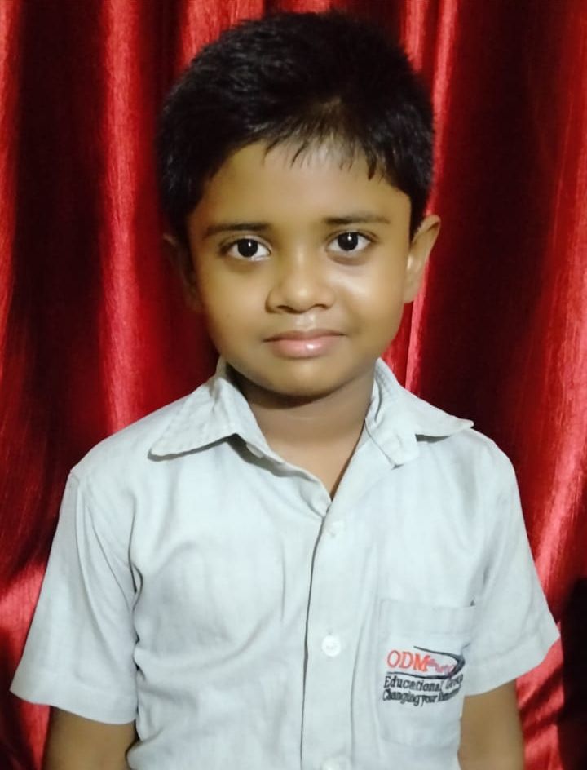
Curious
He is active and a curious boy . He just needs to have focus in MATHS & SST . A little practice will help him to score well.
BISWAJIT ROUT

Slide 22
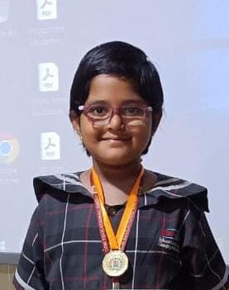
Reliable
She is a positive girl with a lot of patience. She reads well and will definitely do wonders in the upcoming exam and other activities too.
DEPTI DIBYANSHI

Slide 23
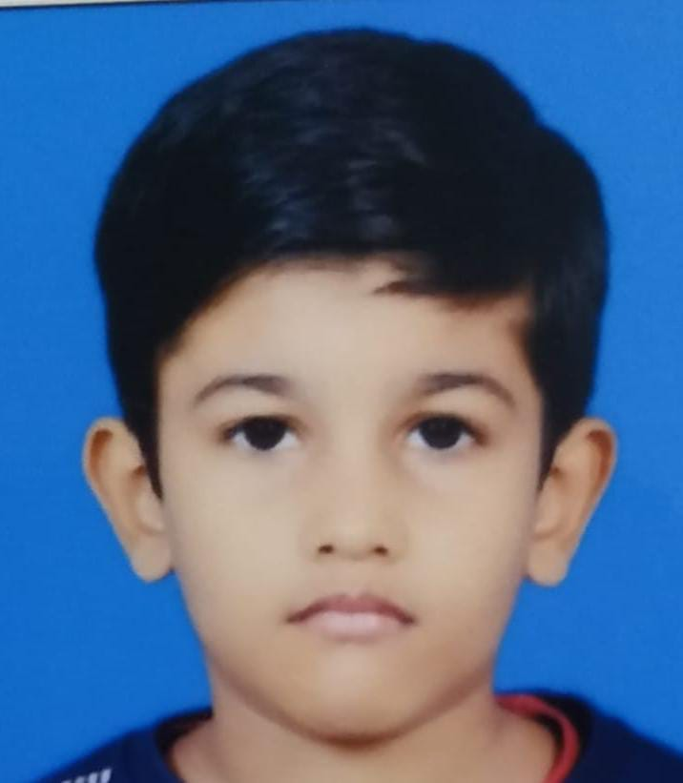
Active
He is active and a hard working boy. He is doing well in academics. Just keep going.
DIVYANSH MOHAPATRA

Slide 24
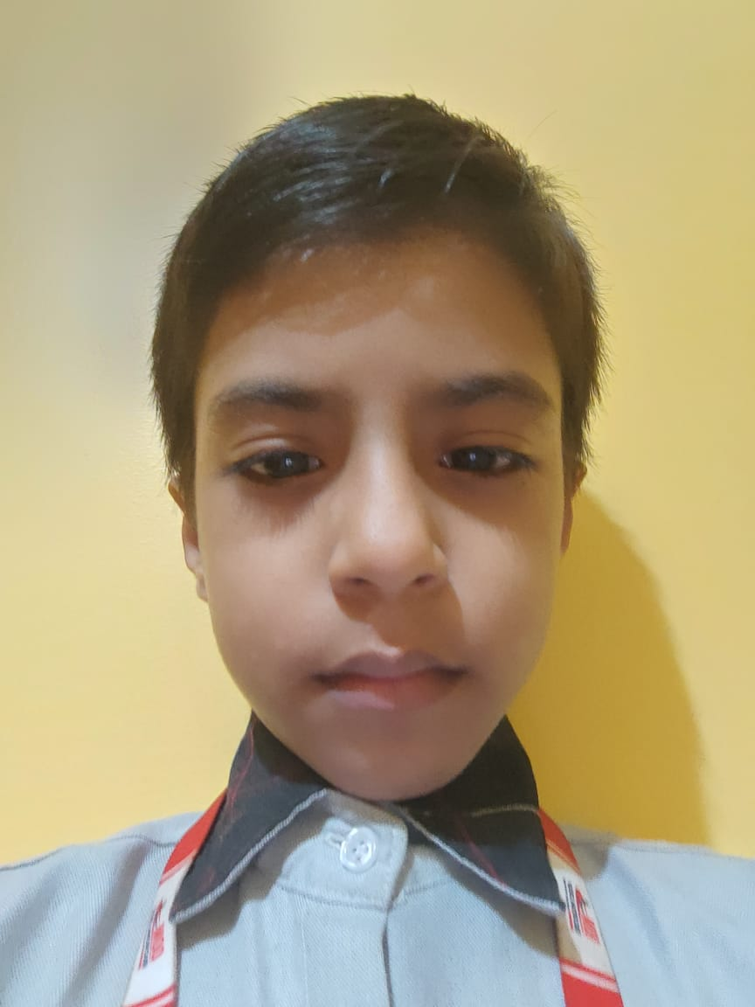
Considerate
He is a well mannered boy and works hard to do great in his academics.
DIVYANSU RAM

Slide 25
Empathetic
She is a well mannered girl with empathy towards others. She just needs a little bit of push in all subjects. She will definitely do great with her hard work.
ELAKSHI PATTNAYAK

Slide 26
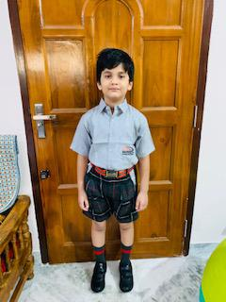
Hard Working
He is a hard working boy with a lot of patience adding to his plus points. He just requires to work a bit harder to get ahead with his scores.
HRIDUM MAHAPATRA

Slide 27
Courteous
She is well behaved girl with a good attitude to all types of situations. But she needs to practice well in Science & Maths,with a little patience and concentration she can do it.
IPSITA SAHU

Slide 28
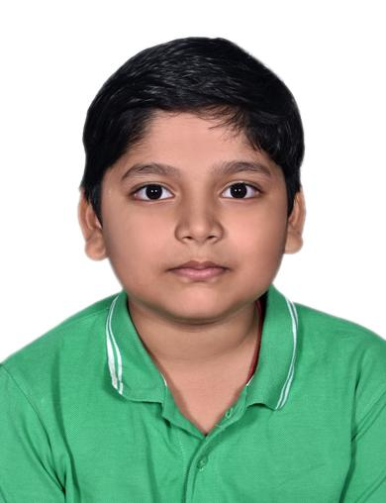
Affectionate
He is a very affectionate boy who likes everybody and everything around him. He just needs to blend his affectionate quality with hard work and then he will do great with his scores.
MANISH PADHIARY

Slide 29
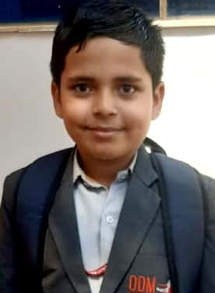
Sincere
He is a well mannered, sincere and a hard working boy. He is focused in his studies. If he stays focused he will do wonders in academics.
MAYAN PANDA

Slide 30
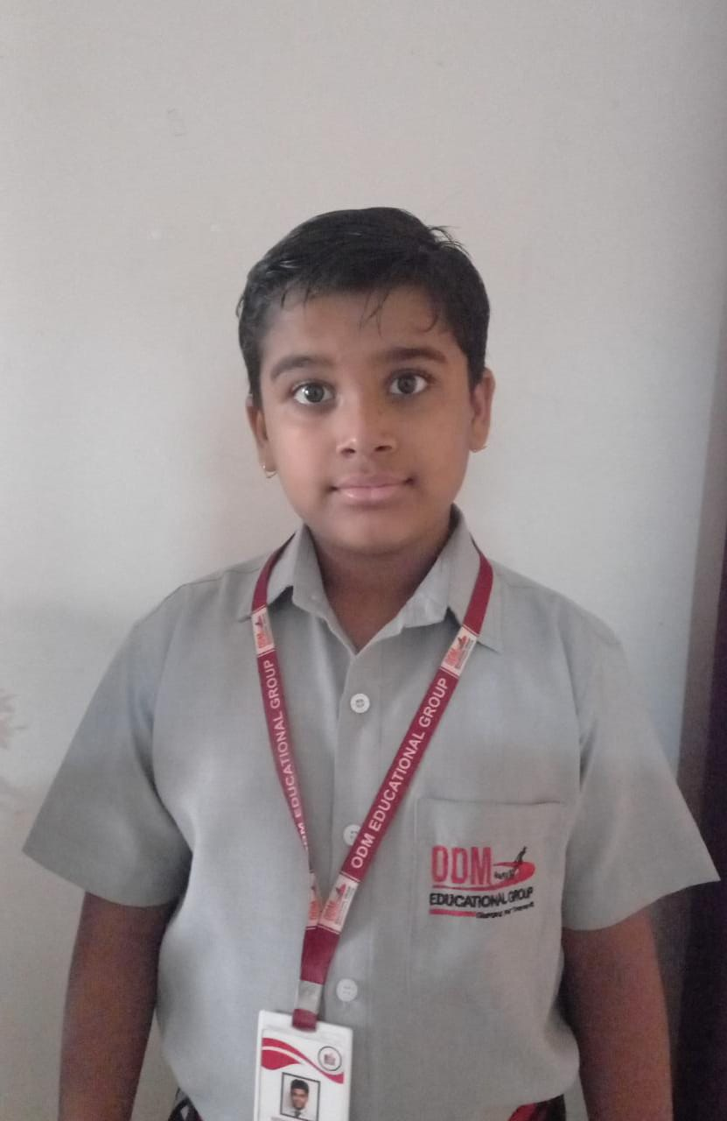
Affectionate
He is a very cooperative boy with the quality of empathy in him. He just needs to focus on Hindi and he will do good in academics.
MAYANK TRIPATHY

Slide 31
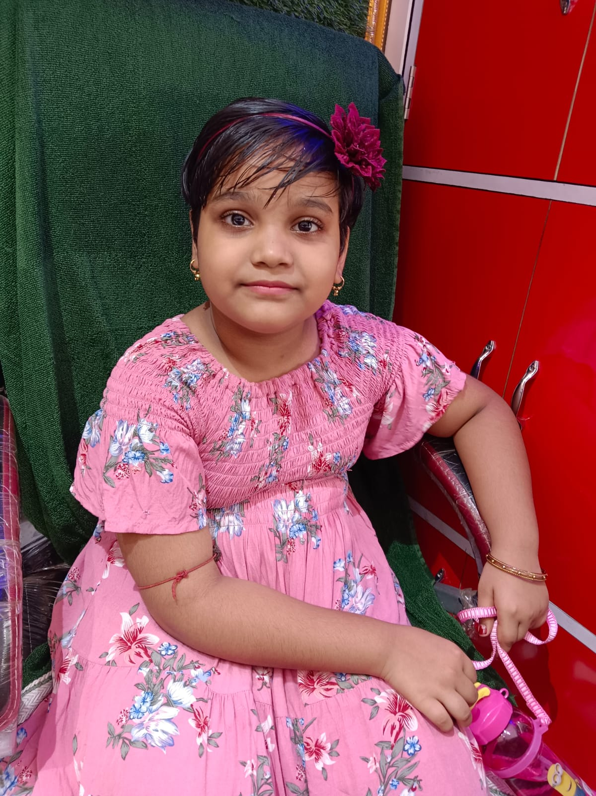
Awesome
She is a good girl and a very sincere one. She keeps herself focused and works hard to achieve the best.
MONISHA NAYAK

Slide 32
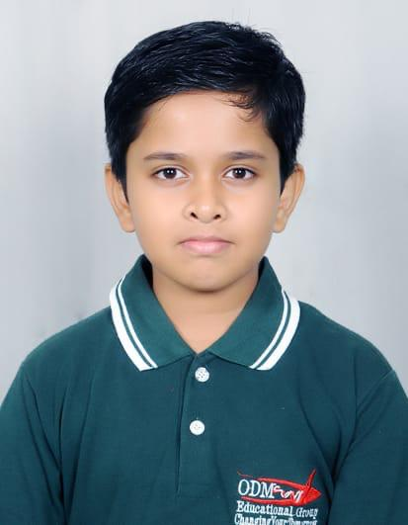
Curious
He is a over active and curious boy. He needs to build up concentration so that he can perform well in the upcoming exam .
MUBASHIR ZAID ALAM

Slide 33
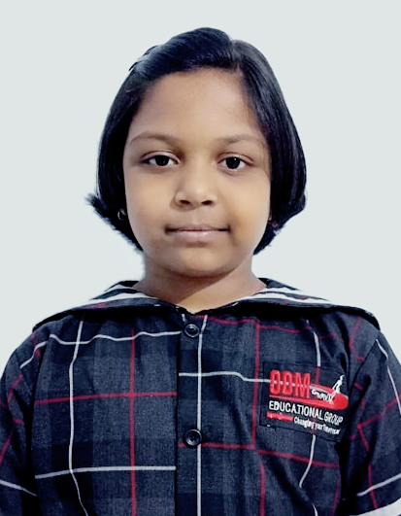
Resourceful
She is a very empathetic, resourceful and hard working girl. She is also very responsible when it comes to academics. She takes care of her work and that is why she is rocking.
OJOSWEE MOHAPATRA

Slide 34
Hard Working
He is a very active boy so, he needs to focus and concentrate to improve his scores in English ,which he will definitely do with care and motivation.
OM PRAKASH ACHARYA

Slide 35
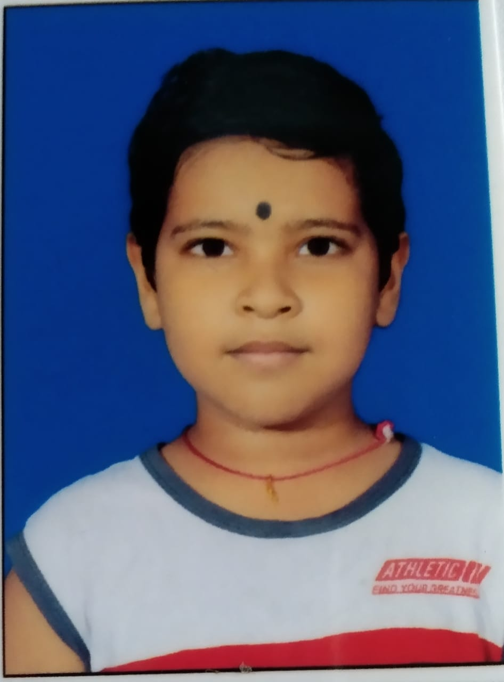
Curious
He is a well mannered boy and works hard to do great in his academics. Just keep going.
OMM SAI SHREE BEURA

Slide 36
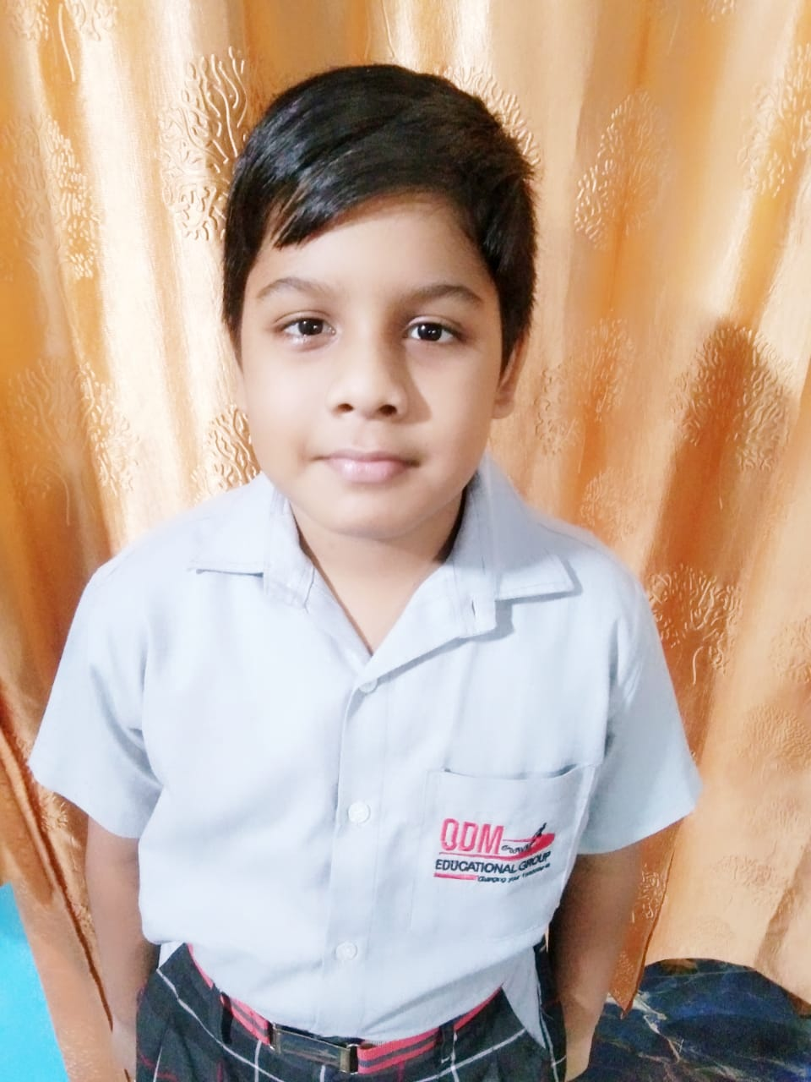
Hard Working
He is a well mannered boy who cares for others, but needs to put in efforts in English which will definitely do well in upcoming exam .
PINAKI RATH

Slide 37
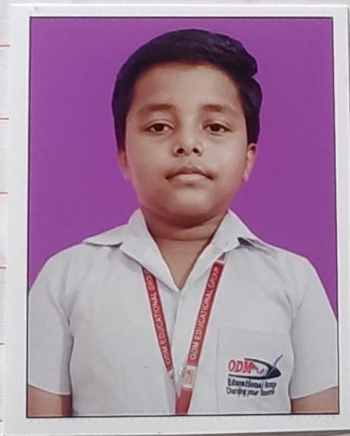
Empathetic
He is an empathetic boy with a friendly nature. Doing well in his studies . Just keep going.
PRIYANSHU PRUSTY

Slide 38
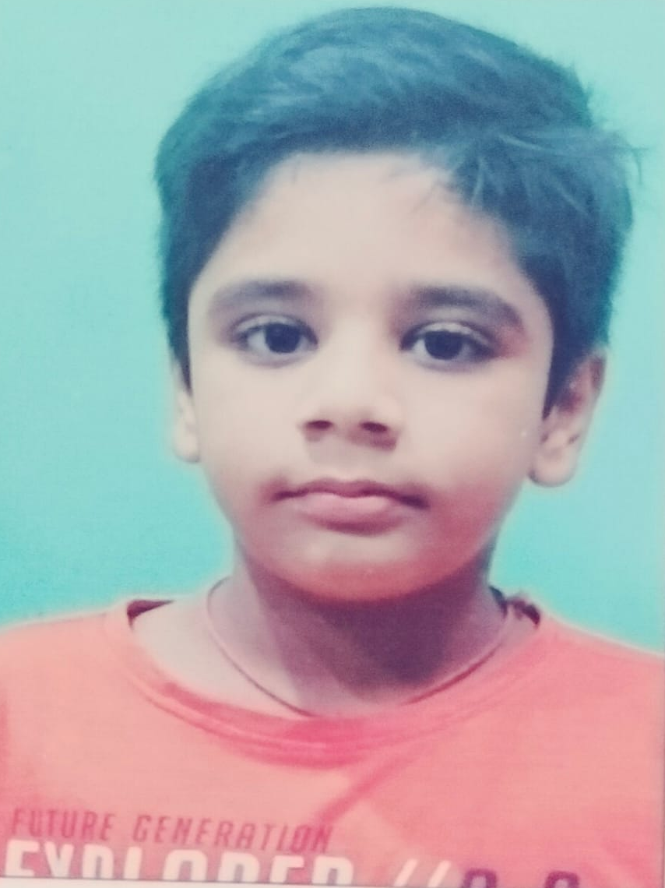
Awesome
He is a sincere boy and a hard working one. He is focused in his studies. If he stays focused he will do wonders in academics.
S. PRIYANSH

Slide 39
Diligent
He is doing great in academics, just a little care and concentration in his subjects will work wonders for him.
SAI KRISHNA DAS

Slide 40
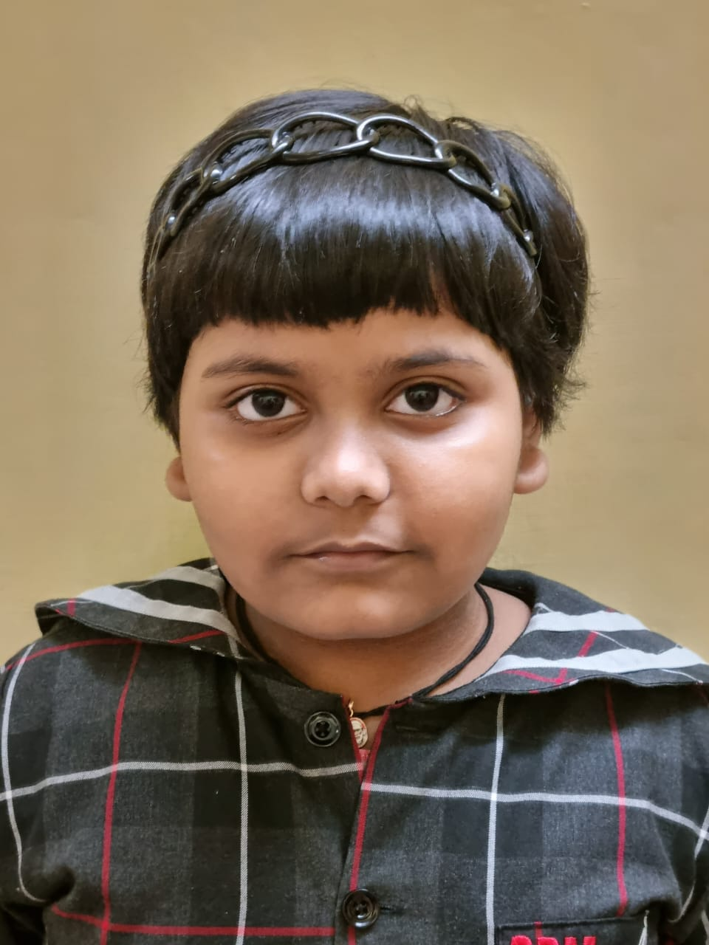
Considerate
She is a well mannered girl and works hard to do great in her academic.
SAI SMRUTEE BARAL

Slide 41
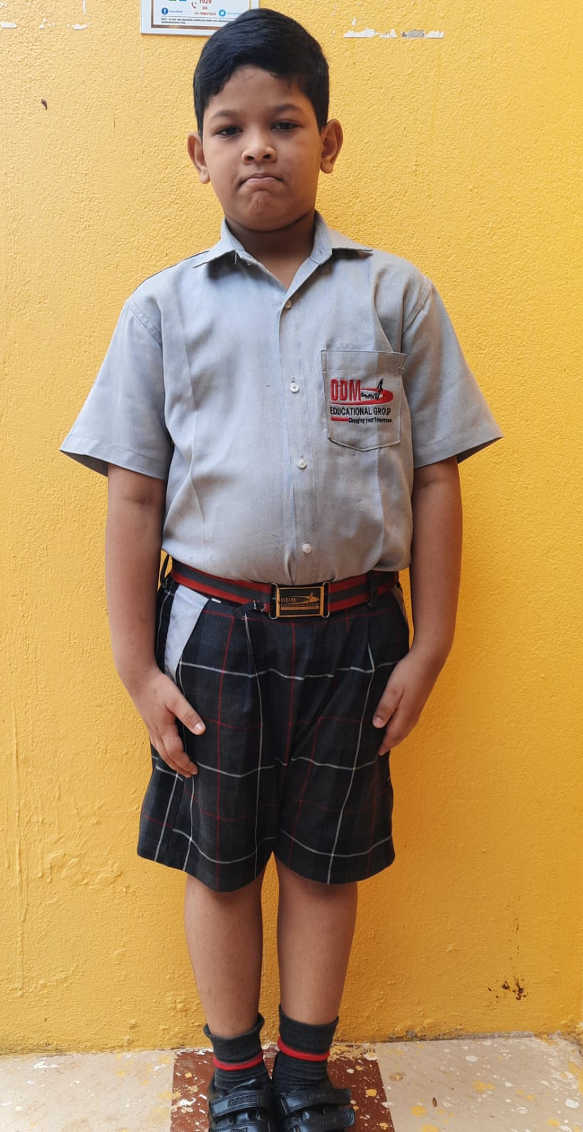
Curious
He is a active boy with innocent face but needs to increase his concentration level for which he has to practice and know his subjects well.
SHASWAT KUMAR SAHOO

Slide 42
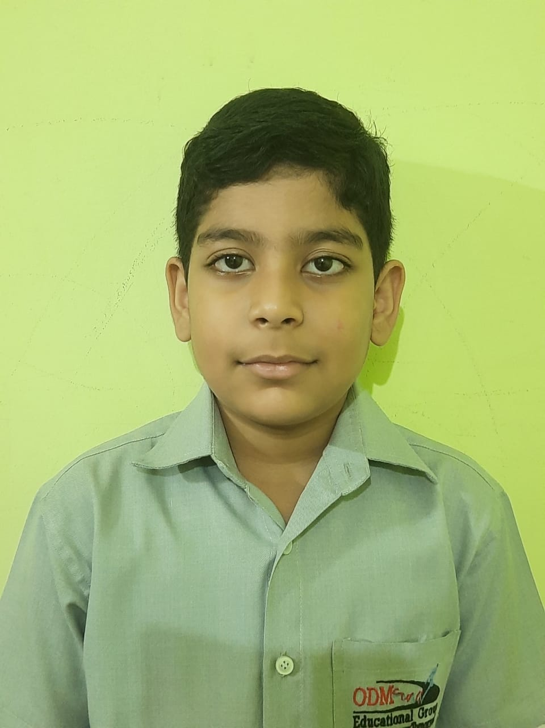
Impartial
He is a well mannered boy who cares for others, but needs to put in efforts in studies which he will definitely do to do well in upcoming exam.
SHIBESH MISHRA

Slide 43
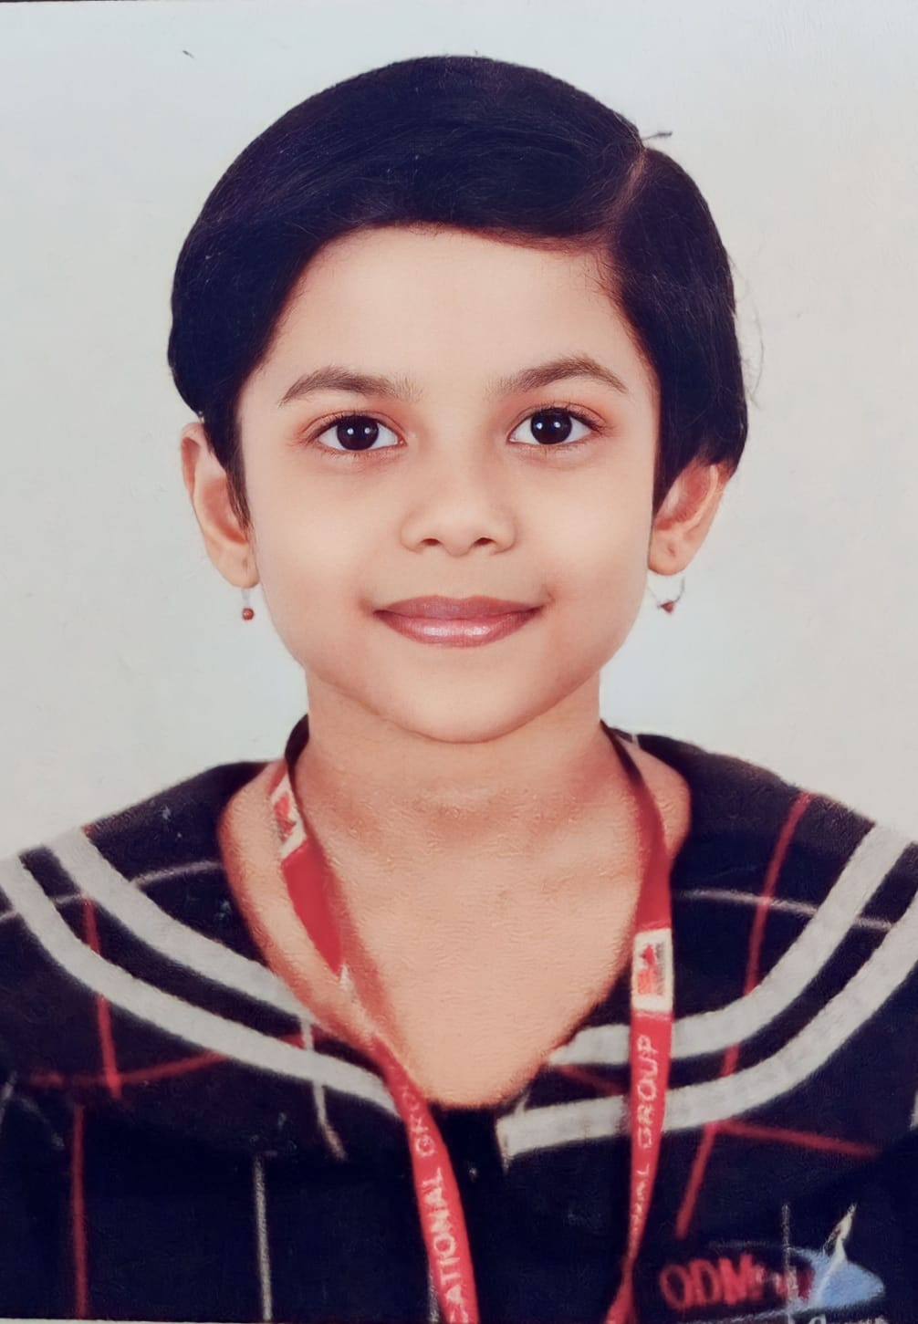
Empathetic
She is an empathetic girl with a friendly nature. She is doing well in her studies . Just keep going.
SHREEJA SHREYANSHI

Slide 44
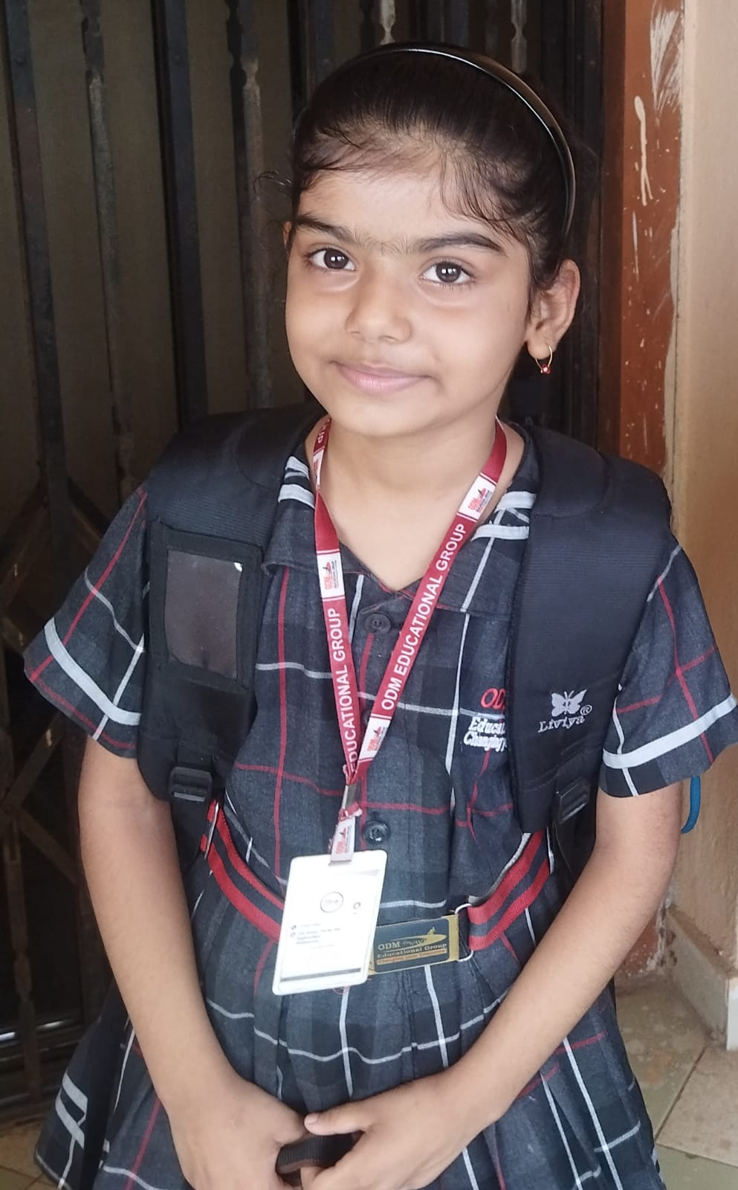
Diligent
She is a very caring and responsible girl, she is doing well in studies.Just keep going.
SHREYA SINGH

Slide 45
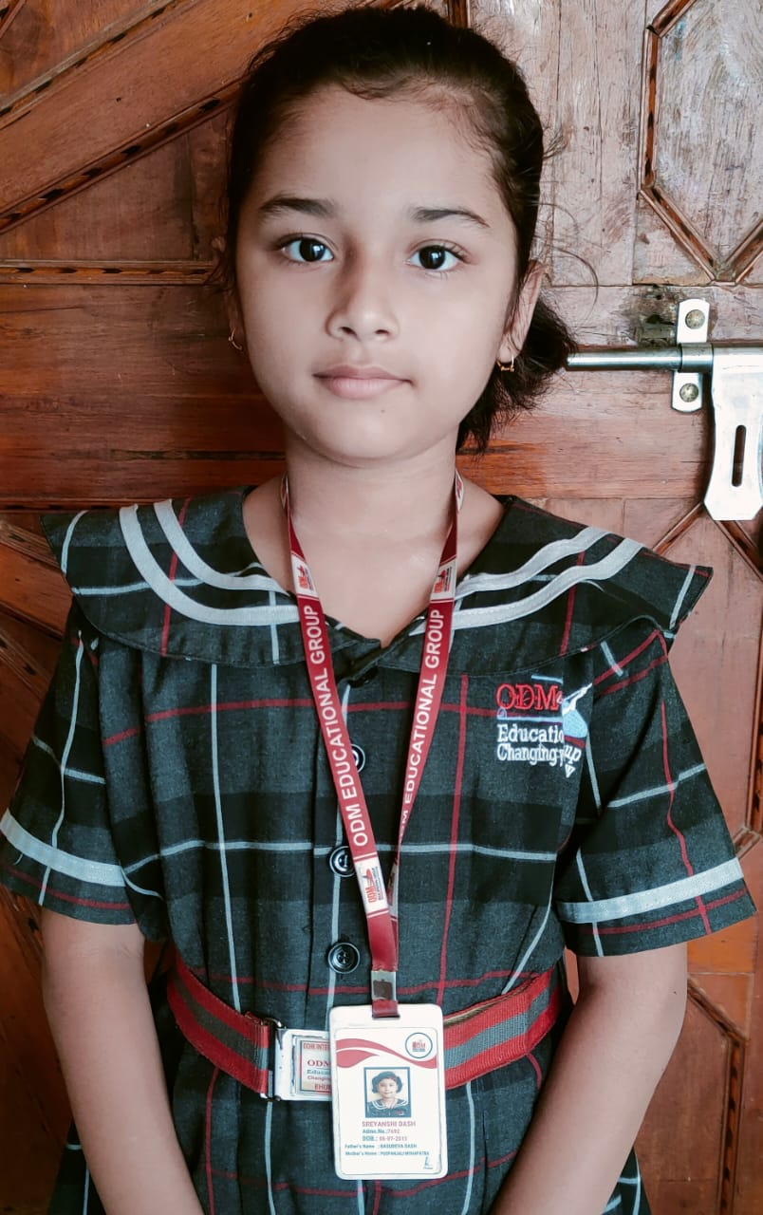
Courteous
She is a well mannered girl with a helpful nature. Doing well in his studies. Just keep going.
SREYANSHI DASH

Slide 46
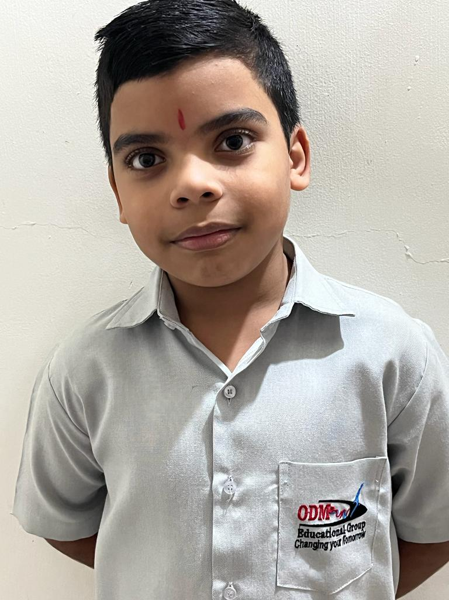
Affectionate
He is a hard working boy and an affectionate fellow.Doing well in his studies. Just keep going.
SUBHAM MOHANTY

Slide 47
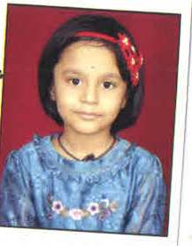
Compassionate
She is a good girl with the capability of doing well in her subjects, she just needs to put in a little hard work in Science and Social Science and will definitely do well.
SULAGNA SETHY

Slide 48
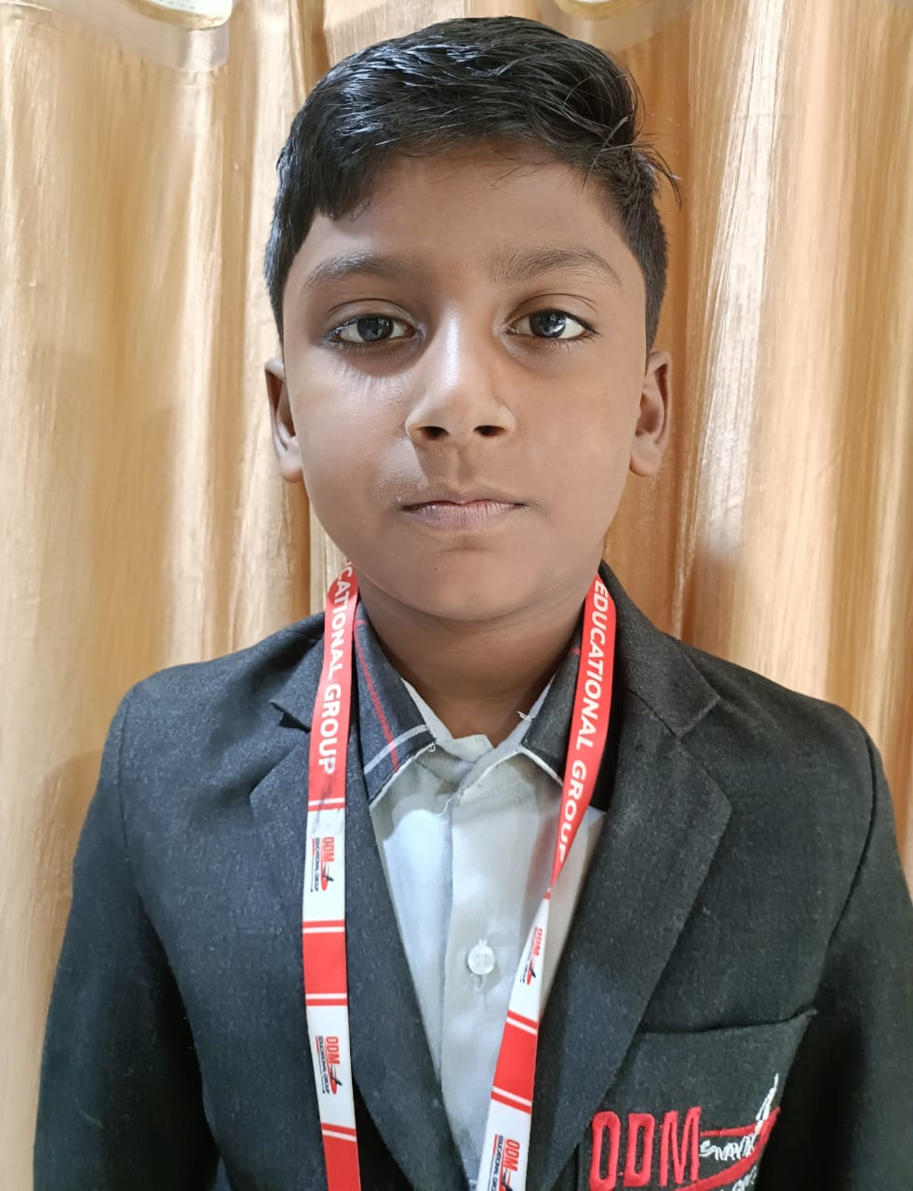
Capable
He is a good boy with capability of progressing in his studies just a hint of sincerity and he can have it.
SURYANSH MALLICK

Slide 49
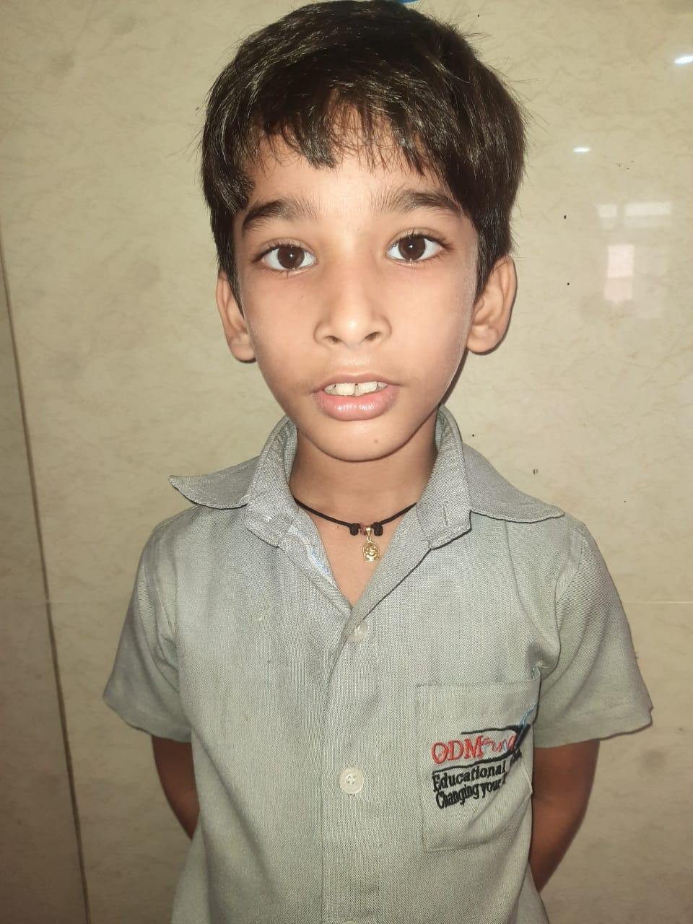
Amiable
He is a sincere and hardworking boy. Doing well in his studies. Just keep going.
SWAGAT SUMAN SAHOO

Slide 50
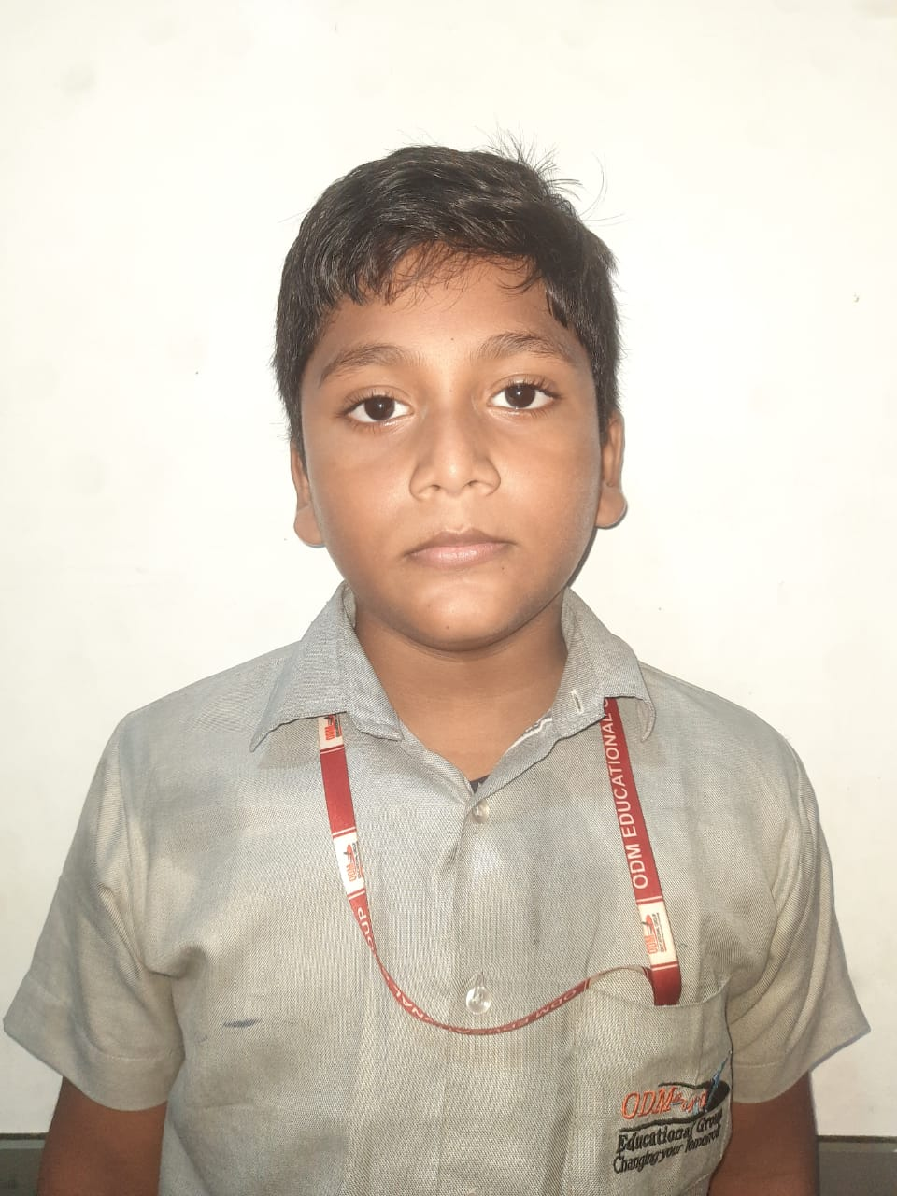
Adaptable
He is a good boy with the capability of adapting to the situation, he just needs to put in a little bit of hard work to do well.
SWASTIK JENA

Slide 51
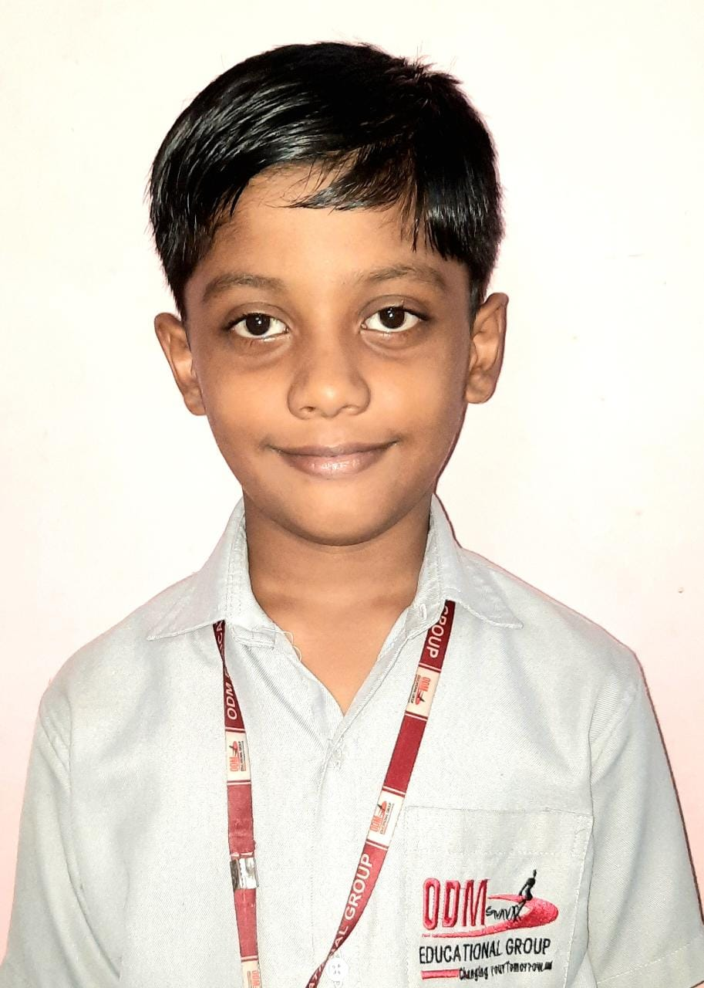
Sincere
He is a hard working boy with a lot of potential and he just needs to put in a little bit of hard work to do well.
SWAYAM SAIDEEP

Slide 52
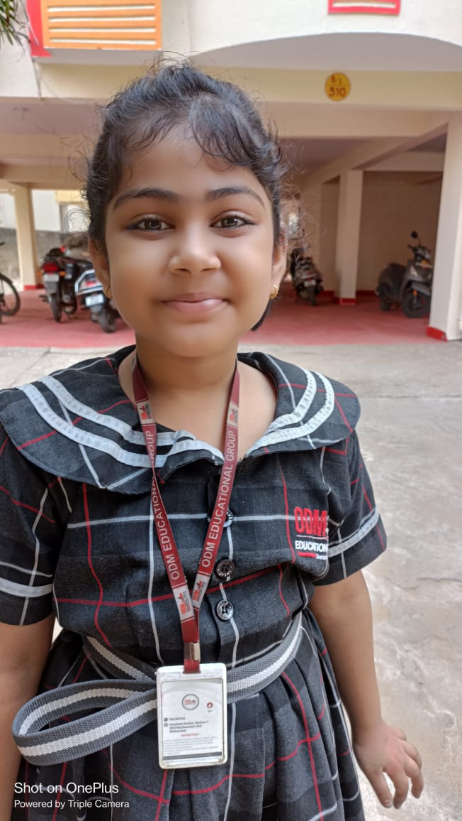
Gregarious
She is sincere and a well mannered girl with a lot of potential, just a little more concentration she will be rocking.
TULIP TANAYA MISHRA

Slide 53
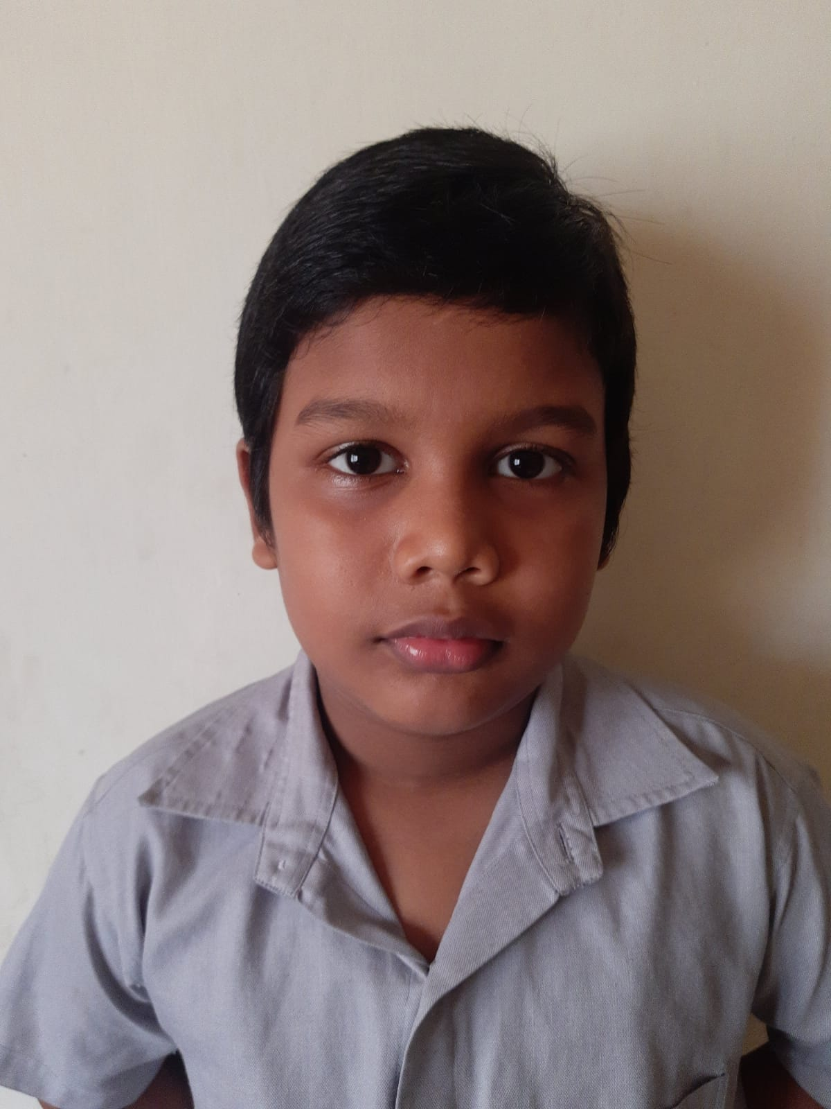
Hard
working
He is a hard working boy and tries his best to do well, needs to practice his subjects well and that can help him grow.
VAIDNSH DAS

